Slide 1
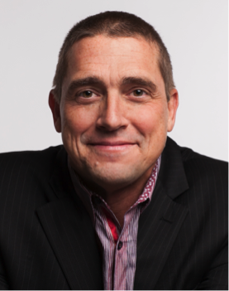
Cutting Pleasantries: Blasting a Clear Path Forward for a New Era in Healthcare
Matt
Cunningham
Jay
Sales
Erik
Pupo
Moderator – Ted Tanner
#Conv2X
October 24, 2018
Lerner Hall Columbia University, NYC, USA

Slide 2
Overcoming Homeostasis – Carbon (Human) Scale
In 2015 Payers wasted $375 BILLION in billing and insurance-related paperwork
In 2015 Providers systems generated 2 BILLION pounds of paper waste
As of 2016 35-40% of ALL DATA at rest and in transit is UNENCRYPTED
In 2017 there were 15 BILLION Faxes

