Slide 1

Blockchain Technology in
Clinic Trials
Uli Broedl
#Conv2X
October 24, 2018
Lerner Hall Columbia University, NYC, USA

Slide 2

Blockchain Technology in Clinical Trials
Uli Broedl

Slide 3
Disclosure
I am employee of Boehringer Ingelheim Canada Ltd
The views expressed are my own and do not necessarily represent the views of Boehringer Ingelheim Canada Ltd
I am a Tech Enthusiast and Consumer but not a Tech Expert

Slide 4



Blockchain Technology in Clinical Trials
Summary
Does Blockchain Technology hold promise to Revolutionize Clinical Trials?
Is Blockchain Technology in Clinical Trials ready for Prime Time yet?
Let’s Collaborate
  Communication of Blockchain Technology’s Value Proposition
  Definition of Standards
  Creation of Regulatory Framework
  Digitalization of Clinical Trials

Slide 5
Blockchain Technology in Clinical Trials
Global Clinical Trial Market Size
Global Clinical Trial Market Size 2016:
USD 40 Billion
Global Clinical Trial Market Size 2025:
USD 65 Billion
Grand View Research Inc. 2017

Slide 6

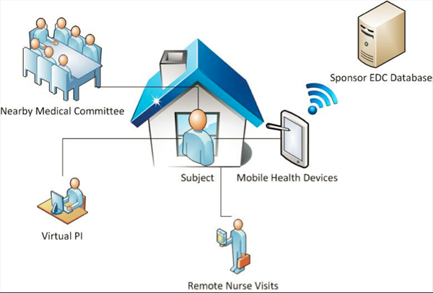

Blockchain Technology in Clinical Trials
Spectrum of Clinical Trials
Classical Clinical Trial
Bring the Patient to the Trial
Remote, Digital Clinical Trial
Bring the Trial to the Patient
Virtual Clinical Trial
EHR-based eClinical Trial

Slide 7
Blockchain Technology in Clinical Trials
Traditional (central) IT Architecture vs Distributed Ledger Technology
Traditional IT architecture
  Limited trust, transparency, and auditability
  High complexity, redundancy and inefficiencies, resulting in high costs
  Limited ability of Real-time processing of data flow
  Limited patient empowerment and patient centricity
Distributed Ledger Technology
  Improved trust, transparency, and auditability
  Time and cost savings
  Near real-time updates
  Patient centricity and empowerment
Improved Compliance and Patient Safety

Slide 8
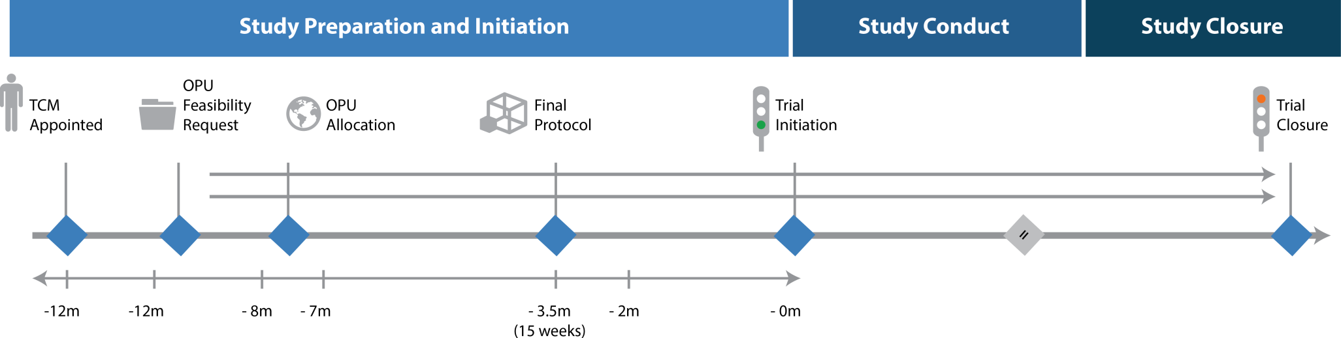

Blockchain Technology in Clinical Trials
Clinical Trial Conduct Overview
Database Lock
TRIAL PREPARATION
TRIAL CONDUCT
TRIAL CLOSE OUT
Site Preparation / Management
Clinical Trial Application and Approval
Drug Supply
Budget and Contracts

Slide 9
Blockchain Technology in Clinical Trials
Clinical Trial Conduct Overview
Database Lock
TRIAL PREPARATION
TRIAL CONDUCT
TRIAL CLOSE OUT
Site Preparation / Management
Site Feasibility and Selection
Initiate Trial Sites
Site Monitoring
Site Close-Out
Prepare Consent Documents
Patient Consent and Data Collection
Patient re-Consent
Implement Site Training
Clinical Trial Applications and Approval
Health Authority CTA
CTP Amendment/ICF update
Notification of Completion
Research Ethics Board
Ethics Renewals
Notification of site closure
Drug Supply
Review Drug Label
Drug Distribution
Drug Dispensing and Accountability
Drug Return
Budget and Contracts
Prepare Budget
Manage Study Costs
Site Budget/Contract
Site Payments
Amend Budget/Contract

Slide 10




Blockchain Technology in Clinical Trials
Clinical Trial Flow
Informed Consent
Screening
Data collection,
Procedures and
Interventions
Secondary Data Sharing

Slide 11
Blockchain Technology in Clinical Trials
Clinical Trial Flow – Health Authority
Informed Consent
Screening
Data collection,
Procedures and
Interventions
Secondary Data Sharing
The rights, safety, and well-being of the trial subjects are the most important considerations and should prevail over interests of science and society*
*E6 (R2) Good Clinical Practice: Integrated Addendum to ICH E6(R1); US HHS, FDA, CDER, CBER, 2018

Slide 12
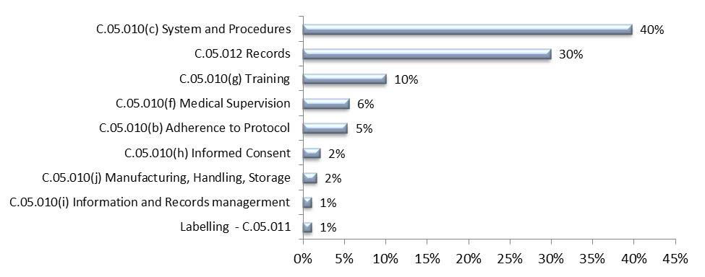
Blockchain Technology in Clinical Trials
Observations during GCP inspections across Canada 2015-2016
Percentage number of observations cited during GCP inspections across Canada in 2015–2016
Inspectorate Program Annual Inspection Summary Report 2015 – 2016 - Canada.ca
GCP, Good Clinical Practice

Slide 13
Blockchain Technology in Clinical Trials
Clinical Trial Flow - Sponsor
Informed Consent
Screening
Data collection,
Procedures and
Interventions
Secondary Data Sharing
The sponsor ensures oversight of any trial-related duties and functions
E6 (R2) Good Clinical Practice: Integrated Addendum to ICH E6(R1); US HHS, FDA, CDER, CBER, 2018

Slide 14
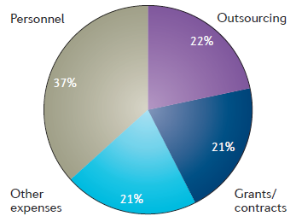
Blockchain Technology in Clinical Trials
Costs of Clinical Trials
Median PIII trial costs:
US$ 21.4M
Martin L et al, Nat Rev Drug Discov 2017;16:381-382

Slide 15
Blockchain Technology in Clinical Trials
Clinical Trial Flow - Patient
Informed Consent
Screening
Data collection,
Procedures and
Interventions
Secondary Data Sharing
Patient Safety, Rights and Empowerment

Slide 16

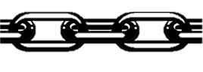
Blockchain Technology in Clinical Trials
Clinical Trial Flow
Informed Consent
Screening
Data collection,
Procedures and
Interventions
Secondary Data Sharing

Slide 17

Blockchain Technology in Clinical Trials
“Team Sport to create Win-Win-Win Situations”

Slide 18
Blockchain Technology in Clinical Trials
Endpoints
Trust
Compliance and Safety
  Number, Type and Risk Level (Patient Safety) of Observations
Monitoring Costs and Time
Patient Satisfaction and Empowerment

Slide 19
Blockchain Technology in Clinical Trials
Why don’t we really see blockchain-based clinical trials?
Limited Understanding of Blockchain Technology’s Value Proposition
Lack of Regulations
Lack of Standards
Practical Limitations

Slide 20



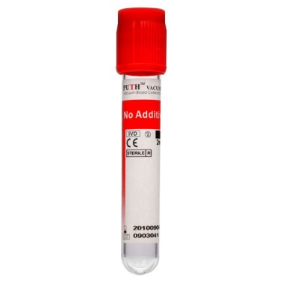

Blockchain Technology in Clinical Trials
Practical Limitations: On-/Off-Chain Interactions
STOP
Blockchain Value Proposition
Informed Consent
“Human Factor”

Slide 21
Blockchain Technology in Clinical Trials
Summary
Does Blockchain Technology hold promise to Revolutionize Clinical Trials?
Is Blockchain Technology in Clinical Trials ready for Prime Time yet?
Let’s Collaborate
  Communication of Blockchain Technology’s Value Proposition
  Definition of Standards
  Creation of Regulatory Framework
  Digitalization of Clinical Trials

