Slide 1
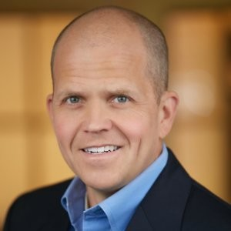
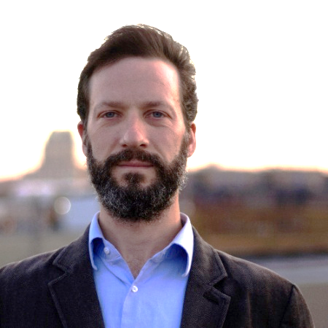
Surfacing Dark Knowledge: How Blockchain Technology Enhances Academic Publishing
Courtney Morris
Sean Manion
Moderator: Tory Cenaj
#Conv2X
October 24, 2018
Lerner Hall Columbia University, NYC, USA

Slide 2
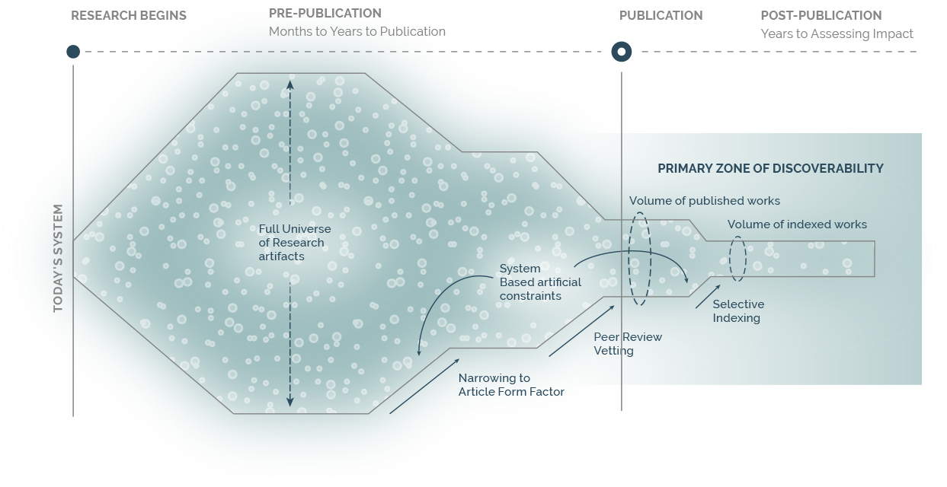
TODAY’S PUBLISHING PROCESS AND TIMELINE
YEARS AFTER THE ACTUAL RESEARCH, ONLY A FRACTION OF ARTIFACTS:
Are indexed and readily discoverable
Can receive attribution that formerly count toward researcher reputation
2

