Slide 1
The Write Stuff: Best Practices in Scientific Writing for Peer Review
Ellen McCarthy, PhD
Julia Saiz Shimosato, PhD
Moderator: Tory Cenaj
#Conv2X
October 24, 2018
Lerner Hall Columbia University, NYC, USA

Slide 2
THE WRITE STUFF
October 24th, 2018

Slide 3
How do we turn data into an article?

Slide 4
What we are going to discuss today
THE DATA:
Which data? Which type of data?
THE AUDIENCE:
Who are we going trying to reach?
THE CONDUIT:
How does peer-review work?
THE FORMATS:
Which type of article are we creating?

Slide 5
There are different types of primary biomedical data
PRECLINICAL
CLINICAL
How does our drug perform
In biochemical assays?
In cells?
In animal models?
How does our drug/device/service perform in patients?
In early-stage trials:
In late-stage trials:
In the real world:
Proof of concept
First in human
Feasibility
Efficacy
Tolerability
Cost-effectiveness
Outcomes
Use case and pilots
Production and deployment
API

Slide 6
There are different types of study settings
PROSPECTIVE
RETROSPECTIVE
Testing a hypothesis established a priori
Interrogating an already closed data set for ‘suspected’ findings
Study datasets
Real world data sets

Slide 7
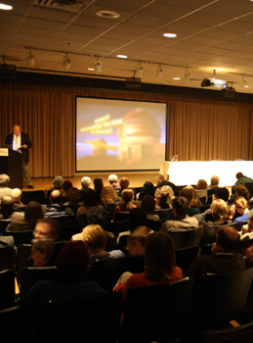
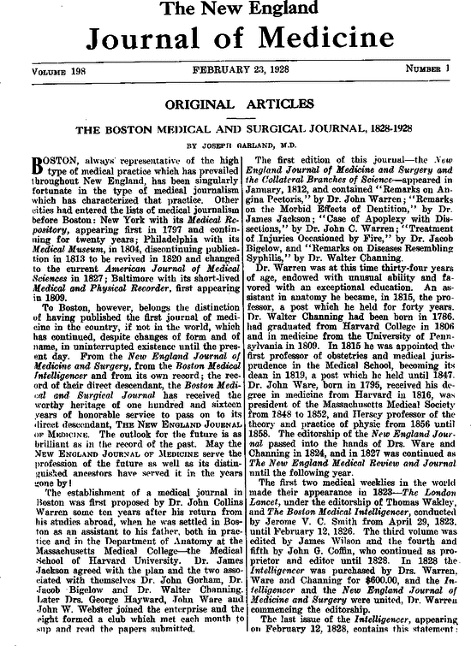
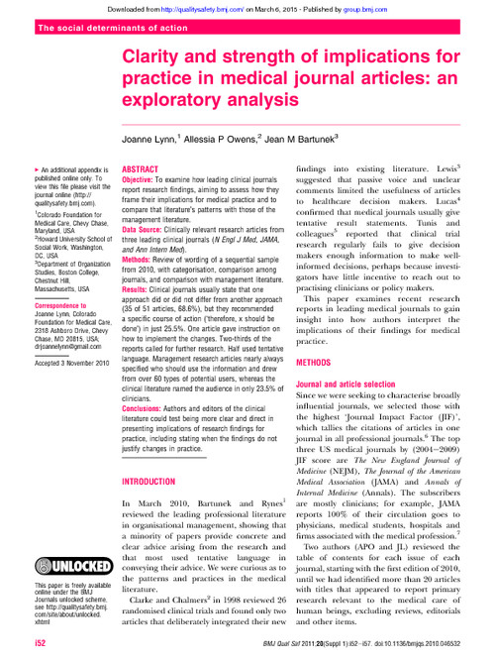
Who are we trying to reach with a biomedical manuscript?
CONGRESS PRESENTATIONS
FULL ARTICLES
Immediate reach
Experts
Physicians
Clinical scientists
…who attend the congress
Indirectly
Journalists
Analysts
Lay audience
Enduring reach
Experts
Physicians
Clinical scientists
Indirectly
Journalists
Analysts
Lay audience
PR
PR

Slide 8
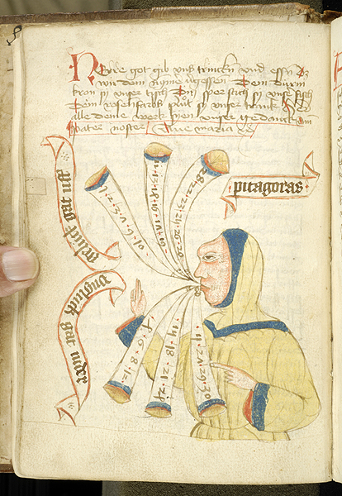
The gatekeeper: Basic elements of the peer-review process
DATA
EDITORIAL OFFICES OF A JOURNAL
Submission
Publication
MANUSCRIPT
External reviewers
Relevance to clinical sciences
Scientific quality
Apparent scientific integrity

Slide 9
The gatekeeper: Basic norms of the peer-review process
DATA
EDITORIAL OFFICES OF A JOURNAL
NOVELTY:
respect embargo policies
Submission
Publication
MANUSCRIPT
ORIGINALITY:
submit your own work to a single journal
INTEGRITY:
Ensure authorship criteria is fulfilled
Ensure transparency in writing process
Comply with Good Publication Practices
External reviewers
Relevance to clinical sciences
Scientific quality
Apparent scientific integrity

Slide 10
The gatekeeper: Basic norms of the peer-review process
AUTHORSHIP CRITERIA
GOOD PUBLICATION PRACTICES
Ensure that authors have access and knowledge of the full original dataset
Ensure that the authors are conceptually and intellectually responsible for the content of the manuscript
Ensure accountability
http://www.icmje.org/recommendations/browse/roles-and-responsibilities/defining-the-role-of-authors-and-contributors.html
Ensure that all the steps in the manuscript preparation are conducted transparently
Ensure that all contributions from non-authors have been vetted by authors
Ensure that conflicts of interest are disclosed
Ensure that the final manuscript corresponds with authors’ intentions
http://annals.org/aim/fullarticle/2424869/good-publication-practice-communicating-company-sponsored-medical-research-gpp3

Slide 11
The gatekeeper: Basic elements of the peer-review process
DATA
EDITORIAL OFFICES OF A JOURNAL
Submission
Publication
MANUSCRIPT
The journal is the vehicle: select the right one to make your data relevant to the right audience
Translational scientists
Generalists
Specialists
High/low impact
External reviewers
Relevance to clinical sciences
Scientific quality
Apparent scientific integrity

Slide 12
The gatekeeper: Navigating the peer-review process
An extensive review process improves biomedical articles….
…even if painstaking
Reviewers may ask for
Appropriate referencing and form
More data
More critical interpretation
Better understanding of the limitations

Slide 13
Types of articles in the peer-review environment
1 DATA SET
Original analysis
Primary article/presentation
1 DATA SET
1 DATA SET
Reanalysis
Pooled analysis
Meta-analysis
1 DATA SET
1 DATA SET
Primary presentation
Interpretation
Primary article
Systematic review
Narrative review
Primary article
Pooled analysis
Opinion
PRIMARY ARTICLE/ PRESENTATION/EVENT
Editorial

Slide 14
What if what I want is……
Seek non-peer review platforms:
State a specific point of view
Outline an agenda
White paper
Reach lay audiences directly
Press outreach
PR efforts

Slide 15
In closing
The peer review system remains the gold standard to disseminate biomedical data
A careful look at an article can tell us a lot about the data behind it
How relevant
How reliable
How comprehensive
The peer review system is often the starting point for other types of communication
To lay audiences
To ignite research agendas

