Slide 1

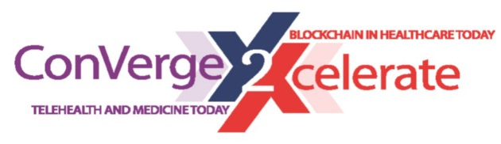
Basics for Blockchain Healthcare Use and Technology: 101 Course
Cees Hesp
#Conv2X
October 24, 2018
Lerner Hall Columbia University, NYC, USA

Slide 2

Blockchain Basics
Cees Hesp, PharmAccess Foundation
New York, October 2018

Slide 3
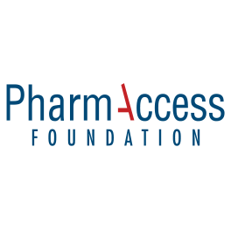

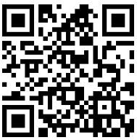
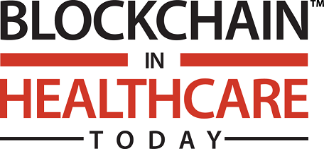
Introductions
Director mHealth Research Labs at PharmAccess Foundation
Board Member Digital Impact Alliance (DIAL) at the United Nations Foundation
Member Peer Review Board of Blockchain in Healthcare Today
Advisory/Supervisory Board Member at various digital health & blockchain startups

Slide 4
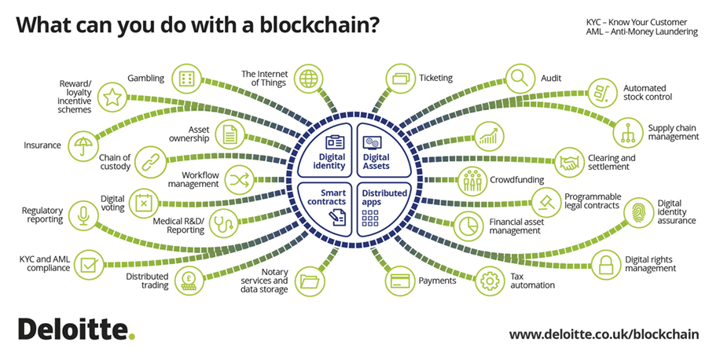
Why the excitement?
Source: https://www2.deloitte.com/ch/en/pages/innovation/solutions/blockchain-practice.html

Slide 5
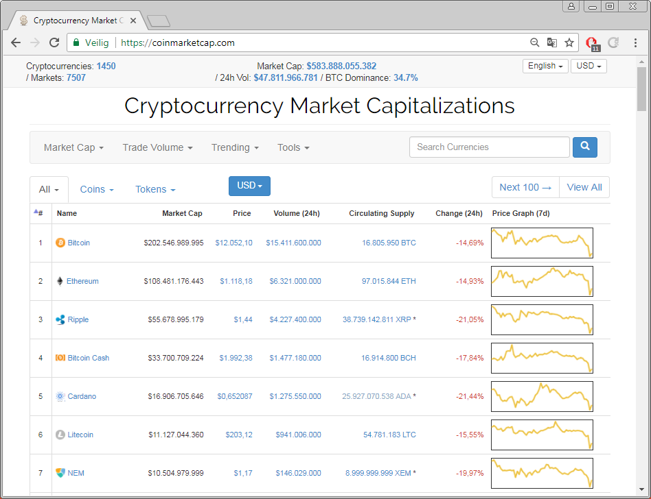
Why the excitement? (cont’d)

Slide 6
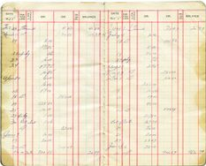
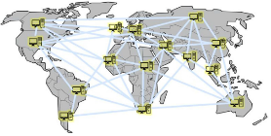
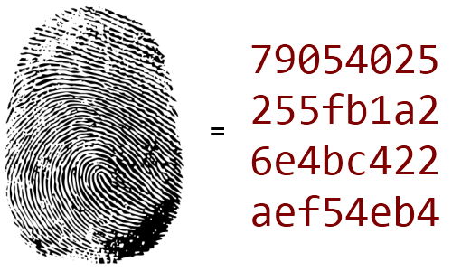
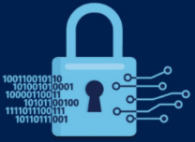
What is blockchain?
Blockchain is:
a digital ledger
managed by a distributed network that uses
hashing and
cryptography
so that any user can securely update it without the need for a “trusted” third party
1
2
3
4

Slide 7
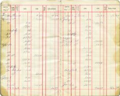
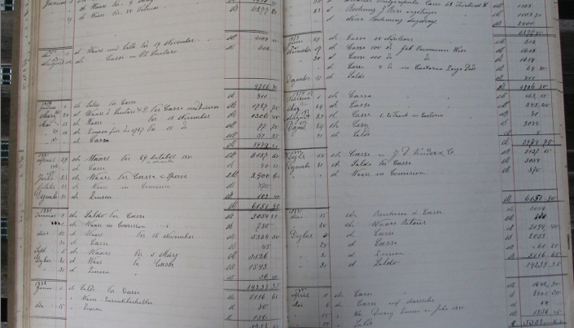
1. Ledger
Transaction ⋍ general-ledger entry ⋍ peer-to-peer value transfer
Each entry is subject to rigorous ordering by date (timestamped)
The records (ledger entries) are permanent & immutable
Any modification of the general ledger will be detected

Slide 8
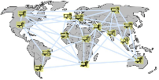
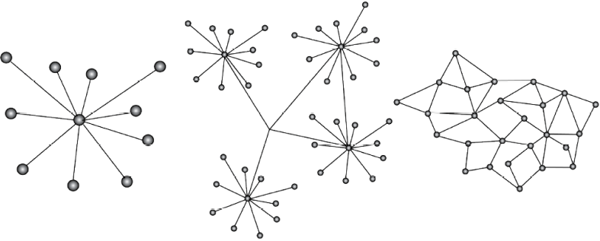
2. Distributed Network
Centralized
Decentralized
Distributed
Plenty of equivalent nodes
Each node has multiple connections to others
Strong resistance to failure or cyber attacks
Network is up when any 2 nodes are online
Flat structure – no client/server
Aka “peer-to-peer”

Slide 9
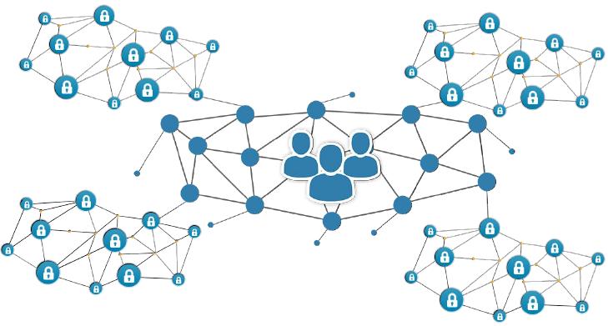
2. Distributed Network (cont’d)
Distributed does not necessarily mean that everybody has access to everything. Some data can be public, other data private, or “permissioned” (i.e. only available to those who have been granted access, even temporary).

Slide 10
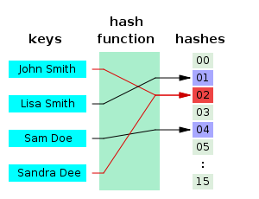
3. Hashing
Hashing is the transformation of a string of characters into a fixed-length value
Hashing is used to index and retrieve items in a database because it is faster
String to be hashed can be anything (document, record, contract, movie, source code, etc)
Small change in input leads to totally different hash
Hashing is one-directional, i.e. input difficult to compute from output
To avoid collision (i.e. 2 strings having the same hash), it is safer to have long hashes
The faster that computers get, the longer the hashes will need to be (SHA-256/512/1024)
 |  |  | MD5 hash
Tom | Dick | Harry | 47d45540475e6a3efbcd41d9d989579a
Tom | Rick | Harry | ad74175a822ba8aab51ce70e1a42e5b0

Slide 11
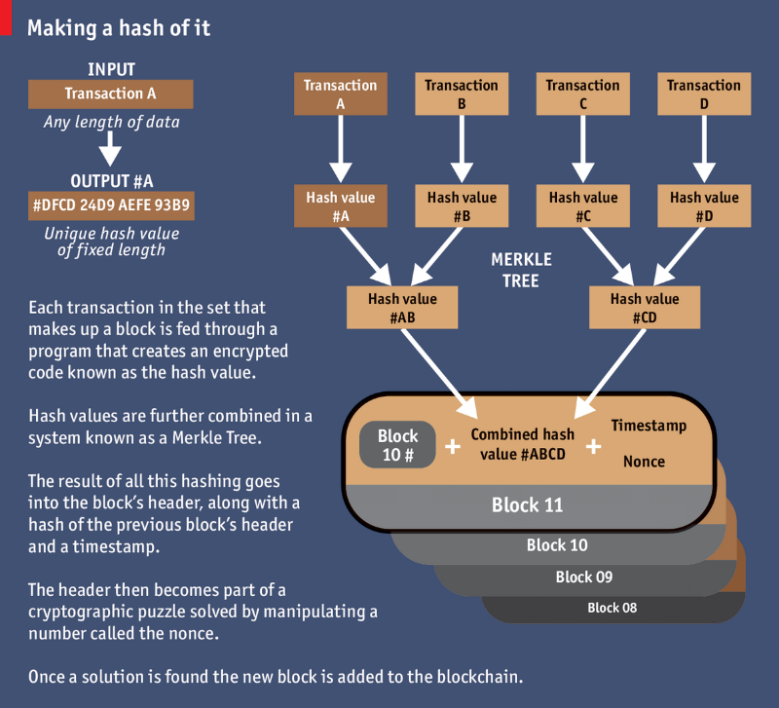
3. Hashing (cont’d)
Tom | Dick | Harry | 47d45540475e6a3efbcd41d9d989579a
Tom | Rick | Harry | ad74175a822ba8aab51ce70e1a42e5b0
Tom | Dick | Harry | 47d45540475e6a3efbcd41d9d989579a
Tom | Rick | Harry | ad74175a822ba8aab51ce70e1a42e5b0
Tom | Dick | Harry | 47d45540475e6a3efbcd41d9d989579a
Tom | Rick | Harry | ad74175a822ba8aab51ce70e1a42e5b0
Source: https://www.economist.com/news/briefing/21677228-technology-behind-bitcoin-lets-people-who-do-not-know-or-trust-each-other-build-dependable

Slide 12

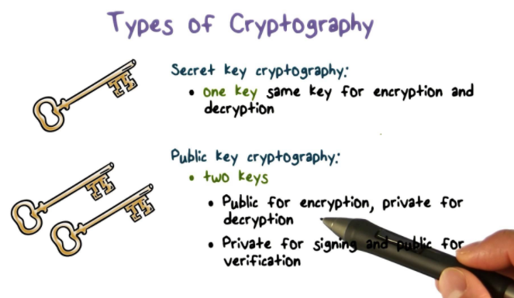
4. Cryptography
Source: https://www.youtube.com/watch?v=Ec7P3jtJLgk

Slide 13
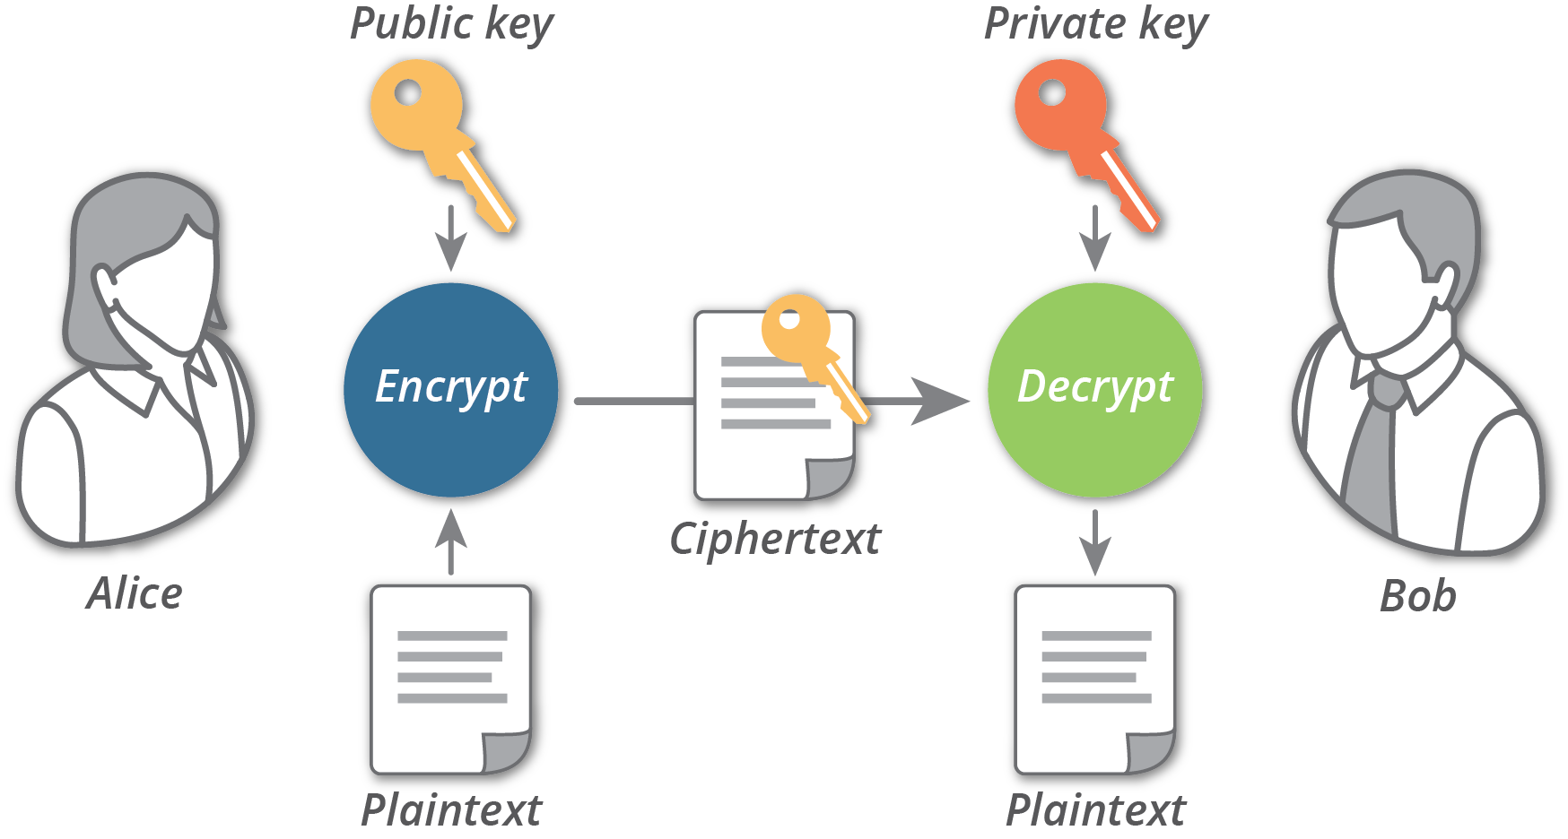
4. Cryptography (cont’d)
Source: https://nationalsecurity.advenica.com/en/cryptography-quantum-age

Slide 14
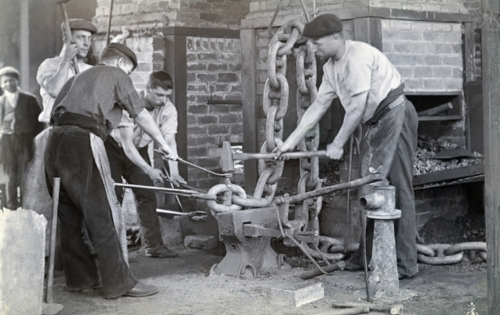
Recap
Distributed (thousands of replicas) therefore resistant to failure & attack
No central server or central authority
No Trusted Third Parties
Insignificant barriers to entry (PC+Internet)
Global and immediate transaction capacity
No chance of double spending or fraud
Transaction fees based on amount of data / not on value transferred

Slide 15
Potential use cases in healthcare
Medical device/asset tracking
Manage access rights to medical files
Combine data with money
Programmable money (“health wallet”)
Audit trails
Automate payments of insurance money
Supply chain management (e.g. drugs)
Data sharing between healthcare providers
Data mining/farming and dissemination for prevention purposes
New innovative business models
Blockchain has the potential to propel innovation in preventative care and community-based healthcare models. The capacity of a distributed ledger technology for ensuring data integrity while sharing between parties can ensure collaboration between rising trends in healthcare, which are vital to the improvement of health in communities worldwide.
Blockchain can tie together a complex team-based healthcare, finance and payment with the care provided along with it. The inherent properties of cryptographic public and private key access, proof of work and distributed data, creates a new level of integrity for healthcare information. Blockchain technology also makes it easy to track a drug as it moves from the manufacturer to the patient. This improves the traceability of a drug as it moves across the supply chain, and helps prevent drug counterfeiting.
Blockchain provides frictionless connectivity, strengthened by smart contracts and authorization to access all electronic health data. Its transaction layer can enable instantaneous access to a diverse set of standardized, anonymous and non-patient identifiable information. Transparency and automation can also lead to higher efficiency and lower administration costs. It is a phased approach rather than an instant overhaul of systems, and hence is suited to the healthcare sector.*
*Source: https://www.ibm.com/blogs/blockchain/2017/10/blockchain-in-healthcare-patient-benefits-and-more/

Slide 16
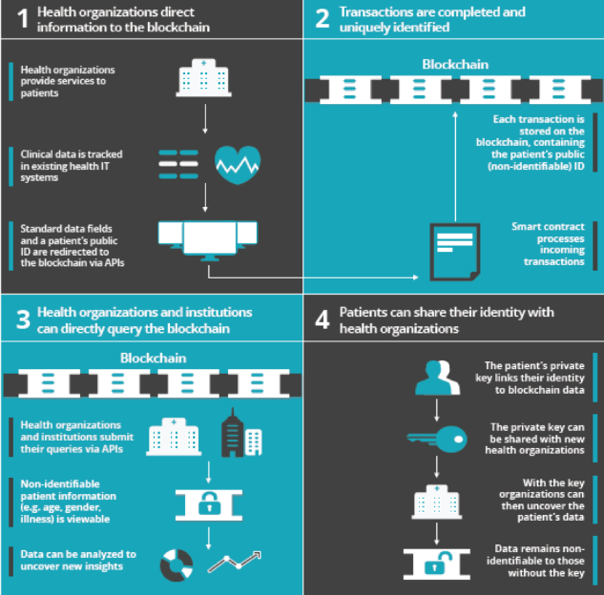
Potential use cases in healthcare (cont’d)
Drug traceability where each transaction can be tracked to verify information and origin, important for tackling issues such as counterfeits
Improvement and authentication of health records and protocols on record sharing
Smart contracts where rule-based methods are created to manage permissions to access patient data
Clinical trials where fraudulently altering or modifying data can be eradicated
Precision medicine where patients, researchers and providers can collaborate to develop individualized care
Genomics research via access to genetic data secured on blockchain
Electronic health records (EHRs)
Nationwide interoperability
Source: https://innovatemedtec.com/digital-health/blockchain/

Slide 17
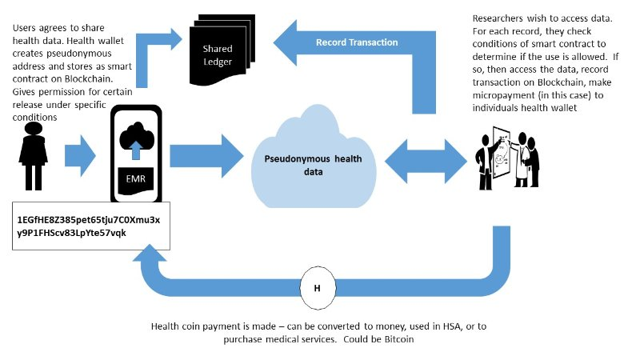
Potential use cases in healthcare (cont’d)
Source: https://www.linkedin.com/pulse/blockchain-use-cases-healthcare-anca-petre

Slide 18
Current trends in the blockchain market
The size of the blockchain technology market worldwide is expected to grow from USD 339.5 million in 2017 to USD 2.3 billion by 2021. These forecasts are based on an annual constant growth rate of 61.5%.
Factors driving the blockchain market
Factors inhibiting the blockchain market
Limited access to population health data
Inconsistent rules and permissions for accessing patient data
Varying data standards reduce interoperability as a consequence of non-compatibility
Privacy and security concerns around the confidentiality of protected health information
Fraud and abuse
Consumer engagement in the form of participation in disease management and clinical outcomes
Immature infrastructure where most blockchain technology is still untested and experimental
High development costs
Patient-controlled data can be risky
Scalability constraints in terms of tradeoff between transaction volume and processing time
Source: https://www.statista.com/statistics/647231/worldwide-blockchain-technology-market-size/

Slide 19
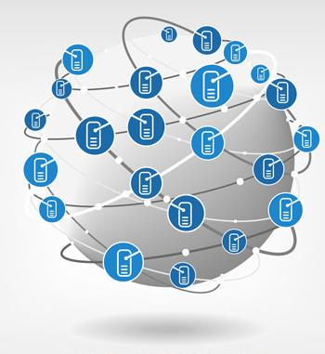

Parting thoughts
Blockchain technology is very promising
But it’s too early to tell which of the many potential use cases will be a success in healthcare, and in which countries, and which ones will not
Some people say that blockchain is now where the internet was in 1995
Blockchain can be a success even if bitcoin proves to be fool’s gold…

Slide 20
Thank you
c.hesp@pharmaccess.org

