Slide 1
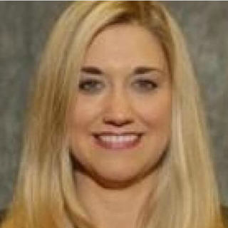


Improving Healthcare Outcomes with Next Generation Internet (NGI): Global Case Study
Shawnna Hoffman
Florence D. Hudson
Carlo Piraino
#Conv2X
October 24, 2018
Lerner Hall Columbia University, NYC, USA

Slide 2

#Conv2X
October 24, 2018
Lerner Hall Columbia University
NYC, USA

Slide 3
Improving Healthcare Outcomes With Next Generation Internet: Global Case Study
Shawnna Hoffmann
Global Cognitive Legal Co-Leader,
Watson Artificial Intelligence & Quantum Computing
IBM
Florence Hudson
Special Advisor, Next Generation Internet, Northeast Big Data Innovation Hub at Columbia University; Co-founder, Blockchain in Healthcare Global
Dr. Carlo Piraino
DNP RN
International Healthcare
Consultant
#Conv2X

Slide 4
Personalized medicine will leverage large volumes and varieties of data to improve insight & outcomes.
Genomic
data
Connected health and patient lifestyle data
    Many data sources and types…
    Genomic, wearables, clinical, research
    Real World Evidence (RWE) leveraging UDIs (Unique Device Identifiers)
    Technologies are needed for privacy and security, reduced latency.
    Low latency high bandwidth networking for real time data sharing and telehealth
    Blockchain for data provenance
    Artificial Intelligence for data insights
Data to Support
Precision Medicine
Clinical and fundamental research
data
Clinical
care
data
Life sciences, environment research data
4
Source: Florence D. Hudson; NIH 2015; *The New England Journal of Medicine, Vol. 378, No. 7, February 15, 2018 “Medical Devices in the Real World”
Notes:
Notes:
Large data volumes and analytics opportunity generated by:
Genomic data
Clinical and fundamental research data
Clinical care data and observations
Patient input including lifestyle, travel
Environmental data (weather, geography)
Wearable health and wellness devices
EMR/EHR
Images (tumors, MRIs, etc.)
Biobank data
Biotechnology, medical technology, pharma
A Biobank is a large collection of biological or medical data and tissue samples, amassed for research purposes.
Biobanks play a crucial role in biomedical research. The wide array of biospecimens (including blood, saliva, plasma, and purified DNA) maintained in biobanks can be described as libraries of the human organism. They are carefully characterized to determine the general and unique features of the continuous cell line and the absence or presence of contaminants, therefore establishing a fundamental understanding about the raw material from which the biological product is being derived and maintained. Biobanks catalog specimens using genetic and other traits, such as age, gender, blood type, and ethnicity. Some samples are also categorized according to environmental factors, such as whether the donor had been exposed to radiation, asbestos, or some other substance that can affect human genes.
Source:
National Institutes of Health, “The Precision Medicine Initiative Cohort Program - Building a Research Foundation for 21st Century Medicine.” September 2015.

Slide 5
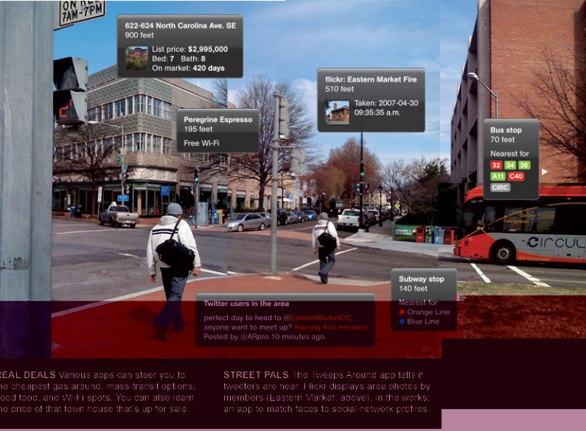

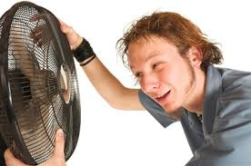
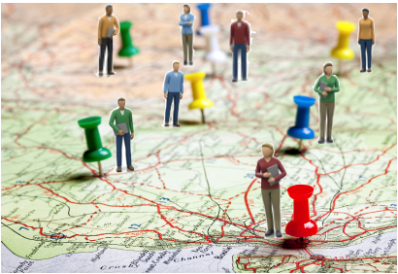
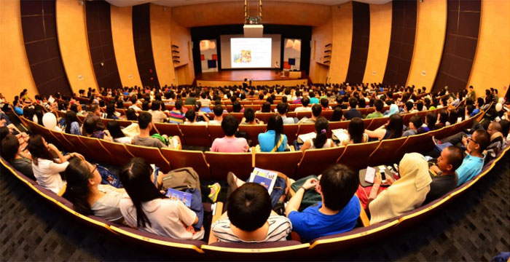
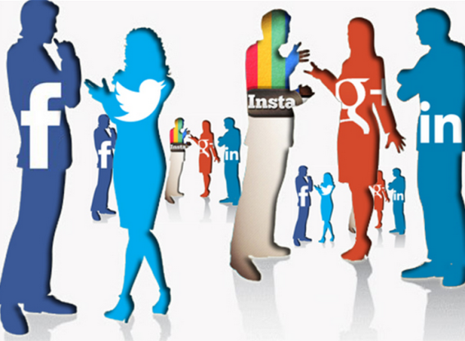

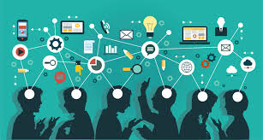
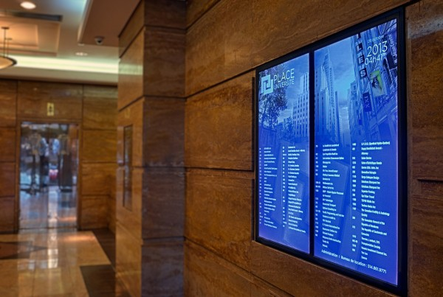


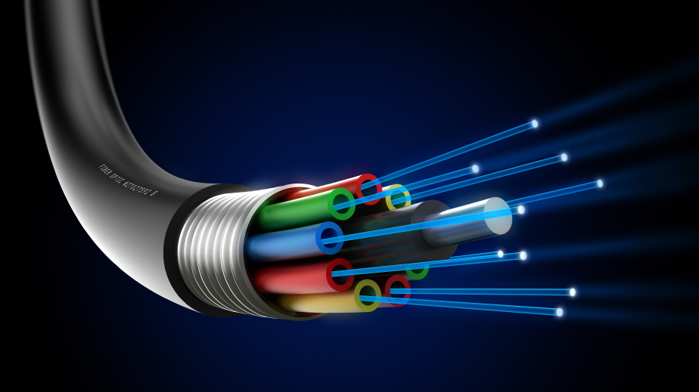


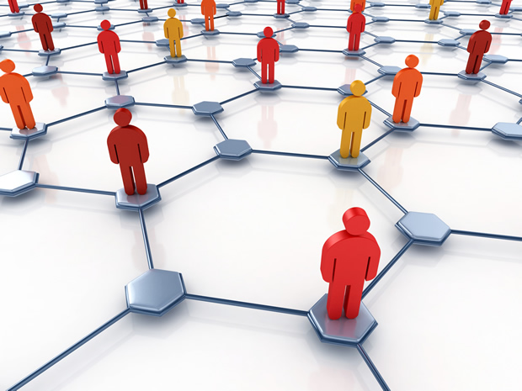
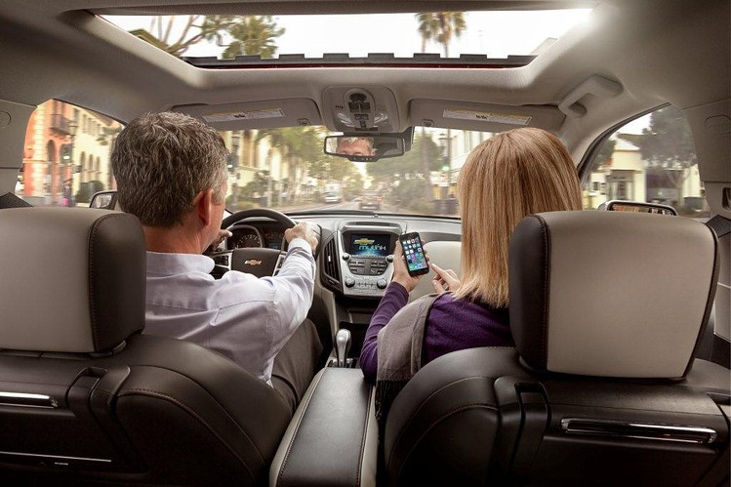
Trust, Identity, Privacy, Protection, Safety, Security for Healthcare is needed to protect patients - TIPPSS
Trust: Allow only designated people/services to have device or data access
Identity: Validate the identity of people, services, and “things”
Privacy: Ensure device, personal, sensitive data kept private
Protection: Protect devices and users from harm – physical, financial, reputational
Safety: Provide safety for devices, infrastructure and people
Security: Maintain security of data, devices, people, etc.
The TIPPSS framework was developed at an IEEE Workshop at George Washington University in February, 2016.
IEEE Workshop recap report: https://internetinitiative.ieee.org/images/files/events/ieee_end_to_end_trust_meeting_recap_feb17.pdf
5
Source: Florence D. Hudson
Augmented Reality
Augmented Reality
Emergency
Notifications
Emergency
Notifications
Buildings & Facilities
Buildings & Facilities
Lecture Space
Lecture Space
Social
Interaction
Social
Interaction
Environmental
Senses
Environmental
Senses
Location
Location
Location
Support
Location
Support
Network Platforms
Network Platforms
Water Systems
Water Systems
Real-Time
Collaboration
Real-Time
Collaboration
Content
Delivery
Content
Delivery
HVAC Sensors
& Controls
HVAC Sensors
& Controls
User Senses
Media
Consumption
User Senses
Media
Consumption
Data
Center
Data
Center
Inter-Server Copper & Fiber
Inter-Server Copper & Fiber
Authentication
Authentication
Mobile Device
Mobile Device
Connectivity
Network Security
Connectivity
Network Security
Vehicles
Vehicles
Notes:
Across elements of a connected ecosystem:
Users
Devices
Gateways
Communications
Clouds
Software
Services
Data
Hardware
Firmware

Slide 6
TIPPSS for IoT is a growing need
Trust, Identity, Privacy, Protection, Safety and Security
6
Source: ”Enabling Trust and Security: TIPPSS for IoT”, Florence D. Hudson, IT Professional, Vol 20, Number 2, Page 15, IEEE Computer Society March/April 2018

Slide 7
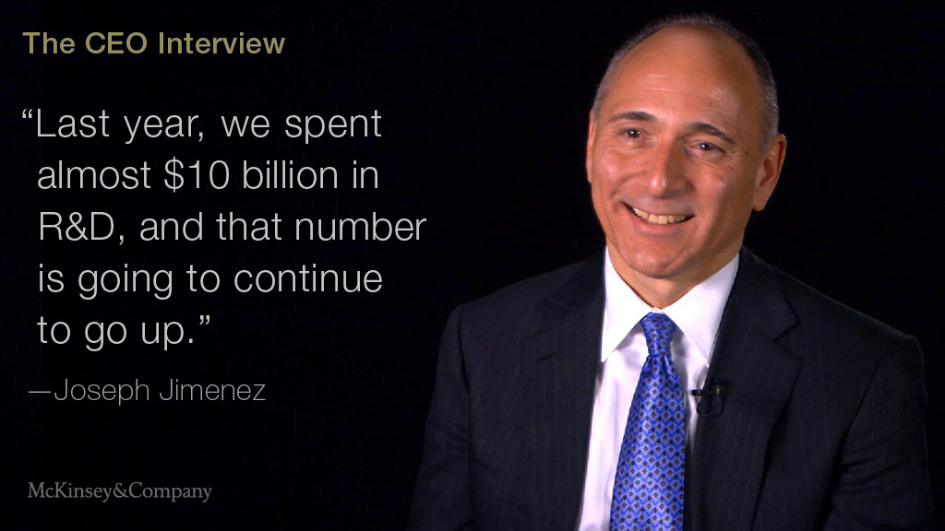
Notes:
CEO Novartis – Digitizing Healthcare

Slide 8
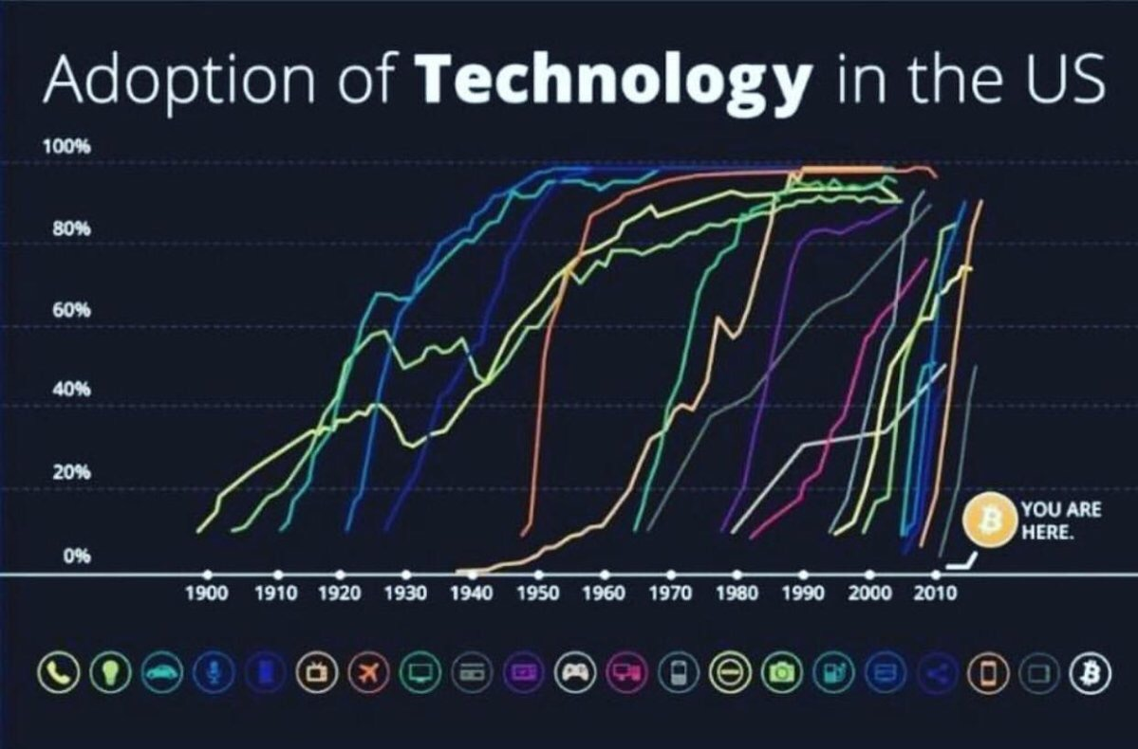

Slide 9
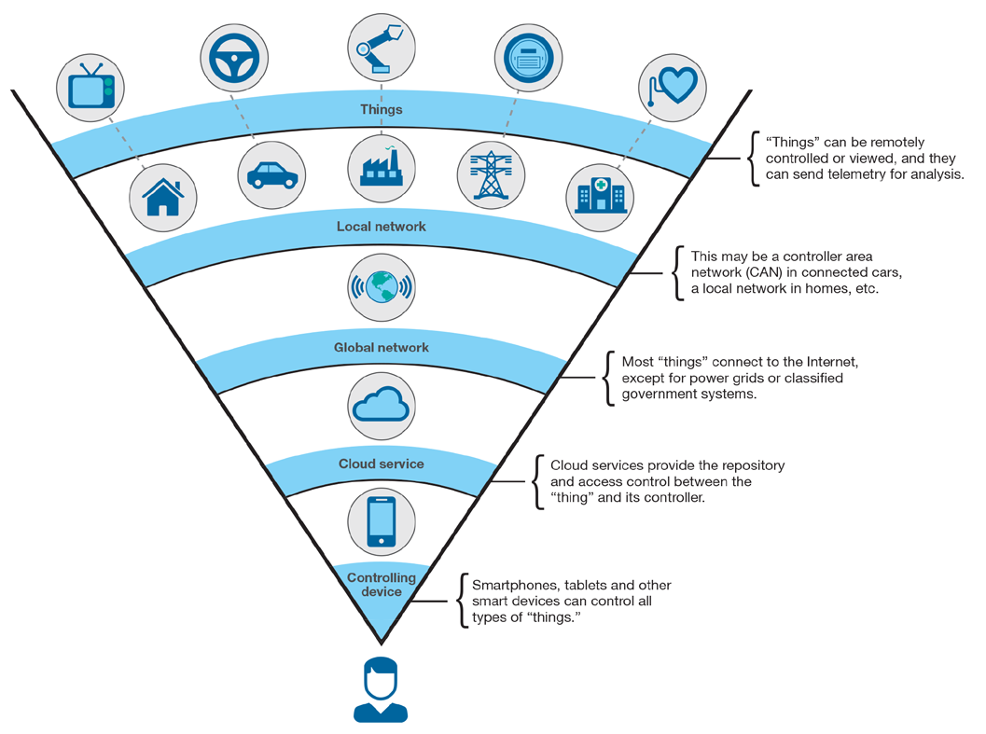
IoT
Notes:
https://www.ibm.com/developerworks/library/iot-lp201-iot-architectures/
Focus on taking data to the people

Slide 10
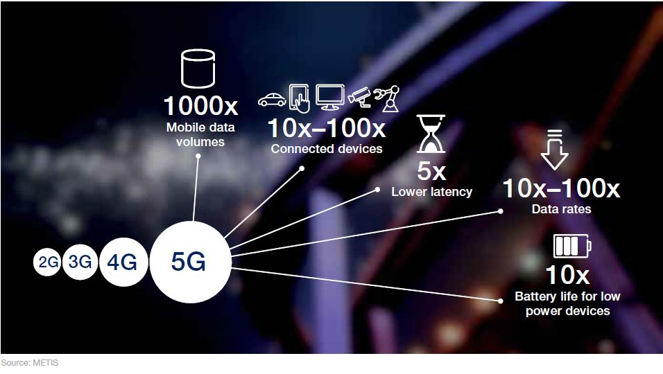
Taking the Data to the People

Slide 11
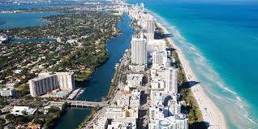
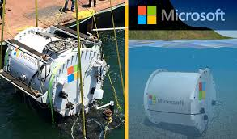
40% of the World’s Population Lives Near the Coast
Notes:
Submerged Data Center by Microsoft

Slide 12
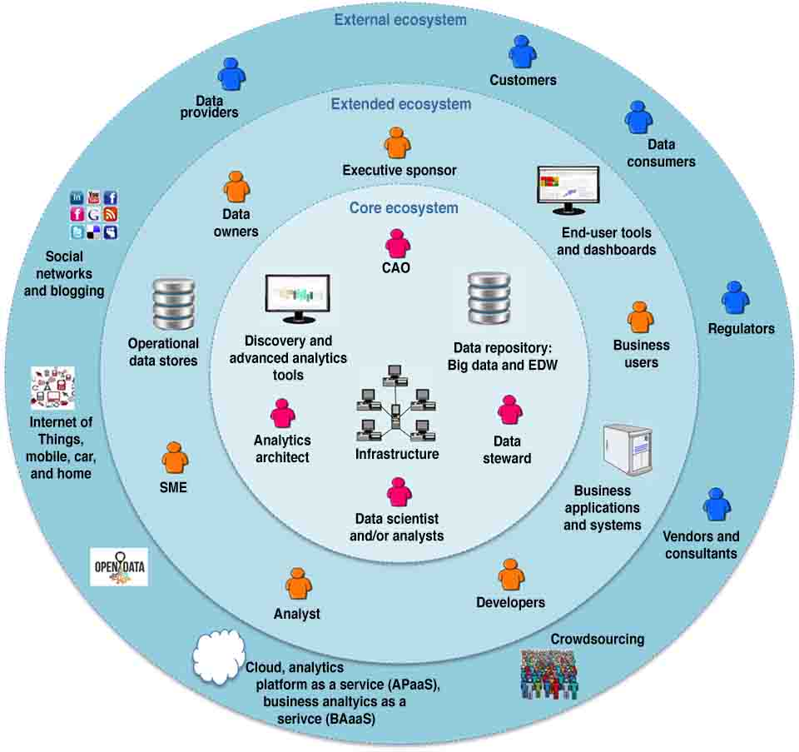
New
Data Ecosystems
Forming
Notes:
https://www.ibmbigdatahub.com/blog/going-beyond-data-science-toward-analytics-ecosystem-part-2

Slide 13
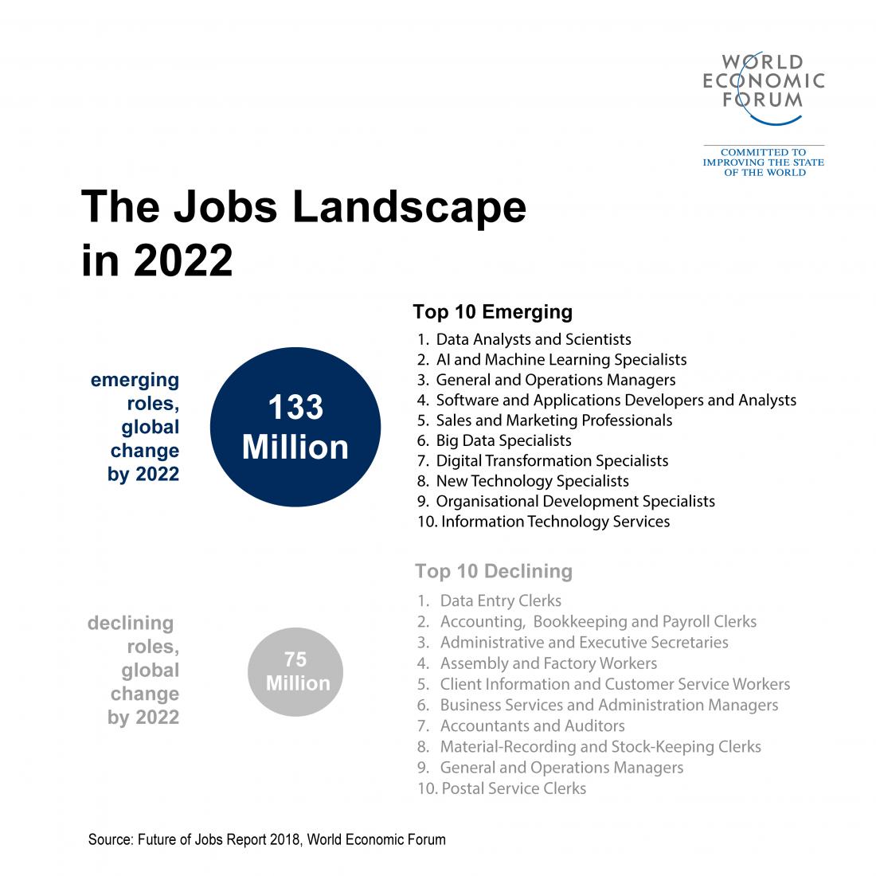



Slide 14

Blockchain + AI
The Two MOST Significant technologies of our time.

Slide 15
Thank you

Slide 16
Title and Content Layout with List
Add your first bullet point here
Add your second bullet point here
Add your third bullet point here

Slide 17
Title and Content Layout with Chart

Slide 18
Two Content Layout with Table
Class | Group A | Group B
Class 1 | 82 | 95
Class 2 | 76 | 88
Class 3 | 84 | 90
First bullet point here
Second bullet point here
Third bullet point here

Slide 19
Two Content Layout with SmartArt
First bullet point here
Second bullet point here
Third bullet point here
Group A
Task 1
Group B
Task 1
Group C
Task 2
Task 2
Task 1
Task 2

Slide 20
Add a Slide Title - 1

Slide 21
Add a Slide Title - 2

Slide 22
Add a Slide Title - 3

Slide 24
Add a Slide Title - 4

Slide 25
Add a Slide Title - 5

