Slide 1
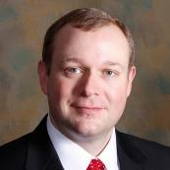
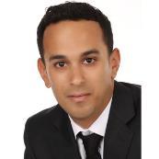

Leveraging Remote Patient Monitoring to Manage Chronic Disease
Michael Adcock, FACHE
Moderator:
Rajiv Leventhal
#Conv2X
October 24, 2018
Lerner Hall Columbia University, NYC, USA

Slide 2
Expert Care is just a screen away
UNIVERSITY OF MISSISSIPPI MEDICAL CENTER
CENTER FOR TELEHEALTH

Slide 3
UMMC Telehealth Overview

Slide 4
Why is telehealth important?
Currently, 53 of Mississippi’s 82 counties are more than a 40-minute drive from specialty care.
UMMC CENTER FOR TELEHEALTH
Provides specialty care that is convenient for patients
Offers vital support for primary care physicians
Helps decrease the cost of
care and
improve patient outcomes
Supports population health in underserved areas
Provides interactive distance education
for providers
to improve quality
of care

Slide 5
UMMC Telehealth Timeline
Diagnostic test interpretation
Adult and Pediatric Cardiology
1990s
First videoconferencing of telemedicine
Emergency Medicine
2003
TelePsychiatry underway
2008
Full-time staff assigned to Telehealth
2011
Center for Telehealth formed
24/7 Telehealth Call Center
2013

Slide 6
Telehealth Scope of Services
Telemedicine: Live (Audio-Video) Interaction
  Scheduled and unscheduled
  Specialty consults, Primary Care, Employee & Student Health,
  Prison Health
  Ancillary health and wellness services
Store & Forward & Diagnostic Tests Interpretation
    Cardiology, Radiology, Neurology, Audiology
    Dermatology, Pathology, Ophthalmology
Remote Patient Monitoring
  Chronic disease management
    Hospitals- at risk population, cost avoidance/reduction
    Clinics- ACOs, Private practice, hospital owned
  Post Acute monitoring

Slide 7
UMMC Telehealth by the numbers
500,000+
200+
telehealth encounters since 2003
Locations,
with new locations weekly
35+
200+
specialty services and growing
UMMC available
specialists

Slide 8
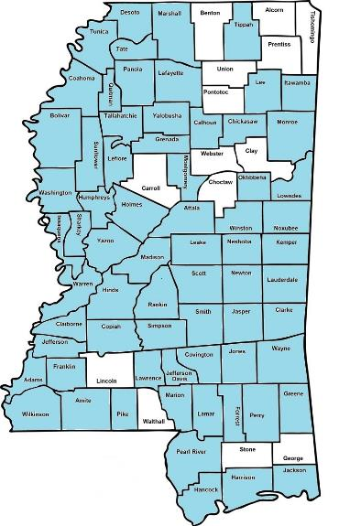
UMMC Center for Telehealth in Mississippi
Community Hospitals & Clinics
Mental Health Clinics
FQHC’s
Schools & Colleges
Mobile Health Vans
Corporations
Prisons
Patient’s Homes

Slide 9
The Problem

Slide 10
The Problem: Diabetes
Mississippi and specifically Sunflower County ranks at the top for the prevalence of diabetes.
People with diabetes have medical expenses approximately 2.3 times higher than those who do not have diabetes.
In 2012, diabetic medical expenses in Mississippi totaled $2.74 billion, according to the American Diabetes Association.

Slide 11
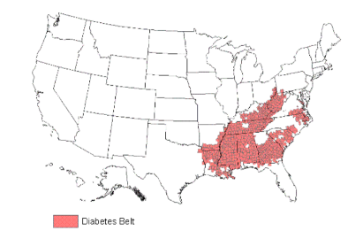
Diabetes Belt
Southeastern United States
More likely to have Type 2 Diabetes
644 counties in 15 states

Slide 12
Mississippi Diabetes Telehealth Network
A Collaborative Approach to Health Care Delivery

Slide 13






Partners

Slide 14
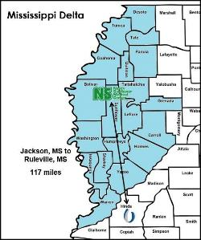
MS Diabetes Telehealth Network
Purpose:
  To improve clinical outcomes and care coordination for chronic disease management
  Increase access to care
  Bring healthcare resources into the patient’s home

Slide 15
Eligibility
Target Number 200
Inclusion Criteria:
Patient at the NSMCSRHC
18 years of age or older
Prior diagnosis of diabetes mellitus
Not pregnant
Hemoglobin A1C greater than or equal to 7% based on prior or current testing at the NSMCSRHC

Slide 16
Sustainable Change: The 3 E’s
Education + Engagement + Empowerment
Education
Phase 1
Behavior
Change
Phase 3
Engagement
Phase 2
Personal
Empowerment
Phase 4

Slide 17
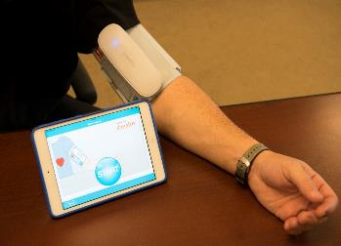
Remote Patient Monitoring (RPM)
Chronic disease management in the patient’s home including:
Daily Health Sessions
Behavior Modification
Personalized Interventions
Targeted Education
Health Coach
Patient Empowerment
Notes:
Remote patient monitoring –
Daily health sessions that are less than 10 minutes at a convenient time for the patient.
Targeted chronic disease specific evidence-based education
Behavior modification
Personalized interventions when patients need a little more education on a topic.
Health coaching
Empowering the patient to take control of their chronic disease

Slide 18
MS Diabetes Telehealth Network
HbA1c 1.7% | Medication Compliance 96% | Health Session Compliance 83%
Retinopathy Found 9 cases | Weight Loss 71 pounds | Miles Saved 9,454.11
No Hospitalizations or ER visits for DM
Preliminary results on first 100 patients

Slide 19
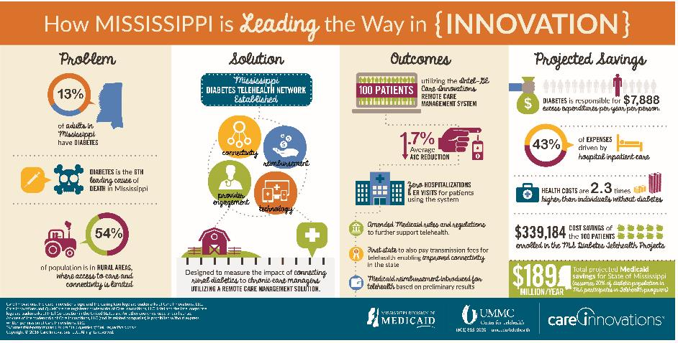
MS Diabetes Telehealth Network Update

Slide 20
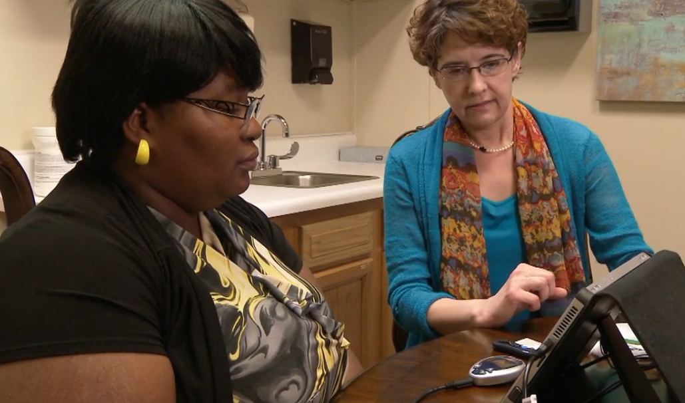
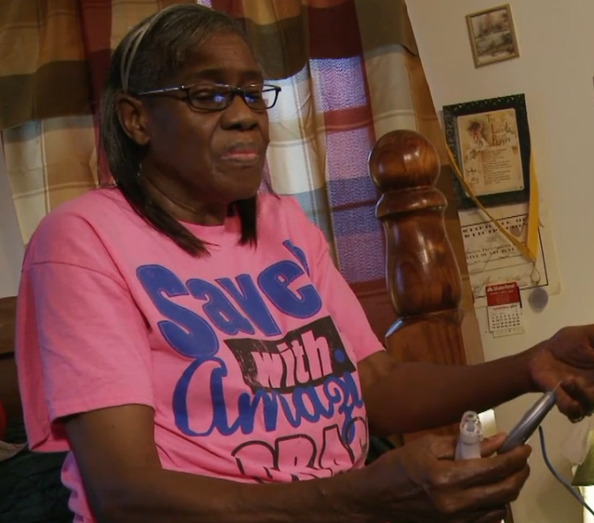
Empowering Patients with Technology
“Education is not a building…it is learning and I’ve learned so much!”
“This program works. I have learned more in this program than I did when I was in a hospital.”
“I never thought to look into my shoes”
“I have learned more in the few months of being in this program than I have in 17 years of having diabetes”

Slide 21
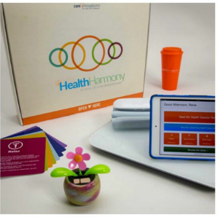
Lessons Learned
Smaller Tablet
  Patients need tablets that are more mobile
No tethered devices
  Cords and cables cause confusion and increased technical issues
Affordable options
  Blood glucose strips were not affordable
Connectivity
  Wireless connectivity limited
  Provide patients with cellular network connectivity

Slide 22
Future Research
Larger sample size
Random assignment of treatment
Patient and provider satisfaction
Analysis of cost effectiveness

Slide 23
Remote Patient Monitoring
CURRENT RPM PROGRAMS
FUTURE RPM PROGRAMS
Chronic Disease
  Diabetes (Adults and Peds)*
  Congestive Heart Failure*
  COPD*
  Hypertension*
  Asthma (Adults and Peds)*
  High Risk Pregnancy
  Bone Marrow Transplant
  Kidney Transplant
Medical Weight Loss
Neonatal
Diabetes Prevention
Hypertension Prevention

Slide 24


Patient Feedback
97%
99%
93%
93%
Strongly Agree
/Agree
Strongly Agree
/Agree
Strongly Agree
/Agree
Strongly Agree
/Agree
I would recommend
this program to others.
I feel this is an important step in my care.
The equipment was
easy to use.
If I had a problem, someone
was available to help me.
Notes:
Benchmarks:
Easy to use – 96% HS-TN; 86% Amed
Available to help - 92% HS-TN; 90% Amed
Easy to read – 97% HS-TN; 94%
Recommend to others: 94% HS-TN; 91% Amed

Slide 25
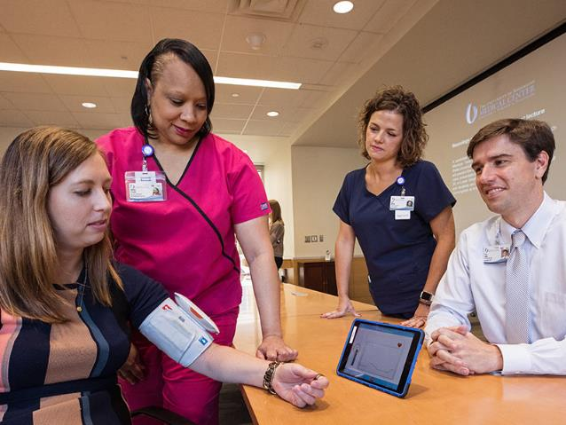
Intensive Hypertension Management Program
Purpose:
  300 patient goal
  Six Month program
  Pharmacist adjusted medication therapy
  Test remote patient monitoring platform for intensive hypertension management

Slide 26
Sustainability

Slide 27
SB 2646 (2014)- SAF; RPM
SENATE BILL NO. 2646
(As Sent to Governor)
AN ACT TO CREATE NEW SECTION 83-9-353, MISSISSIPPI CODE OF 1 1972, TO REQUIRE HEALTH INSURANCE AND EMPLOYEE BENEFIT PLANS IN 2 THIS STATE TO PROVIDE COVERAGE AND REIMBURSEMENT FOR 3 "STORE-AND-FORWARD TELEMEDICINE SERVICES" AND "REMOTE PATIENT 4 MONITORING SERVICES" TO THE SAME EXTENT THAT THE SERVICES WOULD BE 5 COVERED AND REIMBURSED IF THEY WERE PROVIDED THROUGH IN-PERSON 6 CONSULTATION; TO DEFINE "STORE-AND-FORWARD TELEMEDICINE" AND 7 "REMOTE PATIENT MONITORING"; TO AMEND SECTION 83-9-351, 8 MISSISSIPPI CODE OF 1972, TO INCLUDE EMPLOYEE BENEFIT PLANS IN THE 9 REQUIREMENT FOR INSURANCE REIMBURSEMENT FOR TELEMEDICINE SERVICES; 10 AND FOR RELATED PURPOSES.
BE IT ENACTED BY THE LEGISLATURE OF THE STATE OF MISSISSIPPI
http://billstatus.ls.state.ms.us/documents/2014/pdf/SB/2600-2699/SB2646SG.pdf

Slide 28
Other payment models
Contracted Fee for Service
  Payers
  Employers/Self Insured
  Assisted Living
  Hospitals (readmission penalty avoidance)
Shared Savings/Value Based Care

Slide 29

Thank you
Michael Adcock, FACHE
Executive Director, Center for Telehealth
University of Mississippi Medical Center
madcock@umc.edu
@ummctelehealth
601.815.2048
?
Bridging the gaps in quality healthcare

