Slide 1

Joseph M. Smith, MD, PhD
President and CEO, Reflexion Health, Inc
www.reflexionhealth.com

Slide 2


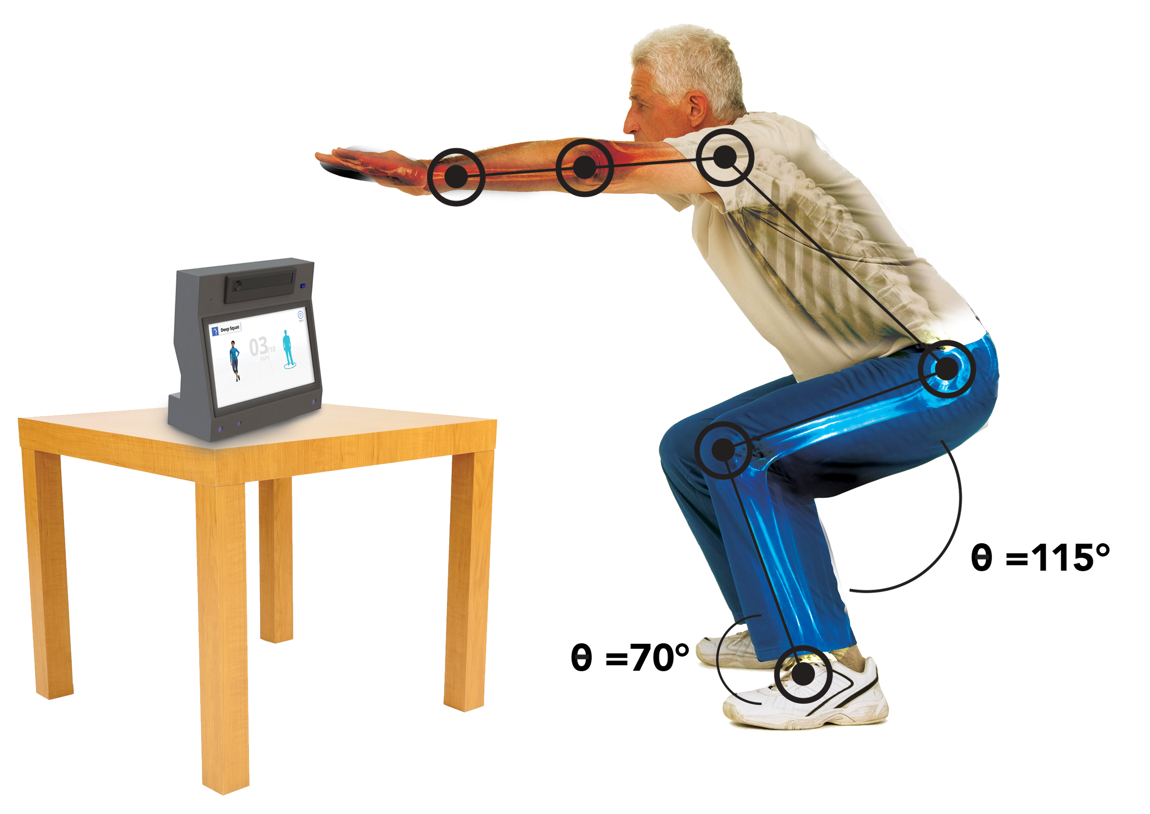
Meet VERA™
An FDA-Cleared Virtual Exercise Rehabilitation Assistant
An engaging avatar, 3D motion-capture technology, and telehealth oversight by licensed PTs lets patients
to do physical therapy at home

Slide 3


Groundbreaking Study Proves VERA:
1
2
3
Saves money
Is as safe and effective as traditional physical therapy
Is a hit with patients
$2,745
9.2
on a scale from 1 to 10
per patient

Slide 4
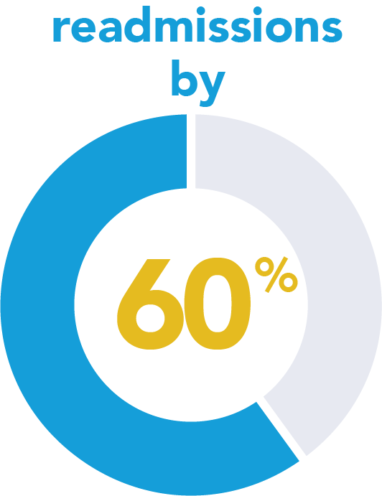
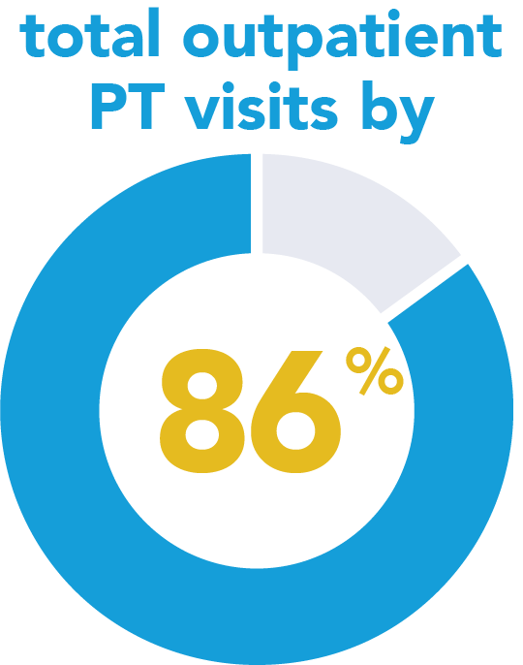
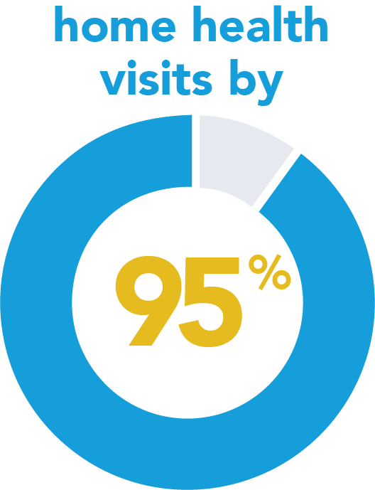
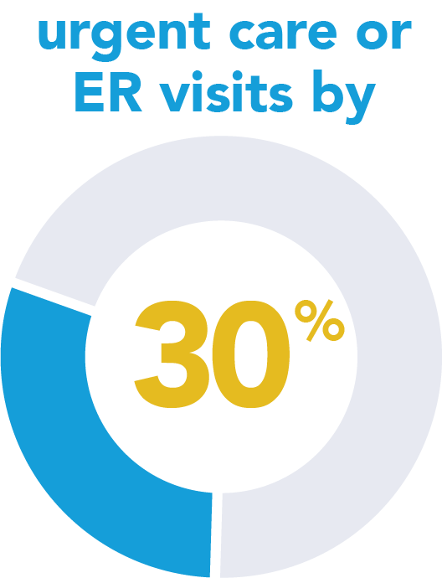

Compared to traditional PT, VERA Reduces:

Slide 5
Media Coverage
Reflexion Health and Duke Clinical Research Institute Announce Results of the First Randomized Controlled Trial Demonstrating Virtual Physical Therapy Outperforms Traditional Approach
Press Release | October 15, 2018
Digital health startups may not want to do randomized trials, but they need to
STAT OpEd | Joseph Smith, MD, PhD | October 15, 2018
Study: Reflexion Health Virtual Therapy System Reduces Rehab Costs
Xconomy | Sarah de Crescenzo | October 15, 2018
Duke Affirms Cost Savings from Physical Therapy Via Telehealth
MHealth Intelligence | Eric Wicklund | October 15, 2018

Slide 6

Why Yale New Haven & Greensboro Orthopaedics are Embracing VERA
https://www.youtube.com/watch?v=sjAUrbA2VwM&t=0s

