Slide 1

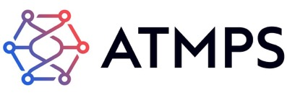
Hataali
A Unified Platform for
Personalized Medicine
raja.sharif@atmps.net
+442032876633
www.atmps.net
Confidential & Proprietary
Any use of this material without prior written permission of ATMPS Ltd is strictly prohibited

Slide 2
What?
Hataali
The Cell and Gene Therapy Ecosystem Platform
One Portal
One Platform
One Solution
— Multiple Therapies
— Multiple Sites
— Multiple Stakeholders

Slide 3
What are We Trying to Solve
What is the Problem for Blockchain to solve?
Businesses are struggling to Digitise and Scale in the Cell and Gene therapy sector
Complex paper-based systems, lack of SoPs, multitude of Lab Equipment, differing communication methods means Pharmaceutical companies can not increase therapies easily and Hospital struggle to administer treatments efficiently

Slide 4
How We Use Blockchain
One Easy to Use, Multi-stakeholder Digital Platform for Pharmaceutical companies
and Hospitals to coordinate and communicate to provide ATMPs globally
Competitive Advantage
Operational Efficiency
Cost Effectiveness

Slide 5
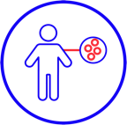
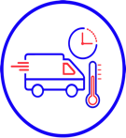


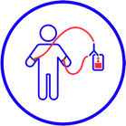

Supply Chain Problems
What Are the Current Challenges?
Sample
taken
Treatment manufactured
Treatment administered
Sample shipped
Treatment shipped
Hospital manually contacts manufacturers
Labels - visible patient data
No tracking of transfer of custody
Paper forms used
Multiple systems
Different manufacturer systems
Lack of real time coordination with hospital
No end user visibility on production status
Manual booking of treatment slots and risk of double bookings
Courier transports sample
Courier have different tracking systems
Patient data visible on containers
No chain of condition info
Confusion of location
Unpredictable delivery of treatments
Lack of process visibility
Scheduling difficult
Lack of chain of custody data
Risk of chain of identity/patient confusion
THE PROBLEMS
✗
Paper Records
Risk of Data Loss
✗
No Data Security
Data Silos
✗
Lack of Transparency Stakeholder Confusion
✗
Scheduling Challenges No Data Analytics

Slide 6
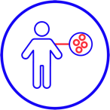
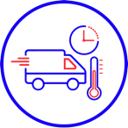


Our Solution
How Are the Problems Solved Utilizing Blockchain?
Sample
taken
Sample shipped
Treatment manufactured
Treatment shipped
Treatment administered
Hataali used to select all cell and gene treatments at the hospital
Anonymized labels applied
Multiple treatments capabilities
Multiple manufacturers listing
Multiple couriers listing
Hataali tracks multiple samples and treatments
Full chain of custody, identity and condition
Interoperability with all stakeholders
Hospital receives treatment into pre-booked treatment slot
Scheduling module for staff, facility and patient
Reorder and payment module
Patient engagement App
Payment capability
Integrates with any MES/ LIMS
Hospital notified in real time
No risk of double booking of labs
Data Integrity Assurance
Data Analytics capabilities
OUR SOLUTION
Fully Digital Process with Immutable Data
HIPPA/GDPR Compliant
Data Security
Real Time Coordination
Automated Notifications
Full Process Visibility
Efficient Automation

Slide 7
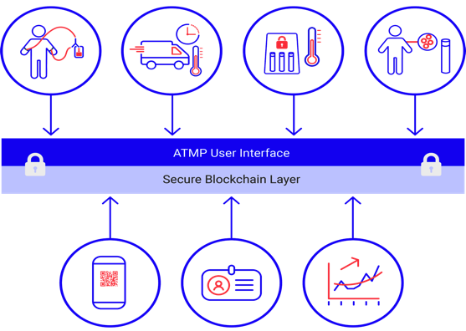
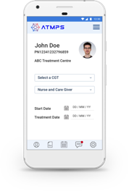
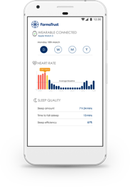
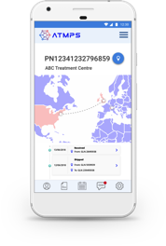
Blockchain Architecture
How do we put it together?
Easy to Use Interface
Hataali is operational, installed and tested. There is interoperability between systems It needs to scale and grow, globally
Innovative UX and UI for ease of use and training
Patient Engagement App for great patient experience
Developer Apps for smaller manufacturers
Sample
taken
Sample shipped
Treatment manufactured
Treatment administered
Secure Backend
Built on distributed ledger platform, most secure solution currently available
Integrates seamlessly with hospitals, manufacturers, laboratories and courier systems
Verification at every step
Auditing simplified
Automatic analytics

Slide 8




What Difference Does Blockchain Make?
Non-Blockchain
Blockchain
Simultaneous R/T Coordination
Reduce Treatment Time
Security and Privacy
Key Concern for Pharma
Easier GDPR/HIPPA Compliance
Protecting Patient Data
FDA 21 CFR 11 by default
Reduces Costs
Interoperability Strategy
Many different systems

Slide 9
Status and Background
What Have We Learnt So Far?
Blockchain is now better understood – distinction between Cryptocurrencies and a Blockchain platform
Sunday Newspaper Experts - ‘Blockchain” is a solution looking for a problem to solve
Legacy technology continues to dominate and “it it ain’t broke, why fix it?” attitude
Blockchain stuck in innovation departments in Pharma companies and Education still required
Some sectors are more receptive to blockchain - pharma still seems to be very conservative
Better Commercialization Strategies are required

