Slide 1




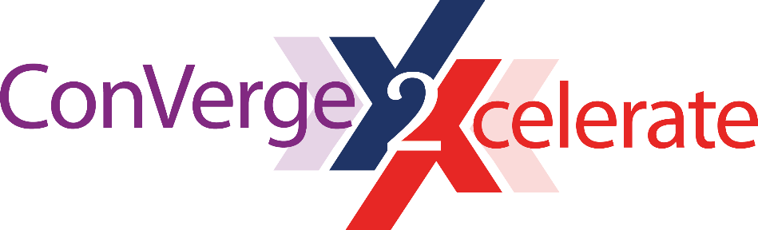
Blockchain in Healthcare
Today & Tomorrow
September 15, 2022
Central Public Library
Austin, TX USA
Going Under the Hood of dApps and DAOs
Dr. Ali Loveys, CMIO, ITPC
2022

Slide 2

Going under the Hood
dApps and DAOs

Slide 3

objectives
The business case – Part i
The business case – Part ii
Are you ready
Due diligence

Slide 4
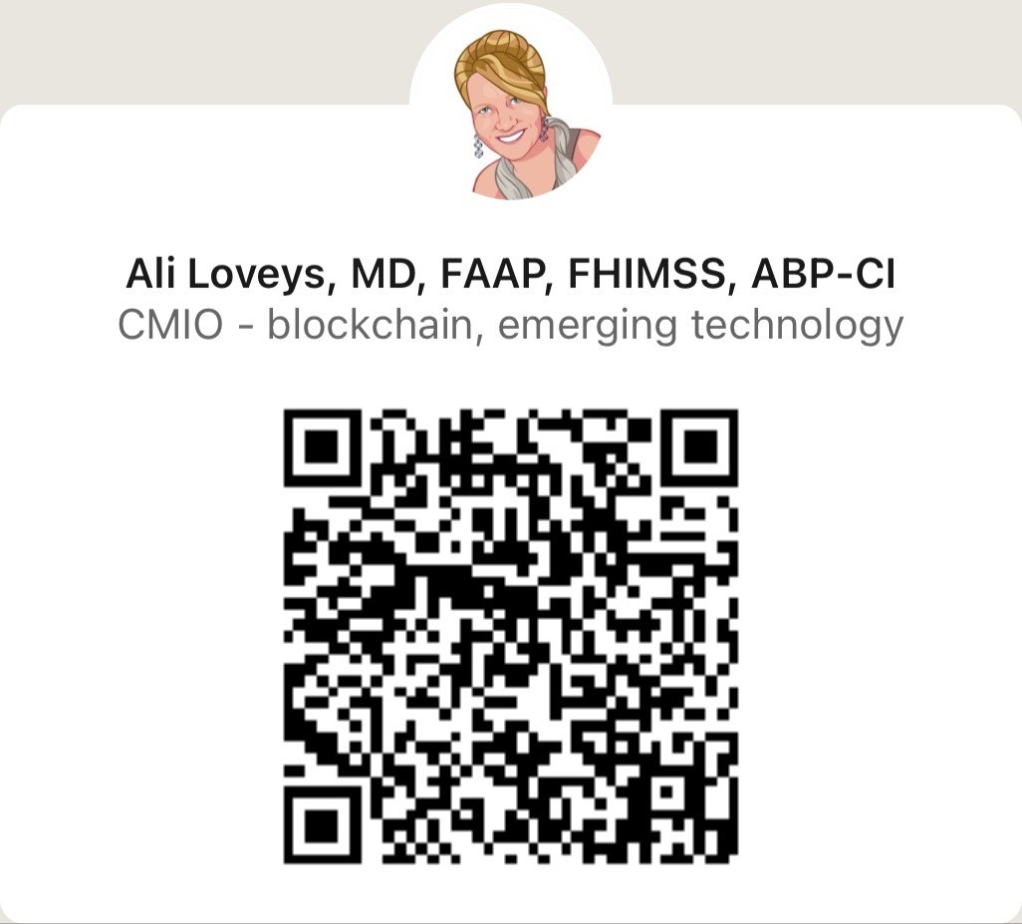
About me
Physician informaticist
Emerging technology
Led blockchain healthcare EY
Start-up world
Advise, mentor - blockchain enablement
https://www.linkedin.com/in/dr-ali-loveys/

Slide 5
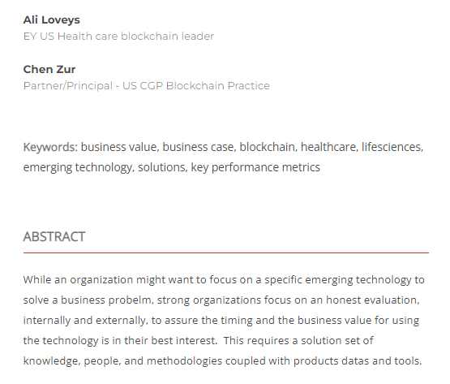
The business case for blockchain in health care — part I
https://blockchainhealthcaretoday.com/index.php/journal/article/view/137

Slide 6
Benefits – WHAT blockchain enabled systems do
Manage asset data
  Increased visibility
  Trust
  Near real time insights
  Immutable transaction record
Healthcare asset examples
  Biologics
  Pharmacologic
  Payments
  Credentials

Slide 7
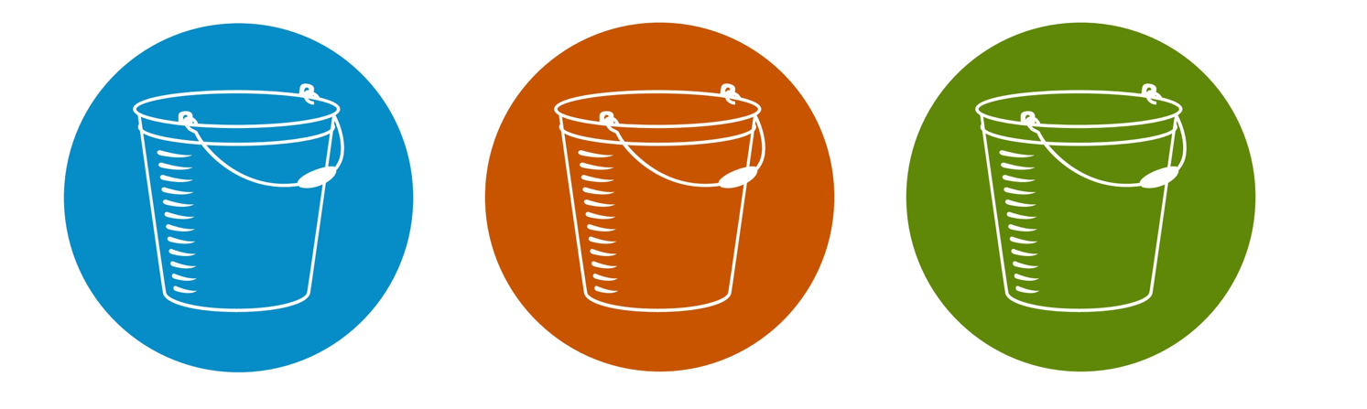
Benefits – WHY use blockchain
Operational efficiencies
Regulatory compliance
New business capabilities

Slide 8
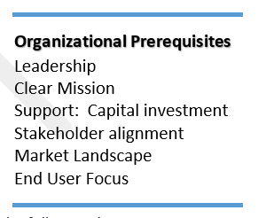
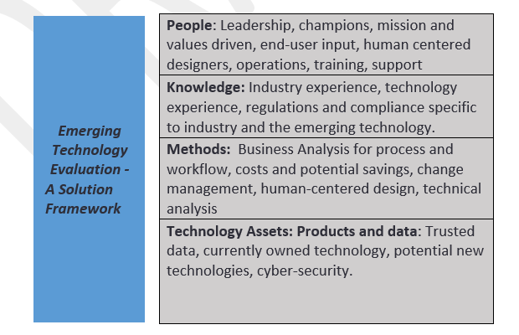
Are you ready?

Slide 9
The business case for blockchain in health care — part II
Questions 2022
Business Value
Governance
Technology
Blockchain protocol
Usability
Graphical user interfaces
People
KPI

Slide 10

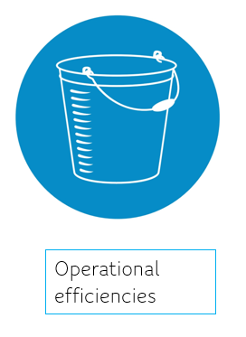

Key performance indicators – Primary
Quantify the value Newco brings to the organization, stakeholders end-users
Revenue
  Monthly recurring revenue
  Daily active users (DAU)
Savings
  Money
  Time
Compliance
  Money – avoid penalties
  Time

Slide 11
Governance
Persons
  Chief executive officer
  Board of Directors
  Founders
  Advisors
  Technologists
    Software engineers
    Designers

Slide 12
Governance
dAPP
  Company structure
  Stage
  409A evaluation
  Intellectual property, patents
  Financing
    Convertible notes
    Safe notes
    Venture debt

Slide 13
Governance
Decentralized Autonomous Organization
  Rule of organization are encoded and transparent
  Member owned communities
  Individuals control their identities and their personal data
  Contributions
  Voting rights

Slide 14
Key performance indicators company
Letters of intent
Proof of concepts
Proof of contracts
Technical milestones

Slide 15
Technology
“Blockchain”
  Which protocol
  Public/Private
  Smart contracts?
Analytics
Artificial intelligence
Machine learning

Slide 16
Usability
Graphical user interface (GUI)
Dashboards
Wallet management
Human centered design

