Slide 1
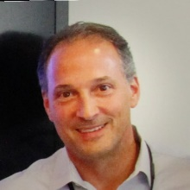
Blockchain in Healthcare Today & Tomorrow
Mark Treshock, Executive Director, Emerging Technology, CVS Health
2022
Bob Holzer, Sr. Director Technology Exploration, Health Care Service Corporation
Moderator
Gabriela Pelin, Chief Innovation Officer Avaneer Health
Sponsored by
September 15, 2022
Central Public Library
Austin, TX USA

Slide 2
How Blockchain Transforms Payer Processes to Create a Person-Centered Experience
September 15, 2022
ConVerge2Xcelerate 2022
Notes:
Updated Aug 2022

Slide 3
Gabriela Pelin
Chief Innovation Officer
Avaneer Health
Mark Treshock
Executive Director Emerging Technology
CVS Health
Bob Holzer
Senior Director
Technology Exploration
Health Care Service Corporation

