Slide 1
Blockchain in Healthcare Today & Tomorrow
September 15, 2022
Central Public Library
Austin, TX USA
Closing a Key Gap in DSCSA Compliance with Credentialing
Bob Celeste, Founder, Center for
Supply Chain Studies
David Kessler, President, Legisym, LLC
2022

Slide 2
OPEN CREDENTIALING INITIATIVE
Closing a Key Gap in DSCSA Compliance with Credentialing

Slide 3
1
OCI
2
DSCSA
Agenda
3
The Gaps
4
Establishing Trust
5
Questions

Slide 4
OCI

Slide 5
OCI: Open Credentialing Initiative
An open ecosystem supporting the pharmaceutical industry in complying with DSCSA requirements by 2023 with available solutions developed in industry-wide pilots
What is OCI?

Slide 6
Advantages of OCI Architecture
Every OCI member is committed to adopting and supporting OCI architecture, guidelines, and trust frameworks to support industry collaboration

Slide 7
What does OCI Do?
Incubates industry-wide adoption of non-proprietary credentialing solutions
Defines conformance and interoperability criteria
Coordinates and maintains frameworks and guidelines for software architecture
Applies open standards (GS1, W3C and DIF)
Addresses needs of all stakeholders along the pharmaceutical supply chain
Facilitates pilots to explore credentialing for and beyond DSCSA requirements
Publication of all technical work on dedicated GitHub account: https://github.com/Open-Credentialing-Initiative

Slide 8
OCI Structure
Steering Committee
DSCSA Program
Policy & Architecture Committee
KYC/KYS Emerging Initiative
Industry Alignment
OCI Steering Committee
OCI Open Calls
Industry Innovation
External Advisors
Membership Required
Communications
Committed Roles
OCI Management
Administration
Non-committal Engagement
Organizational Functions

Slide 9
OCI has developed the Governance, architecture and Conformance Program for the Pharmaceutical Industry use of Verifiable Credentials
OCI is in the process of doing the same for:
Know Your Customer / Know Your Supplier
Medical Device Representative Credentialing

Slide 10
The Drug Supply Chain Security Act
DSCSA

Slide 11
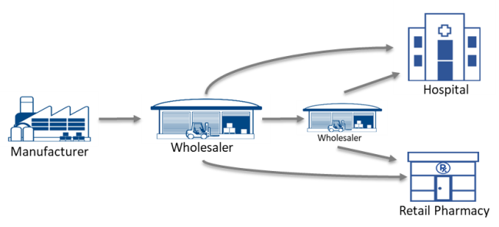
DSCSA Timeline
Package & Case Serialization
Product Verification
Product Tracing

Slide 12
DSCSA Timeline - Delay
Package & Case Serialization
Product Verification
Product Tracing

Slide 13
The Gaps

Slide 14
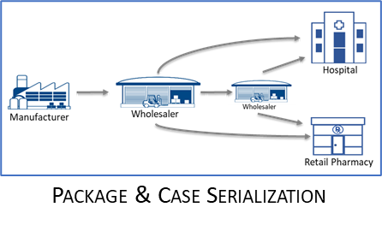
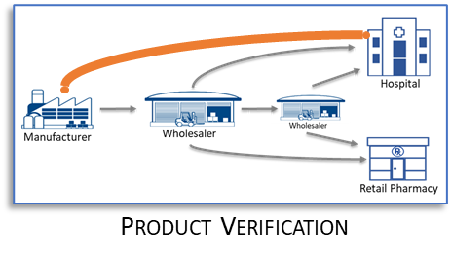
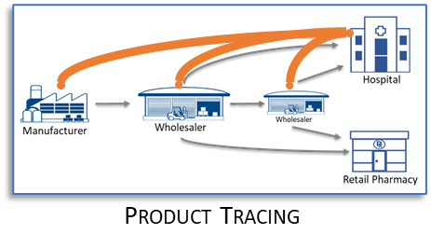
DSCSA Product Verification and Tracing
Authentication and Authorization
Established Relationships
Know Your Customer Processes
Know Your Supplier Processes
Authorized Trading Partner
Direct System Connections
AS2
Ad Hoc Relationships
Authorized Trading Partner?
Ad Hoc Connections
API

Slide 15
OCI solves the DSCSA ATP challenge
Key Requirements
Systems and processes in place to verify product information and trace back to the Manufacturer
Transact with “Authorized” Trading Partners only.
Authorized Trading Partners (ATP)
Verification
DSCSA
Product Tracing
(Serialization)
Product Identification

Slide 16
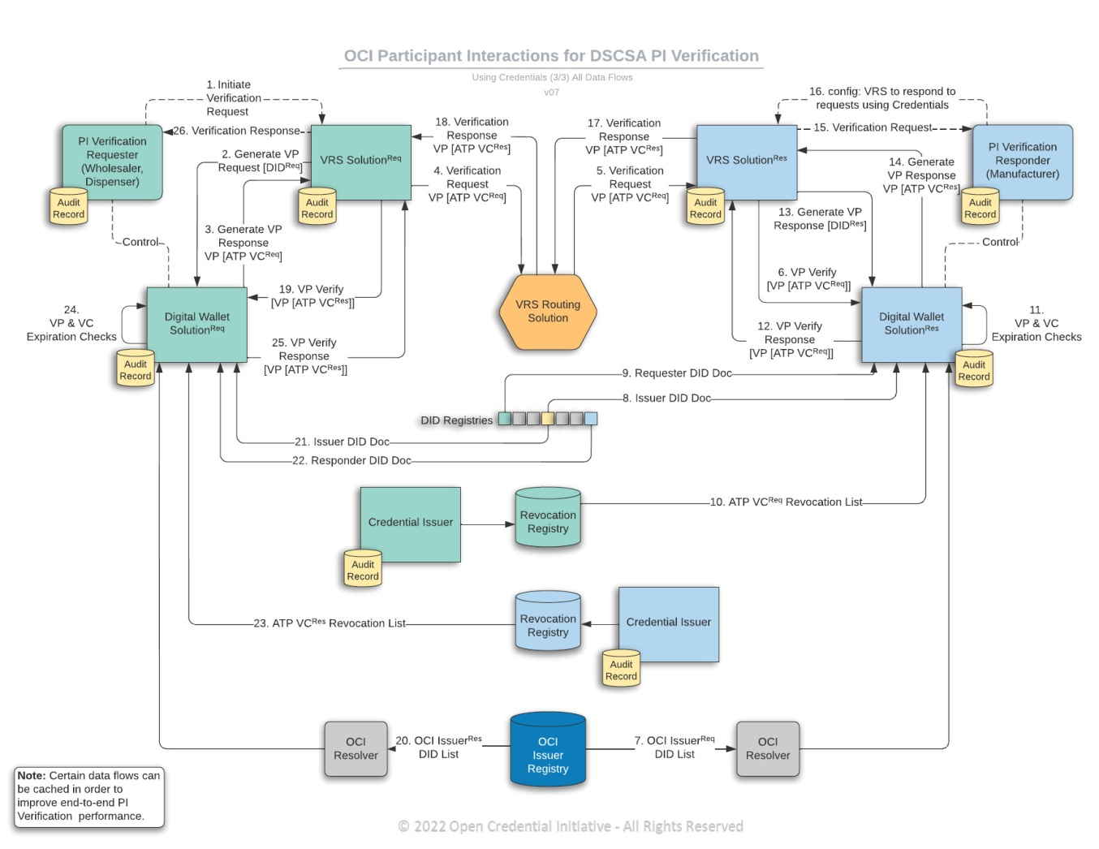
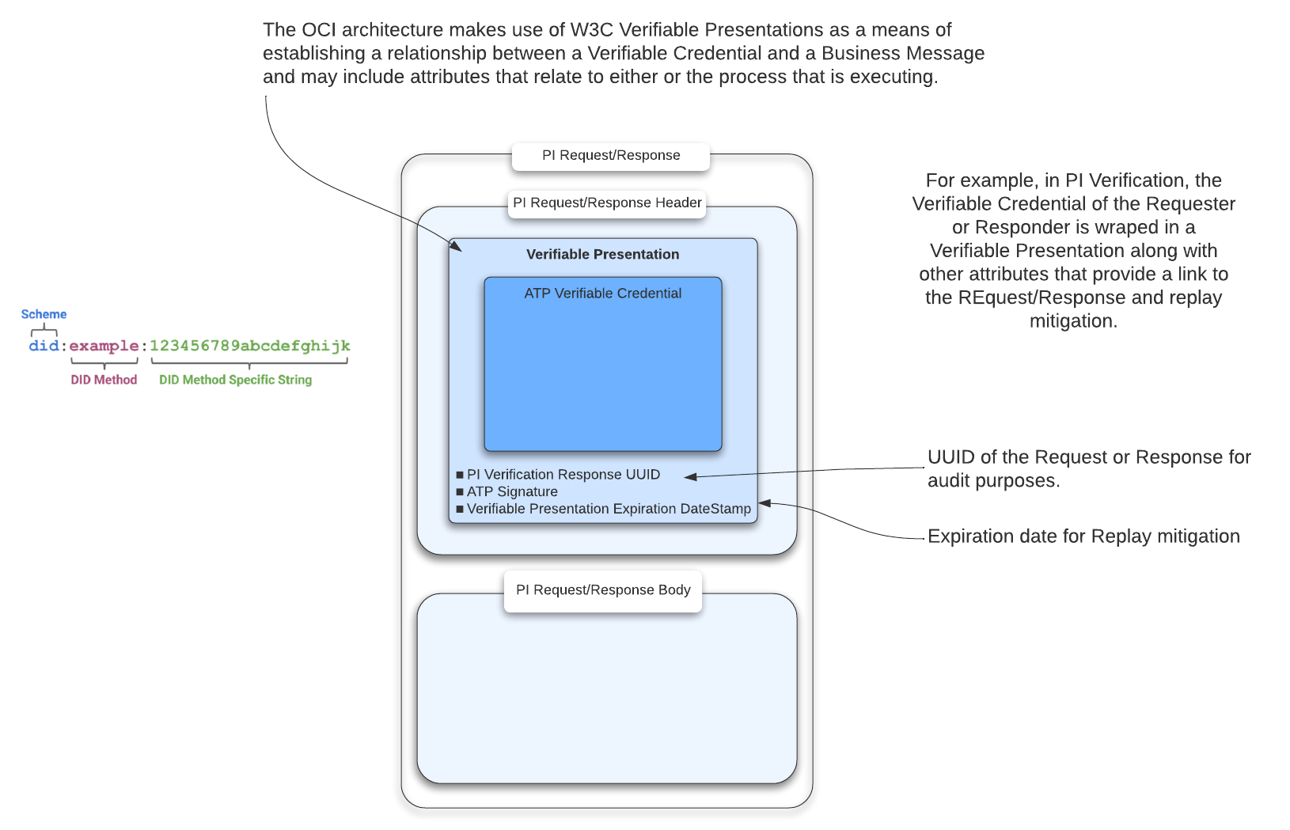
DSCSA Product Verification and Tracing
Adapting Current Processes to use W3C Verifiable Credentials and Decentralized Identifiers

Slide 17
Establishing Trust

Slide 18
What makes a trading partner authorized?
Entity is a Trading Partner when it accepts or transfers direct ownership of a product from or to a manufacturer, third-party logistics provider, wholesale distributor or dispenser.
Where can Trading
Partners check each others Authorized status?
Entity is Authorized
when it ...
Is registered with FDA in accordance with section 510 of the FD&C Act
FDA´s drug establishment current registration database
Manufacturer
Repackager
Third-Party
Logistic
Provider
Has a valid state or federal license
Wholesale
Distributor
Database of authorities
Dispenser,
Pharmacy
Has a valid license under state law
Clinic
Database of authorities

Slide 19
Product Verifications only between Authorized Trading Partners
DSCSA CHALLENGE
!
Wholesaler
Dispenser
Lack of proof of ATP status
is a compliance gap
Manufacturer
Wholesaler
Dispenser
Dispenser
Challenge for Trading Partners
Challenge of GLN (existing solution)
Response within 24h
Over 60,000 indirect trading partners can send product verifications
No industry solution in place
Electronic, interoperable system required by 2023
Manufacturers discovered that requester GLNs are not always well maintained
GLNs do not
inform about trading authorization
ascertain origin of the received GLN

Slide 20
DSCSA SOLUTION
Verifiable Credentials. Identify and verify indirect trading partners
Wholesaler
Dispenser
Exchange verifiable authorization status
Manufacturer
Wholesaler
Dispenser
Dispenser
Compliant and audit-ready ATP checks in every product verification
Automated processes
Secure communication channels with previously unknown trading partners
Credentials can be used for other business requirements

Slide 21
Credential Issuer
Verifies identity and license status of trading partner
Solution
Onboarding
Issuer
Onboarding
ISSUANCE OF IDENTITY AND ATP CREDENTIALS
Requester
Responder
Wholesaler
Dispenser
Manufacturer
Trading Partner
Monitors ATP interactions
No technical integration required
DIGITAL WALLET
DIGITAL WALLET
DIGITAL WALLET
Verification Router Service
Verification Router Service
Integrates with Credentialing Service
Attaches credential to product verification request and response message
Get and verify ATP Credentials
Get and verify ATP Credentials
Routing PI verification
Request and responses including ATP Credentials
VRS
VRS
Notes:
real solution available - not just talking theory here

Slide 22
Verifiable Credentials (VCs)
What
“Credentials are a part of our daily lives; driver’s licenses are used to assert that we are capable of operating a motor vehicle, university degrees can be used to assert our level of education, and government-issued passports enable us to travel between countries. A W3C Verifiable Credentials provides a mechanism to express these sorts of credentials on the web in a way that is cryptographically secure, privacy respecting, and machine-verifiable.”.
W3C Verifiable Credentials Data Model v1.1,
Expressing verifiable information on the Web
In a world of indirect relationships, it is hard to be certain if who you are interacting with is truly who they say they are AND that they have the proper authorization to interact and exchange information. A Verifiable Credential (VC), allows indirect trading partners like a manufacturer and a dispenser, to both prove
they are who they say they are AND
other sets of claims, such as their DSCSA Authorized Trading Partners (ATP) status,
in a secure and verifiable way EVEN if they have had no prior business relationship. Backed with a clear audit trail of the interaction.
are they?
Why
do I need them
Notes:
The DSCSA requires that trading partners interact only with other trading partners that meet the DSCSA defined Authorized Trading Partner definition. Although manufacturers, wholesalers, and dispensers currently establish the Authorized Trading Partner (ATP) status of direct trading partners (those that they directly purchase from or sell to) through Know Your Customer (KYC) requirements, there are a number of DSCSA required interactions between companies where a direct trading partner relationship has not been established.
The challenge in these interactions between indirect trading partners, is that the companies are still bound by the DSCSA requirements but have yet to do the proper due diligence on each other to establish each other’s identity and DSCSA defined ATP status. The first contact might be a PI Verification event such as Saleable Returns (products returned to a wholesaler who then deems that the product is in saleable condition) and later for Suspect or Illegitimate investigations and tracing.
In order to meet industry defined performance requirements, the DSCSA ATP Credentialing solution was designed to move the process to establish trading partner identity and ATP status off the critical path of multiple days to complete due diligence to sub-second response times for day-to-day PI Verifications.
The DSCSA ATP Credentialing Pilot’s use of existing standards by GS1, W3Cs, and NIST, underlying technology, and the processes necessary to establish, maintain and use credentials, allowed for a straightforward architecture for VRS to integrate with and easy to understand processes for trading partners to follow.
Lastly, the team behind the DSCSA ATP Credentialing Pilot established a roadmap towards implementing the use of Decentralized Identifiers and Verifiable Credentials for DSCSA and has shared that roadmap with the whole industry to execute within the FDA’s November 27, 2023 timeline.

Slide 23
Root of Trust and Credential Issuers
Use of Verifiable Credentials
By performing thorough OCI Credential Issuer Due Diligence processes first to establish a root of trust, an Legisym promotes confidence in the Trading Partner’s digital identity prior to the issuance of all ATP Credentials.

Slide 24
Onboarding Process – Obtaining an Identity Credential
Prior to issuing an ATP Credential, Legisym performs a thorough and auditable due diligence process to first prove the identity of the Trading Partner and then issue the Identity Credential used as the root of trust for proving identities.
Two Methods to Prove Identity and Establish Corporate DID
Use of DEA Signing Certificate:
The following details are entered by User:
Enter DEA Number
Upload DEA Signing Certificate
Enter DEA Signing Certificate Password
Submitting Notarized Corporate Documents:
The following corporate documents would be presented by User:
Articles of Incorporation,
IRS Employer Identification Number Assignment Letter,
DUNS Number
For Entity’s Responsible Party:
Name
Address
Corporate Email Address
Government-Issued Photo ID (copy)
Notarized Identity Credential Request letter
(signed by Corporate Responsible Party)
Notes:
HOW DO I GET THEM?
Credentials are obtained by seeking a trusted Credentials Issuer like Legisym, and completing a one-time due diligence onboarding process. When onboarding with Legisym, a user is guided through two simple onboarding screens where they, as an authorized representative of an organization, securely enter and upload the required information to prove identity and Authorized Trading Partner (ATP) status. This user is often an individual within the Administrative or internal Legal Team as they typically have the proper authority and access to corporate documentation and registrations. From there, the User’s effort is complete.
Depending on the verification method the user selected for verifying their identity and ATP status, the process for approval could take as little as 5 minutes.

Slide 25
Obtaining an Identity Credential
Prior to issuing an ATP Credential, Legisym performs a thorough and auditable due diligence process to first prove the identity of the Trading Partner and then issue the Identity Credential used as the root of trust for proving identities.
LEGITIMACY OF THE ORGANIZATION
AUTHORITY OF THE REPRESENTATIVE
Requesting entity submits all required facility proof.
Trust built upon Legisym’s due diligence performed to validate the legitimacy of the facility
Requesting person submits all required identity proof.
Trust built upon Legisym’s due diligence performed to authenticate the applicant’s identity AND corporate responsibility.

Slide 26
Onboarding Process – Obtaining ATP Credential
Legisym performs due diligence to prove that the entity possesses a valid license. This license proofing process consists of checking publicly available state license databases and/or FDA registration databases.
Verify the Credential Requestor Holds At Least One (1) Valid...
State Board of Pharmacy (BOP) license (for Wholesalers or Dispensers)
The following details would be entered
State BOP License Number
State BOP that Issued the License
FDA Establishment Identification (FEI) Number (for Manufacturers)
The following details would be entered:
FEI Number

Slide 27
Obtaining an ATP Credential
Prior to issuing an ATP Credential, Legisym performs a thorough and auditable due diligence process to first prove a VALID State-BOP License exists and OWNERSHIP of the license by the proven corporate identity.
LICENSE IN GOOD STANDING
OWNERSHIP OF LICENSE
Requesting facility submits state-issued BOP License.
Trust built upon Legisym’s due diligence performed to confirm the license exists and is in good standing.
Requesting facility already obtained an Identity Credential
Trust built upon Legisym’s due diligence performed to validate the proven identity has ownership of the valid license.

Slide 28
Questions?

