Slide 1
Blockchain in Healthcare Today & Tomorrow
September 15, 2022
Central Public Library
Austin, TX USA
Blockchain for Precision Medicine
Robert Chu, Co-Founder & CEO, Embleema
2022
https://conv2xsymposium.com

Slide 2
Blockchain for Precision Medicine
ConV2X Blockchain Event
September 15, 2022
Austin

Slide 3
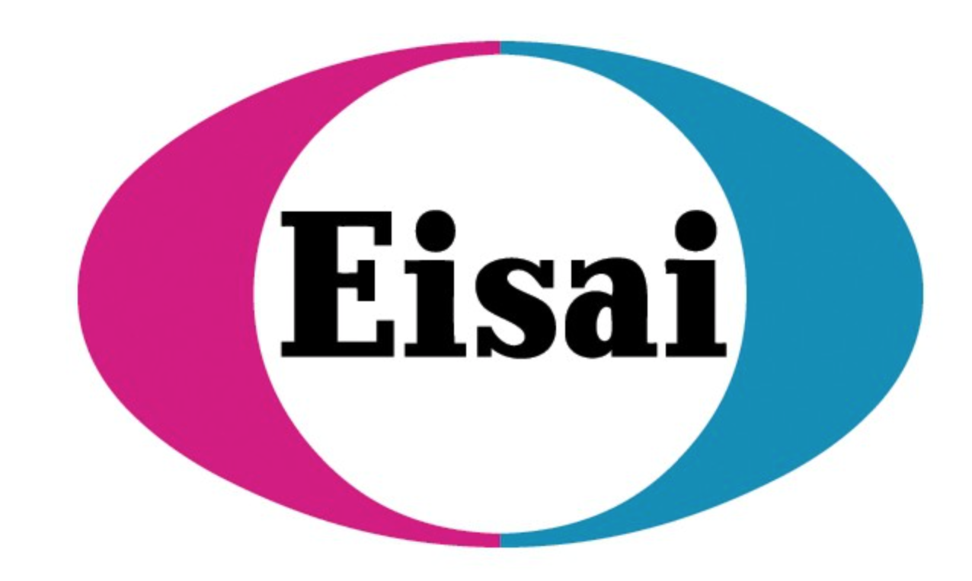
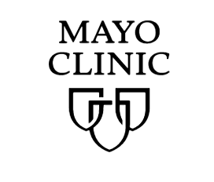
Embleema in a Nutshell…
Clients
Embleema’s regulatory-grade health data and analytics SaaS platform accelerates precision medicine by expediting evidence generation and regulatory reviews of novel treatments
Cell & Gene Therapy Biotechs
Embleema fills 3 unmet needs for precision medicine
Integrated Platform for Clinical, Real-World and Molecular Data
Regulatory Bioinformatics with the FDA
Enhanced Patient Monitoring with Clinical-Grade Real-World Data from > 60,000 Care Centers and Better Engagement

Slide 4
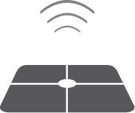
Embleema is the Only Integrated Data & Analytics Platform for Precision Medicine
Analytics & Visualizations
Data Collection
Data Enrichment
Regulatory Submission
CLINICAL, MOLECULAR AND REAl-WORLD DATA
EMBLEEMA HIVE (*)
FDA HIVE
Patient Led
EMR & CLAIMS
DEVICES
PRO
CASE REPORT
FORMS
Investigator Led
EMR
MOLECULAR
EMBLEEMA
BLOCKCHAIN
User Consent
Provenance
(*) 21 CFR Part 11, FISMA -M, Regulatory ATO, NIST-800 compliant
HIPAA & GDPR Compliant
Notes:
Seems to be a lack of focus on Virtual in the presentation. Does Virtual have multiple interfaces? One for personal./patient use and one for use by “Investigators”? Who are the investigators? Are these the Patient Advocacy group?, If not what are these. There is a lack of focus on the benefit VIRTUAL brings to the patient. Is the only platform that integrates with your EMR records (regardless of health system? Only participating partners?) and wearables? – Is this not unique?
What is the benefit of combining genomic data and real-world data for FDA submission? Is the genome data flowing through HIVE and Virtual? What are the sources? Does HIVE pull data from various projects and databases? And also C&GT biotechs? The biotechs use HIVE?
Is collecting real-world data a big value driver? Or is this the market with the lowest barriers to entry/ least level of sophistication?
Is clinical trial data not considered real-world data?
“Real world data in medicine is data derived from a number of sources that are associated with outcomes in a heterogeneous patient population in real-world settings, such as patient surveys, clinical trials, and observational cohort studies.”

Slide 5
Data and Computation Issues in Precision Medicine
Analytics & Visualizations
Data Collection - Quality Control
Regulatory Submission
MISLABELLED SAMPLES
FLAWED EXPERIMENTS
MISSING DATA
UNREPRESENTATIVE DATA
INCONSISTENT DATA
“BRUTE FORCE” DATA
DIFFERENT CODING AND ONTOLOGIES
DUBIOUS PROVENANCE
...
WRONG COMPUTATIONS
FLAWED COMPUTATIONS
NON REPRODUCIBLE COMPUTATIONS
SENSITIVITY ISSUES
LINEAR TOOLS ON NON-LINEAR PROBLEMS
1:1 CORRELATIONS VS N:P CORRELATIONS
DUBIOUS PROVENANCE
...
JUST ONE OF THOSE ISSUES WILL DELAY OR TANK THE APPROVAL OF A NEW DRUG
Data and Analytics Cannot Be Trusted and Are Not Regulatory-Grade

Slide 6
Blockchain for Computation Provenance in Precision Medicine
https://www.biocomputeobject.org/ IEEE 2791-2020
Computation Producer (e.g. Drug Sponsor)
Computation Verifier (e.g. FDA)
REQUEST CERTIFICATE
RECEIVE CERTIFICATE
REQUEST VERIFICATION
RECEIVE VERIFICATION
BCO ID
Computation (BCO JSON + input files + output files)
Computation platform certification ID
Computation ID
Computation Certificate
Verifier entity ID
Computation ID
Computation Certificate
API
API
Compute a Certificate (Hash of all the files provided by the Producer)
Write the Certificate in Blockchain
Return Certificate to the Producer
Fetch in Blockchain the Certificate associated to the Computation ID
Return Certificate to the Verifier
Write in Blockchain:
Computation ID
Computation Certificate
Read from Blockchain the
Certificate for Computation ID
Return from Blockchain the
Computation Certificate
Embleema Blockchain

Slide 7
Embleema and CDISC, with the support of the FDA, are defining the standards for precision medicine evidence generation
New Standards for CGTP Monitoring
International standardization body with the broadest network of regulators, life sciences and clinical research organizations
Proven expertise in defining and deploying clinical data standards
CDISC standards are required by U.S. FDA and Japan PMDA, recommended by China NMPA
Embleema HIVE bioinformatics platform is used by the FDA and life sciences to align regulatory evidence for CGTP
Expertise in CGTP clinical data generation and analytics
Regulatory expertise in evaluating CGTP
Experimental Assays and Bioinformatics Protocols
Interoperability, Privacy and Provenance of Multi-Omics Data
Longitudinal Patient Monitoring and CGTP Specific Outcome Measures
Notes:
Where does real world data come into this equation? Is there revenue generation from this? More importantly is the consumer facing app actually that important?
Who creates the patient advocacy groups? Is this something done by the Epilepsy Foundation?

