Slide 1



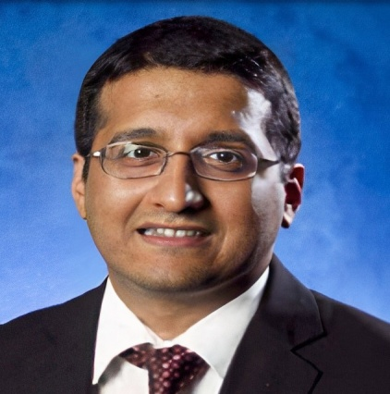




Blockchain in Healthcare
Today & Tomorrow
2022
Daniel Toshio Harrell, PhD, Research Associate, Department of Population Health, Dell Medical School, University of Texas at Austin
Open DLT for Patient Privacy Protection in the Age of Healthcare Consumerism
Sachin Shetty, Associate Director , Virginia Modeling, Analysis and Simulation Center (VMASC), Old Dominion University, and Executive Director of the Center for Secure and Intelligent Critical Systems
Moderator
Maria Palombini, Director, Healthcare & LIfe Science Global Practice Lead, IEEE SA
Sponsored by
September 15, 2022
Central Public Library
Austin, TX USA

Slide 2

Open DLT for Patient Privacy Protection in the Age of Healthcare Consumerism
15 September 2022

Slide 3



ABOUT THE IEEE
Mission
The core purpose of IEEE is to foster technological innovation
and excellence for the benefit of humanity
Vision
IEEE will be essential to the global technical community and to technical professionals everywhere, and be universally recognized for the contributions of technology and of technical professionals in improving global conditions
Collaborating and coordinating with national, regional
and international standards bodies
Global collaboration helps to ensure the coordination of standardization works and the harmonization of standards
Existing global standards jointly developed by IEEE provide solutions to industry needs, avoid unnecessary duplication
and can be leveraged for technology transfer, interoperability
and global marketability—supporting import/export
ABOUT IEEE

Slide 4

IEEE BY THE NUMBERS
400K+
160+
46+
MEMBERS
COUNTRIES
TECHNICAL SOCIETIES
& COUNCILS
1900+
5M+
ANNUAL CONFERENCES
TECHNICAL DOCUMENTS
4

Slide 5

ADVANCING TECHNOLOGY
FOR HUMANITY
ABOUT IEEE
      Inspiring a global community of innovation
      Where forward-thinking professional collaborate
      Discover what’s next in tech innovation
      Build technical communities
      Shape and share research
      Create global standards
      Engage in Humanitarian activities
5

Slide 6

To improve the global standard quality of life at every step through affordable healthcare and access to medicines; support innovation to improve overall wellness and improve societal outcomes; and to enable innovation through open and standardized means.
Visit Website
#IEEEHLS ieeesa.io/hls
1. Pharma/Biotech
2. Clinical Health
3. Global Wellness
Notes:
The IEEE SA Healthcare and Life Sciences Practice is a global platform of excellence bringing together committed volunteer stakeholders to evaluate, validate, and develop solutions for establishing trust in new technology applications that will afford the right to safety, security and protection of life.

Slide 7
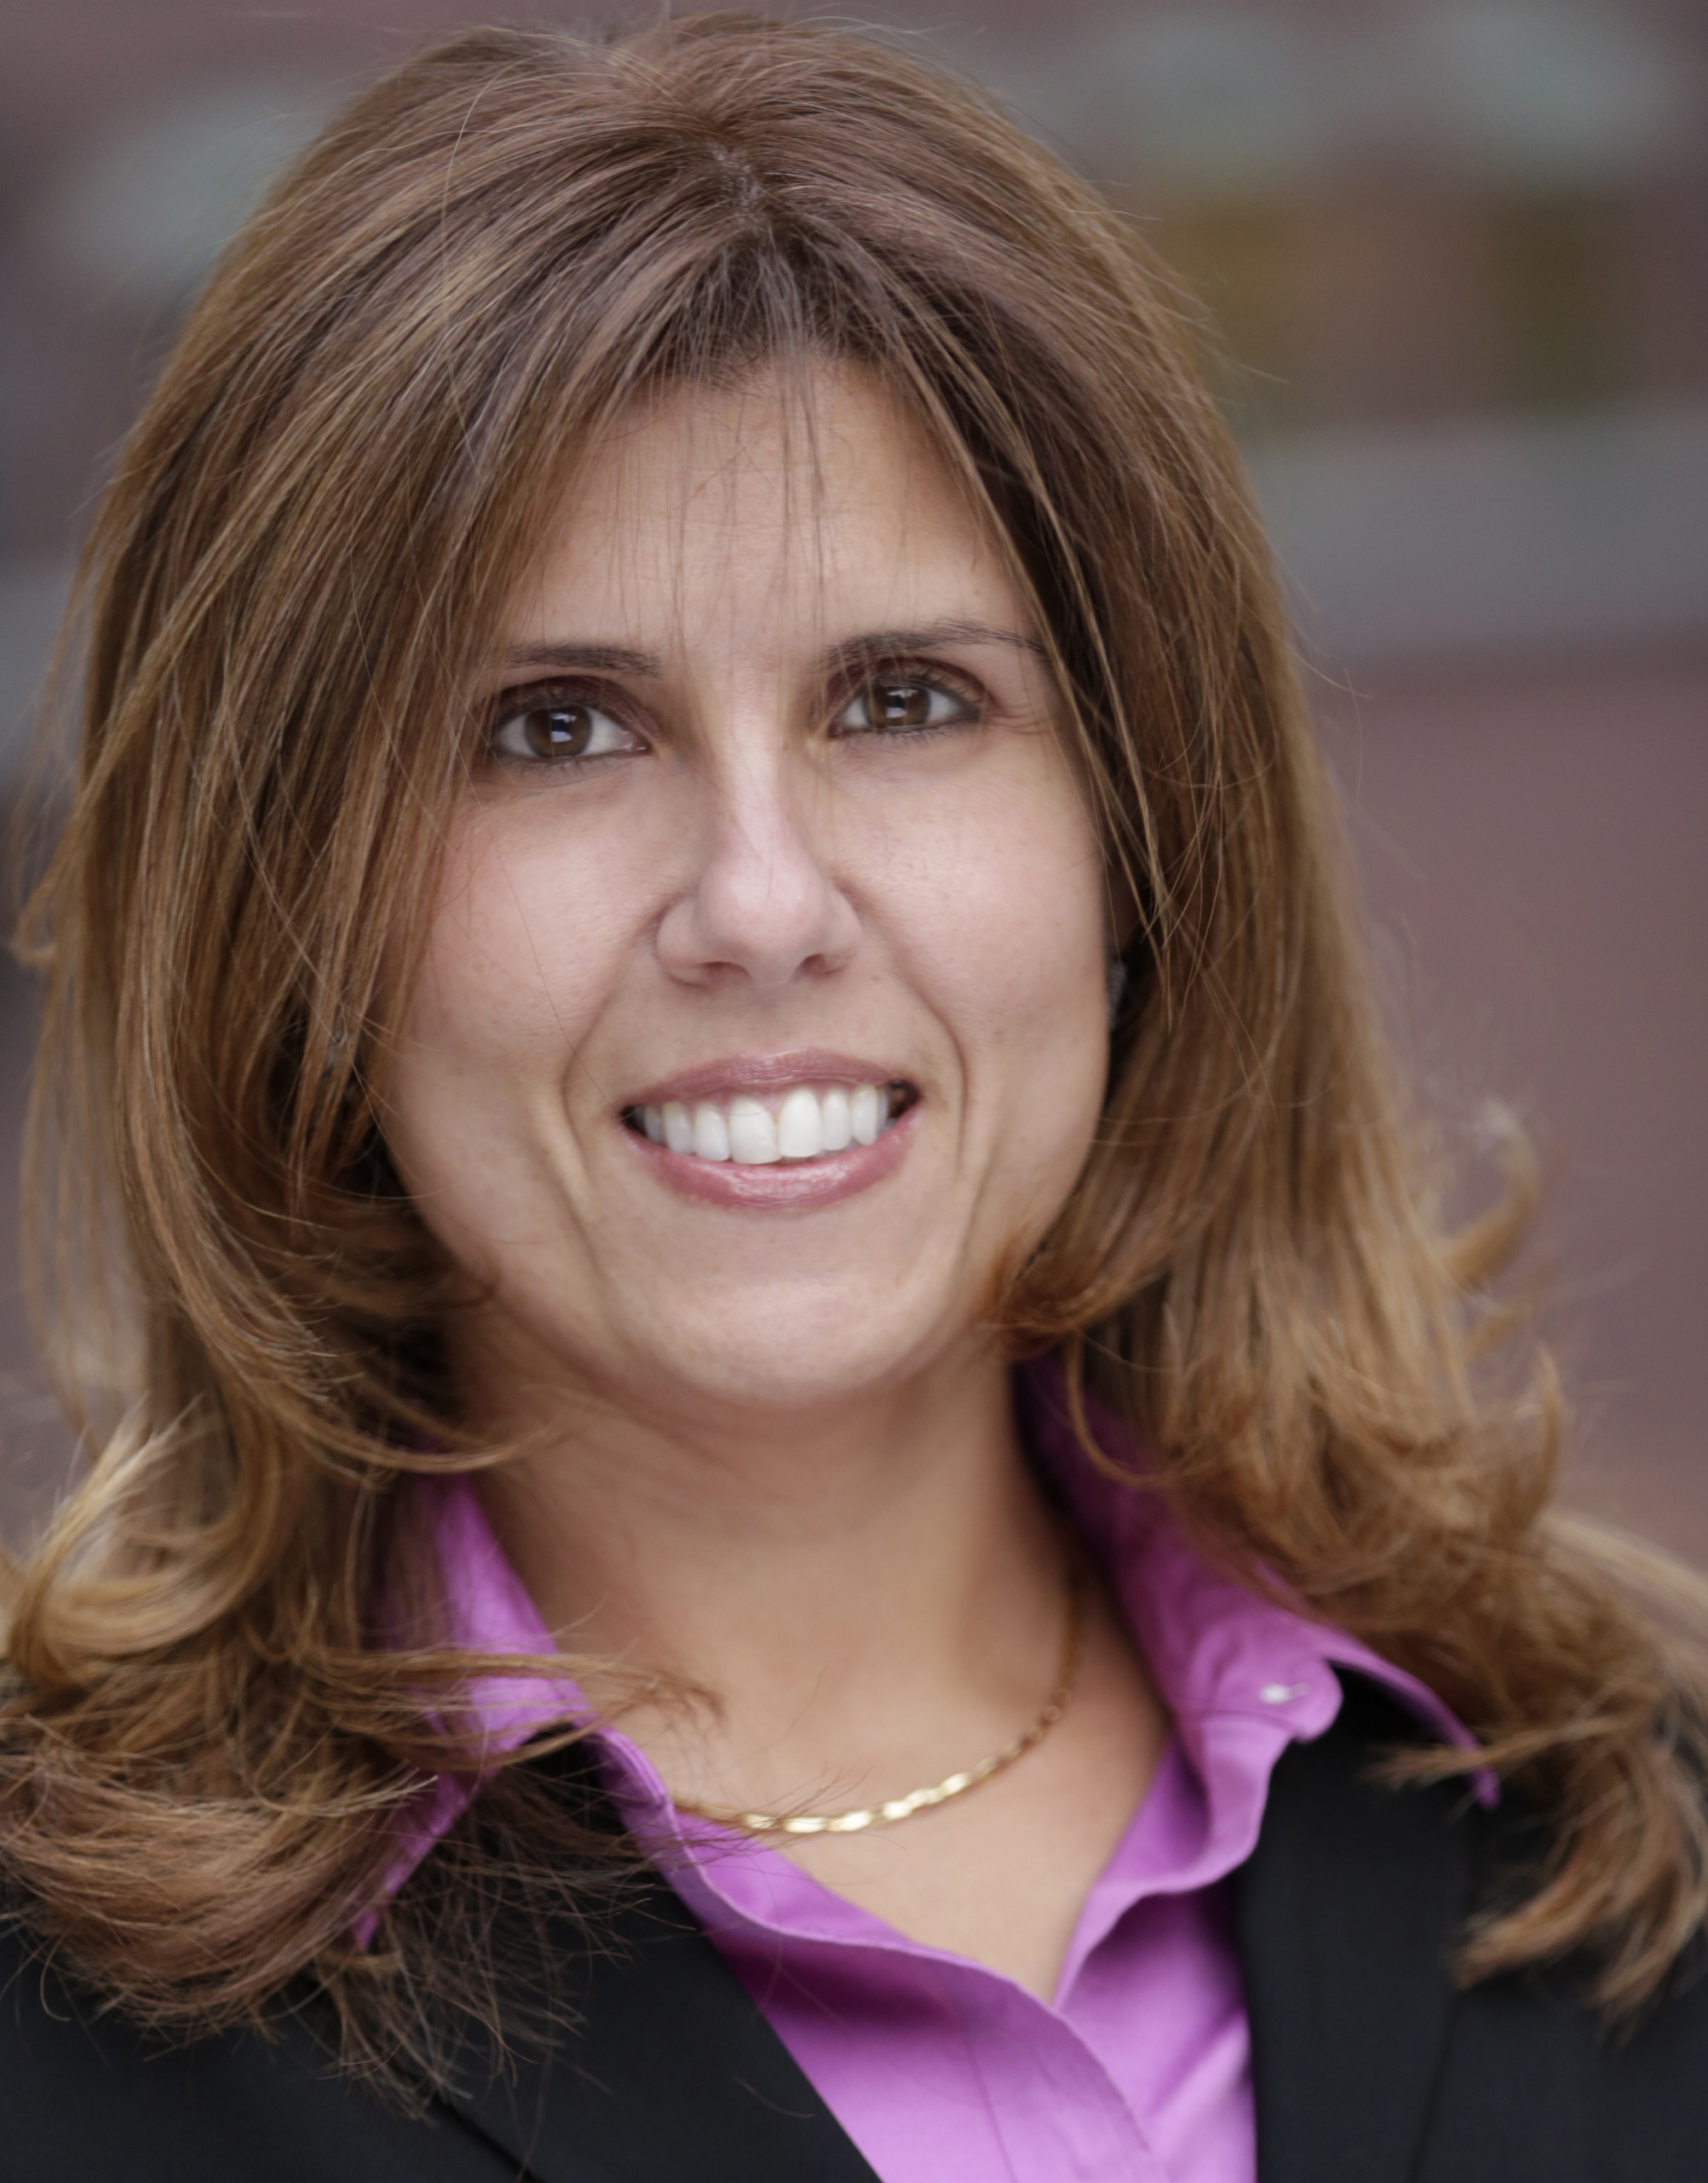
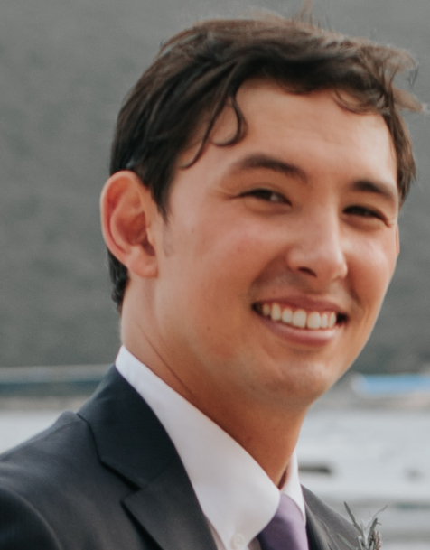
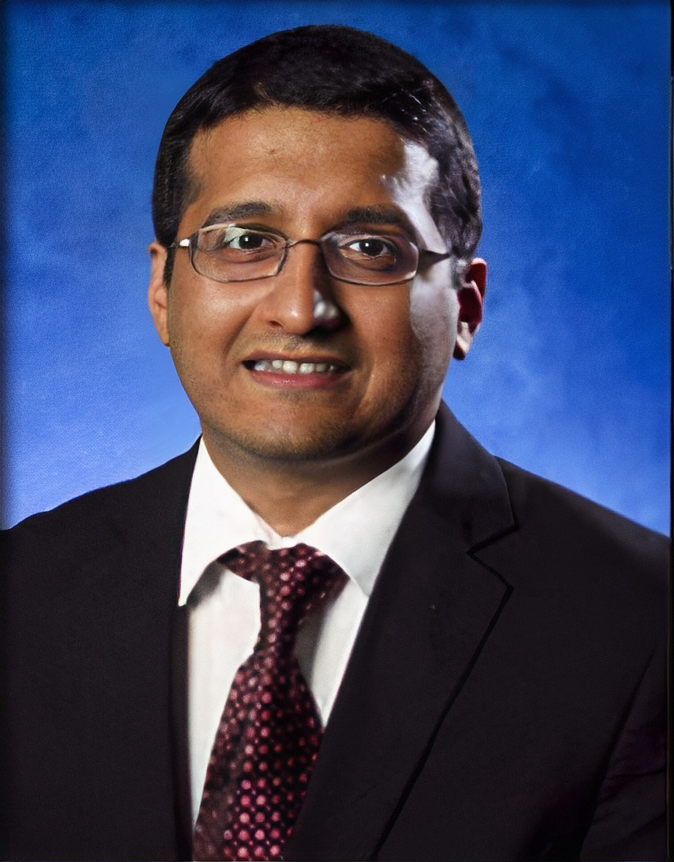
OUR EXPERT PANEL
MARIA PALOMBINI
Director, Healthcare and Life Science Global Practice, IEEE Standards Association
DR. DANIEL HARRELL
Research Engineering/Scientist Associate, Dell Medical School at the University of Texas at Austin
SACHIN SHETTY
Exec Dir. of the Center for Secure and Intelligent Critical Systems; Assoc Dir, Virginia Modeling, Analysis and Simulation Center (VMASC), Old Dominion University

Slide 8
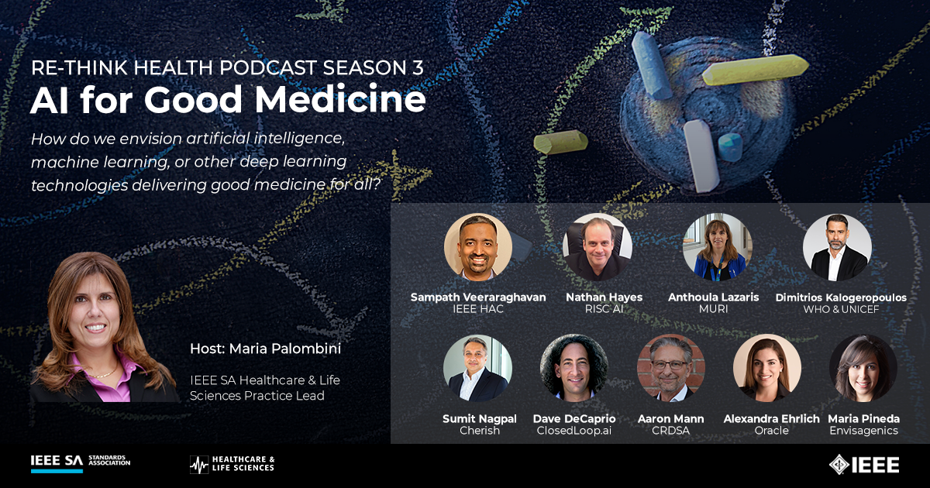
IEEE HLS Re-think Health Podcast Series
SEASON 3: AI FOR GOOD MEDICINE
Ieeesa.io/healthpodcast

Slide 9
Incubator programs– Healthcare & Life Sciences
    Technology & Data Harmonization for Decentralized Clinical Trials
    Transforming the Telehealth Paradigm
    Digital Inclusion, Identity Trust and Agency (DIITA)
    Neuro Tech for Brain-Machine Interfacing
    Ethical Assurance of Data-Driven Technologies for Mental Healthcare
    Responsible Innovation of AI in Life Sciences
    Global Initiative on Blockchain-based Omnidirectional Pandemic
    The IEEE Global Artificial Intelligence Systems (AIS) Well-being Initiative
    Synthetic Data
    Transforming Digital Personalized Medicine
    IoT Ecosystem Security
    Surveillance AI Systems for Governance for Cities
https://standards.ieee.org/industry-connections/activities.html

Slide 10
IEEE STANDARDS PROJECTS relative to topic
IEEE 11073 Suite –Health Informatics - Personal Health Device Communication - Device Specialization
P1752.1 - Standard for Mobile Health Data
P1752.2 – Standard for Mobile Health Data: Representation of Cardiovascular, Respiratory, and Metabolic Measures
P2550 - Standard for Remote Monitoring of a Neonate and the Mother Post-Partum in a Non-Clinical Healthcare Setting
P2650 - Standard For Enabling Mobile Device Platforms To Be Used As Pre-Screening Audiometric Systems
P2144.1 - Standard for Framework of Blockchain-based Internet of Things (IoT) Data Management
P2144.2 - Standard for Functional Requirements in Blockchain-based Internet of Things (IoT) Data Management
P2144.3 - Standard for Assessment of Blockchain-based Internet of Things (IoT) Data Management
P2418.1 - Standard for the Framework of Blockchain Use in Internet of Things (IoT)
P1451-99 - Standard for Harmonization of Internet of Things (IoT) Devices and Systems
https://Standards.ieee.org

Slide 11
IEEE STANDARDS PROJECTS relative to topic
P1528.7 - Guide to Assess the Electromagnetic Fields (EMF) Exposure of Internet of Things (IoT) Technologies/Solutions
P2802 - Standard for the Performance and Safety Evaluation of Artificial Intelligence Based Medical Device: Terminology
P2418.6 - Standard for the Framework of Distributed Ledger Technology (DLT) Use in Healthcare and the Life and Social Sciences
P2933 -Standard for Clinical Internet of Things (IoT) Data and Device Interoperability with TIPPSS (Trust, Identity, Privacy, Protection, Safety, Security)
IEEE 2791-2020 - IEEE Standard for Bioinformatics Analyses Generated by High-Throughput Sequencing (HTS) to Facilitate Communication
P2968.1 - Trial Use Recommended Practice For Decentralized Clinical Trials Patient Safety
P2968.2 - Trial Use Recommended Practice for Decentralized Clinical Trials Threat Modeling, Cybersecurity, and Data Privacy
      Learn more at standards.ieee.org

Slide 12
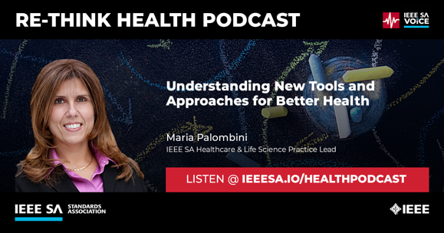
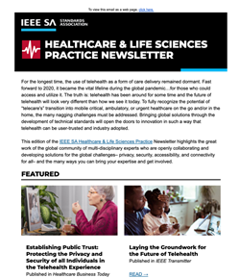

SUBSCRIBE TO THE #IEEEHLS Practice Activities
FREE SUBSCRIPTION https://ieeesa.io/hls
Exploring new tools, technologies and applications to re-think the approach to better health for all.
SEASON 2
Global Perspectives on Cybersecurity for Connected Health
Tune in @ ieeesa.io/healthpodcast

Slide 13
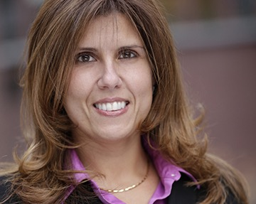
THANK YOU
GET INVOLVED:
Write about it, talk about it, develop solutions…make an impact.
MARIA PALOMBINI
Healthcare & Life Sciences Practice Lead, IEEE SA
m.palombini@ieee.org
Linkedin.com/in/mpalombini
http://ieeesa.io/hls

