Slide 1

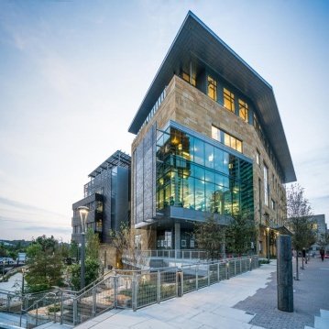




Blockchain in Healthcare
Today & Tomorrow
September 15, 2022
Central Public Library
Austin, TX USA
Why Healthcare Needs
Web 2.5 Before It Can
Adopt Web3
John Hatchell, Co-Founder and Chief Executive Officer, Tydei.io
Bart Cant, CTO, Tydei.io
2022

Slide 2


Walk Before You Run
Why Healthcare Needs Web 2.5 Before It Can Get To Web 3.0

Slide 3
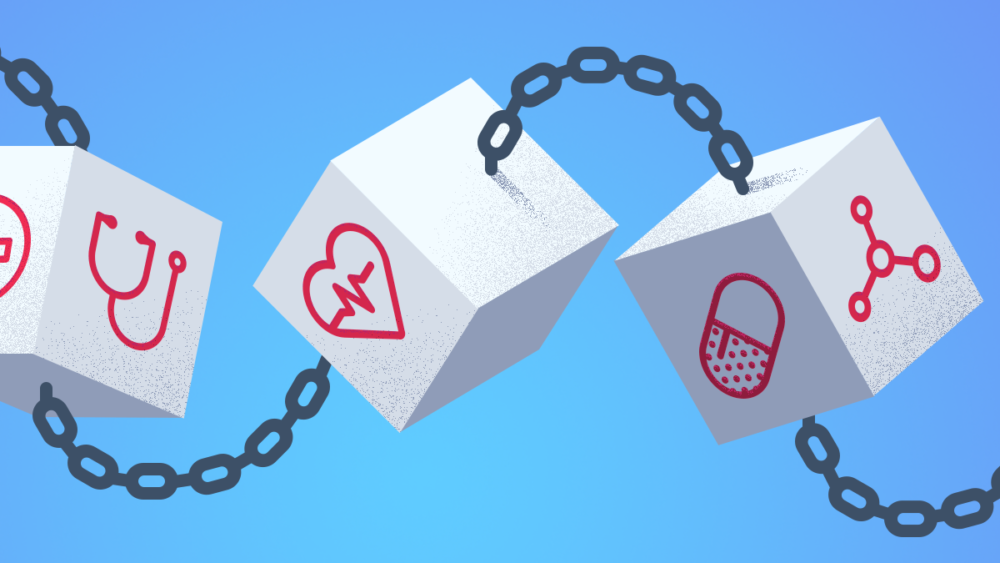
The Opportunities
Patient Records
Supply Chain
Payments
Research

Slide 4

Healthcare In a WEB 3.0 World
Lower Costs
Interoperability
Better Access To Care
Improved Efficiency
Waste Reduction
Data Ownership
Democratized Research & Trials
Transparency

Slide 5

Barriers To Adoption
Lack of technical expertise or understanding
“Players” actively try NOT to share data
Healthcare is ALREADY distributed
Key Management
Access to capital
Regulatory concerns
Intimidating

Slide 6


WEB 2.0
WEB 3.0

Slide 7

WEB 2.5 “The Island of Misfit Toys”

Slide 8
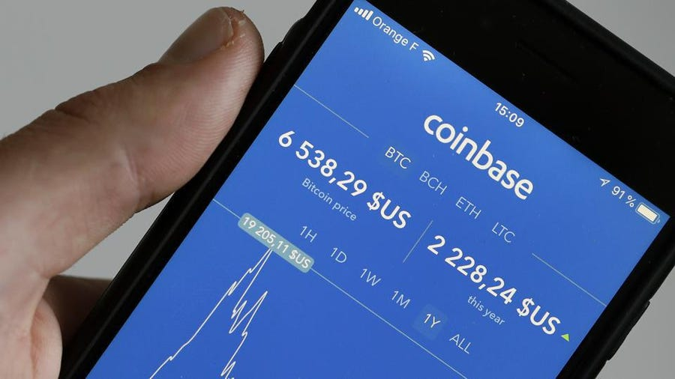
Example
Web 3.0 Assets Using
Web 2.0 Infrastructure
The ESSENCE of Web 2.5

Slide 9

Web 2.5.
What Are We Giving Up ?
Decentralization
Permissionless Platforms
Self Sovereign Identity
Fully Autonomous Organizations
Cross Platform Interoperability
What Are We Getting?
Centralization
Permissioned Platforms
Smart Contract Logic
Partially Immutable Records
Enhanced Rights & Obligations

Slide 10
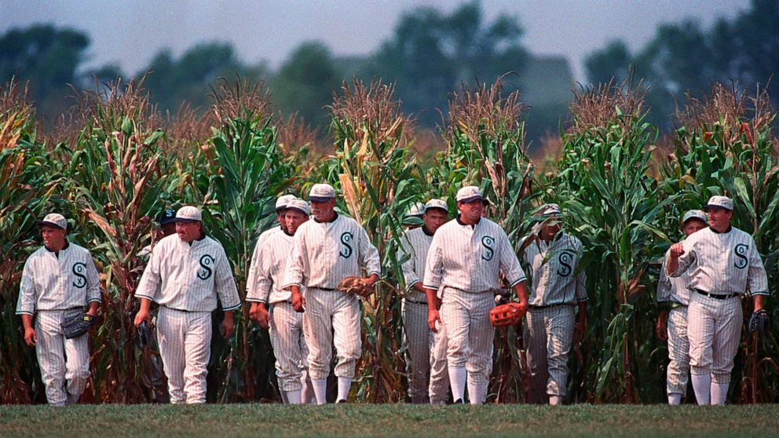
If You Build It (in web 2.5), They Will Come…
Intuitive UI
Value Added Services
Security Protection
Utilize Open Standards (e.g. FHIR)
Integrates Easily With Existing Infrastructure (e.g. EMR, ERP)
Provide Automation For Existing Processes (e.g. electronic payments)
ROI Positive

Slide 11

For The Road Ahead …
Build Community
Evangelism
Observe And Learn
BUIDL: Iterative Design and Execution
It’s a Team Sport: Collaborate

Slide 12

Panel Discussion

