Slide 1


Democratizing Patient Health Record Access
Through DLT & Token Economics
Jim Nasr, CEO, Acoer
e: jnasr@acoer.com
t: @jnasr
Last updated: SEP.15.2022
ACOER Confidential – Do Not Share or Distribute Without Explicit Written Permission

Slide 2

Vision

Slide 3

Vision: Enabling Patient Driven Clinical Research
Empower patients with the means to easily access, manage, and consent to share personal health data through simple, intuitive apps
Establish trust between patients and trial sponsors through highest security, privacy preserving, transparent infrastructure
Prove authenticity of transactions and underlying data by using Distributed Ledger Technologies (DLT) to show computational proof
Incentivize patients to stake ownership in their own health data by using Token Economics to create value and build network effect for an ethical and transparent reward mechanism
Increase reach to underserved patients for clinical recruitment by combining expertise in patient recruitment and clinical research with secure, rewarding and easy to use technology
Improve clinical study design by collaborating with researchers and offering them patient consented, privacy compliant validated real-world data at the point of study design

Slide 4
Opportunity: Connecting Motivated Parties in Orphan Drug Development
PATIENTS WITH ULTRA RARE CONDITIONS
88% of rare disease patients willing to engage with an investigational treatment
7000 rare diseases impacting 460m people globally
Patients with ultra rare conditions most motivated to contribute to research and help develop therapies
Patients with these conditions are isolated in healthcare, form communal clusters, and are knowledge about their disease
More likely to have chronic co-morbidity
DRUG DEVELOPERS
Only 25% of rare diseases have an FDA approved treatment
Ultra rare disease drugs 23x more expensive than traditional drugs
$262bn worldwide orphan drug sales forecast by 2024
12% of rare disease trials fail or do not retain patients due to lack of efficacy
50% of rare disease trials fail because of lack of accrual to meet enrollment deadlines and requirements

Slide 5
HealthReady Platform
INTEROPERABLE
FAST
The platform uses the latest machine-readable data standards to collect, store and share medical records. Fast Healthcare Interoperability Resources (FHIR) standards have been implemented to enable API based access and exchange of health data with thousand of health data providers.
The platform has a modern architecture, is scalable on demand and is ready to support millions of patients.
SECURE
TRANSPARENT
HealthReady adheres to the Health Insurance Portability and Accountability Act (HIPAA) and provides all users with HIPAA compliant storage. All medical records are stored by a dedicated data provider protecting sensitive personal and health information.
The platform uses a public Distributed Ledger Technology (DLT), called Hedera Hashgraph, to transparently verify patient data transactions, prove active patient consent and provide a means for token economics to incentivize participation.

Slide 6

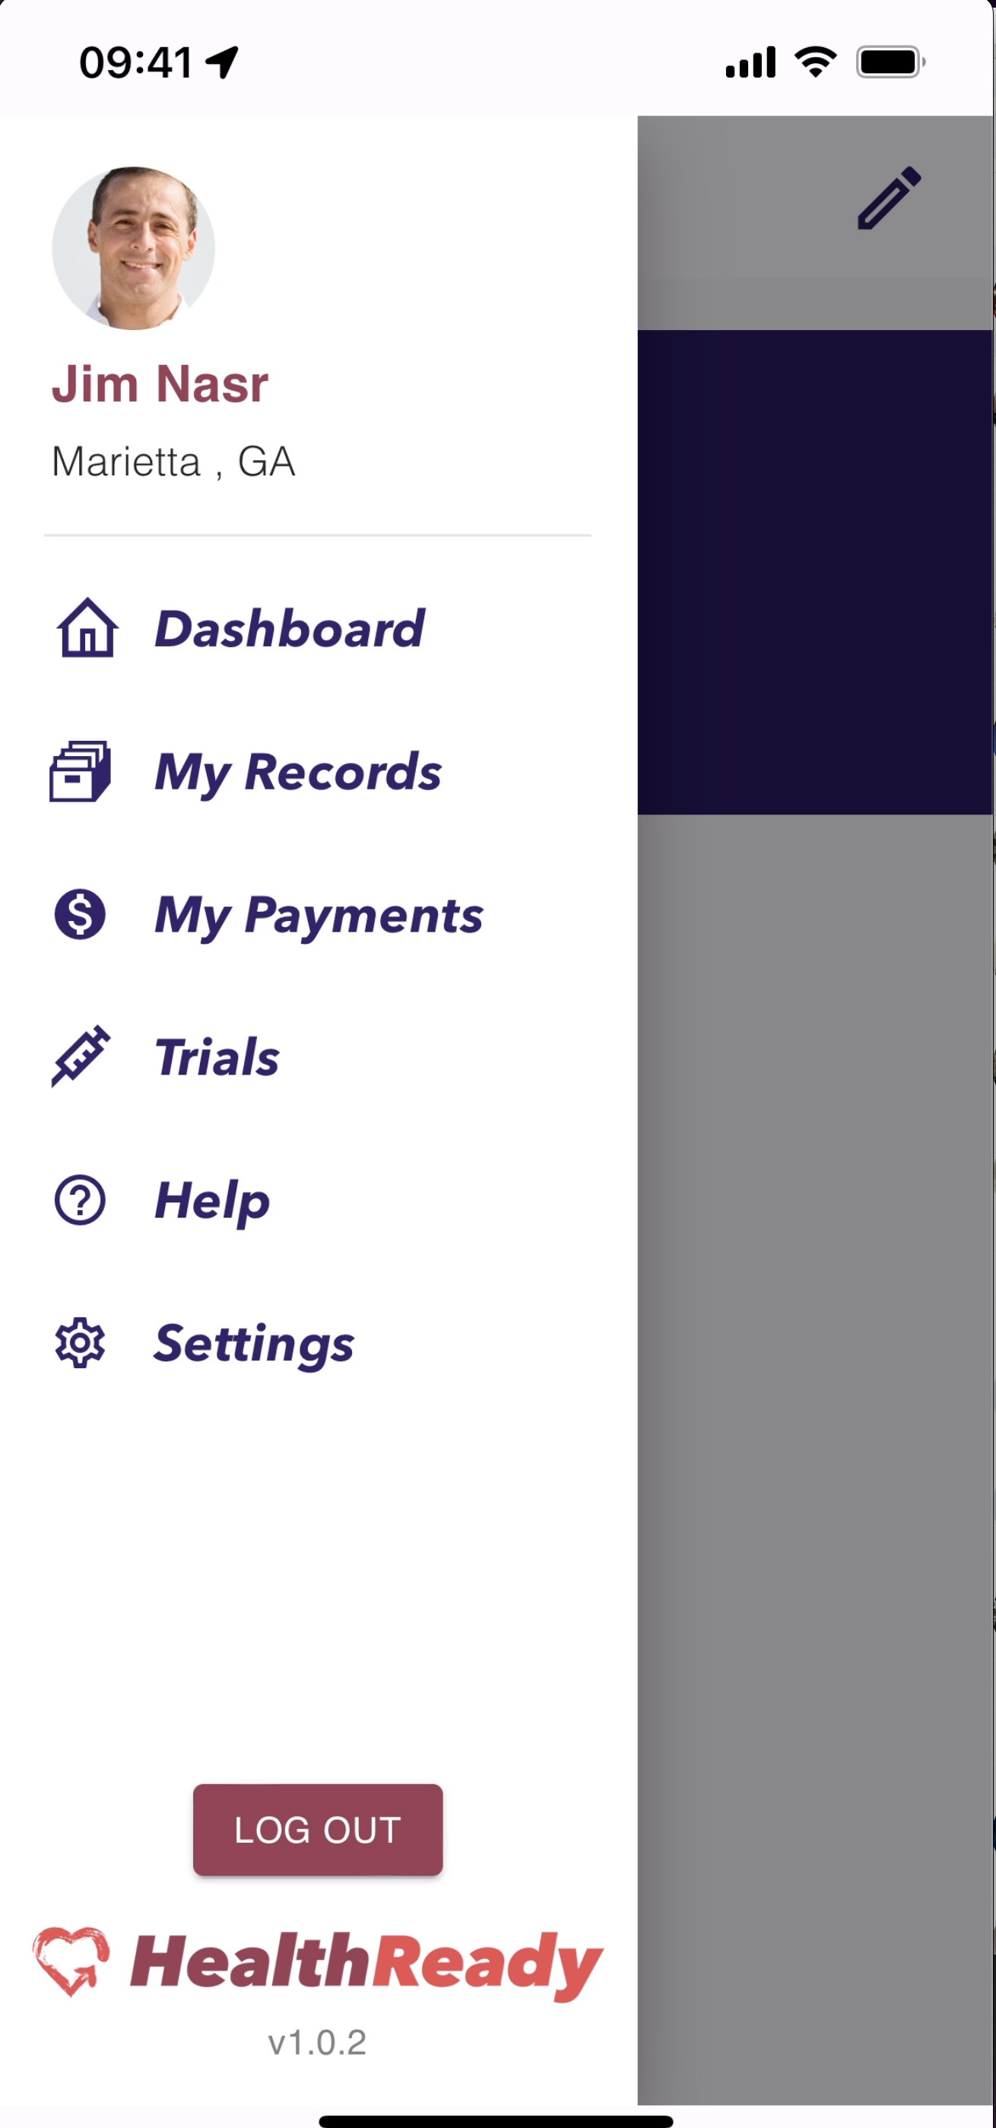
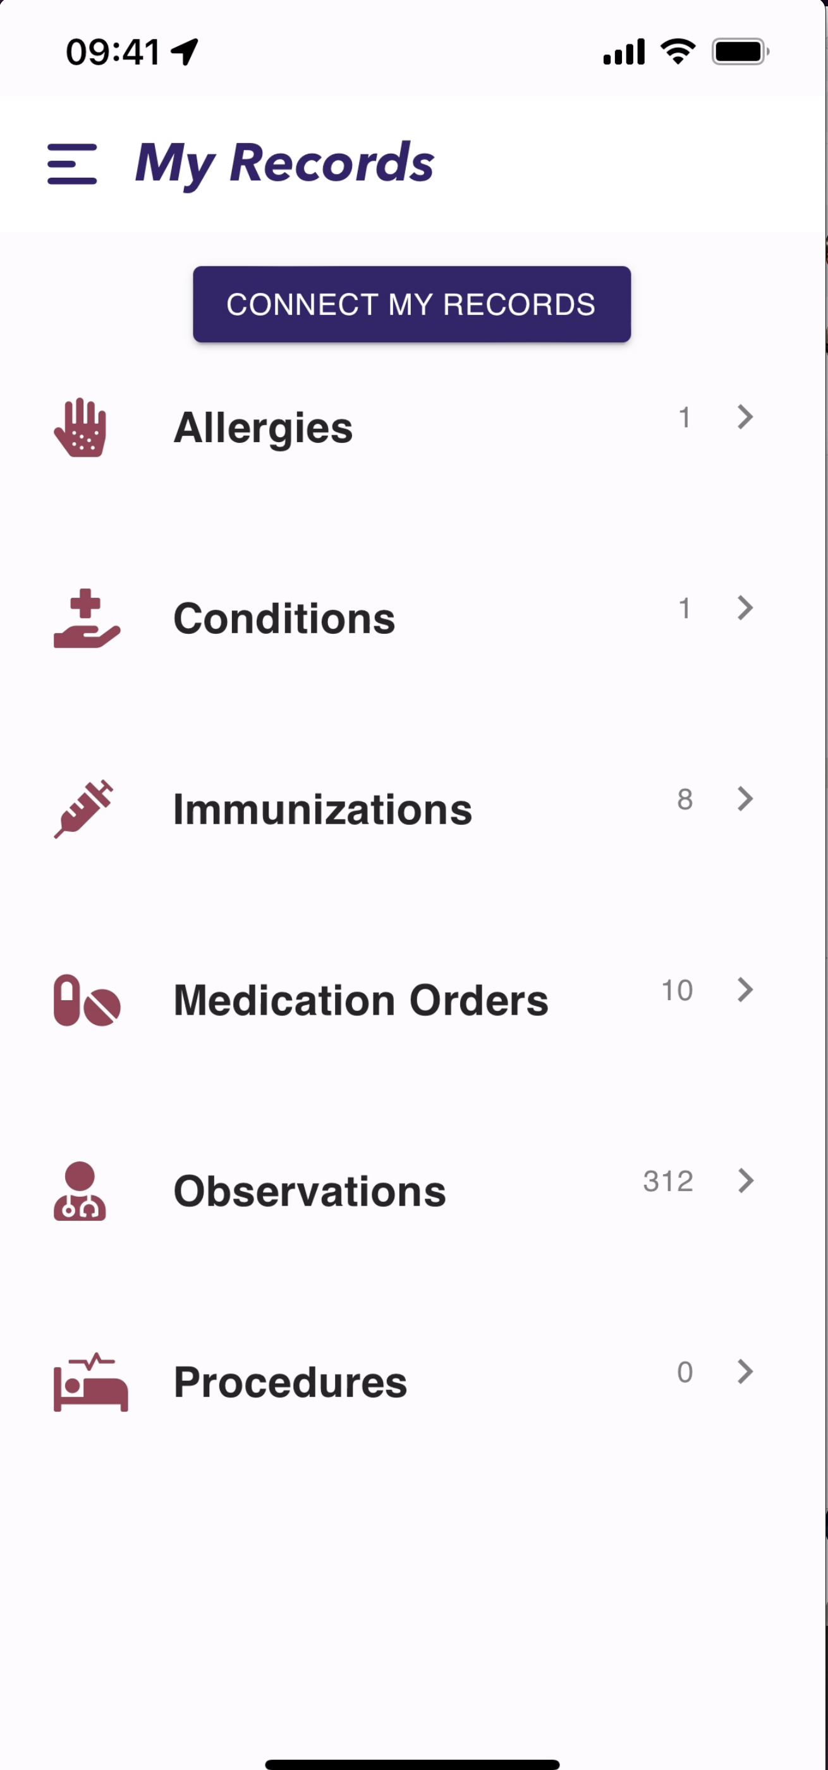
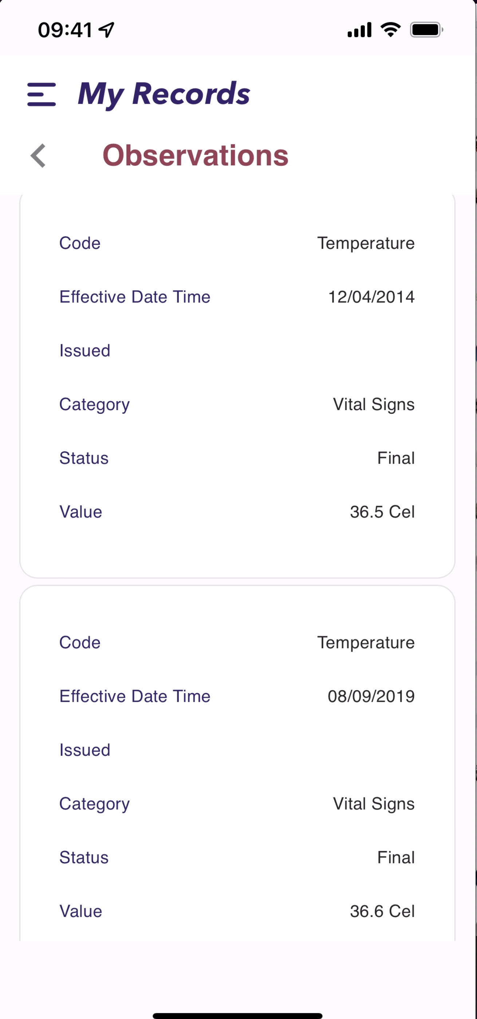

HealthReady App at a Glance
Blockchain Data Stamping and NFT Consent Tracking “behind the scenes” to prove authenticity and active consent
Signed JSON Web Tokens
Data Stamping APIs
Consent Tracking

Slide 7
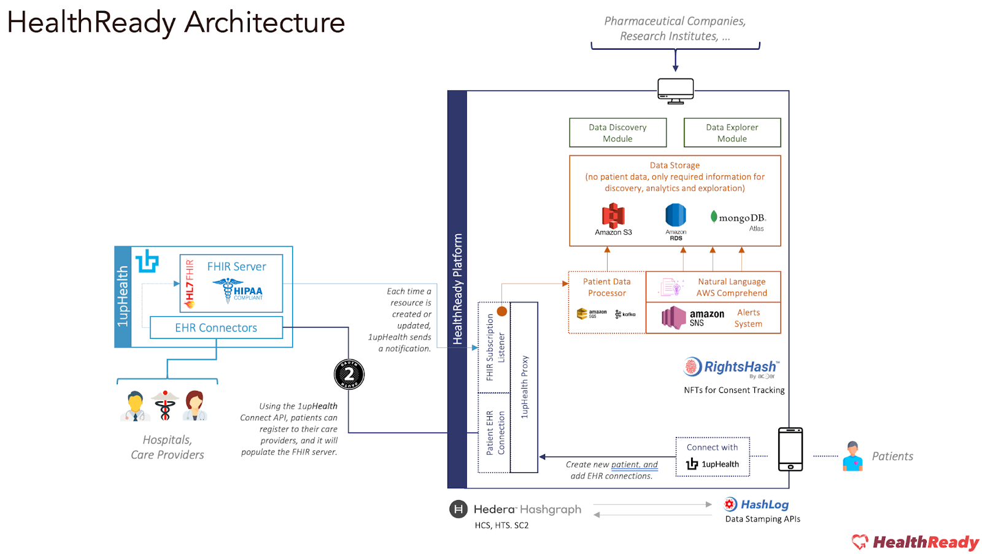
HealthReady Architecture

Slide 8
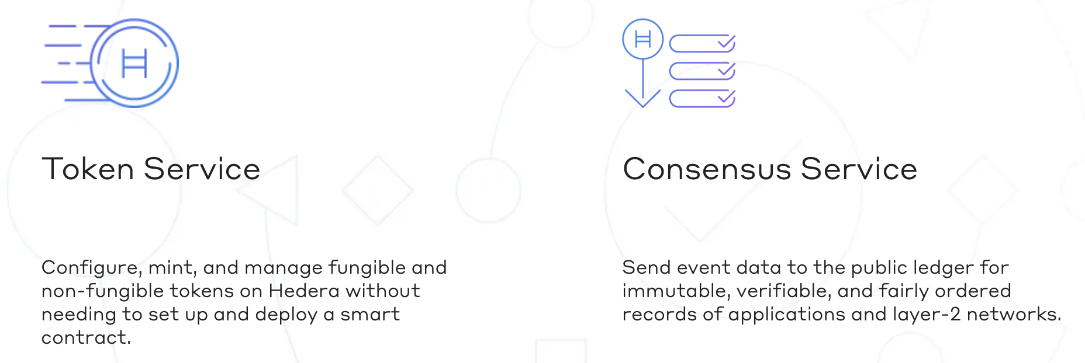

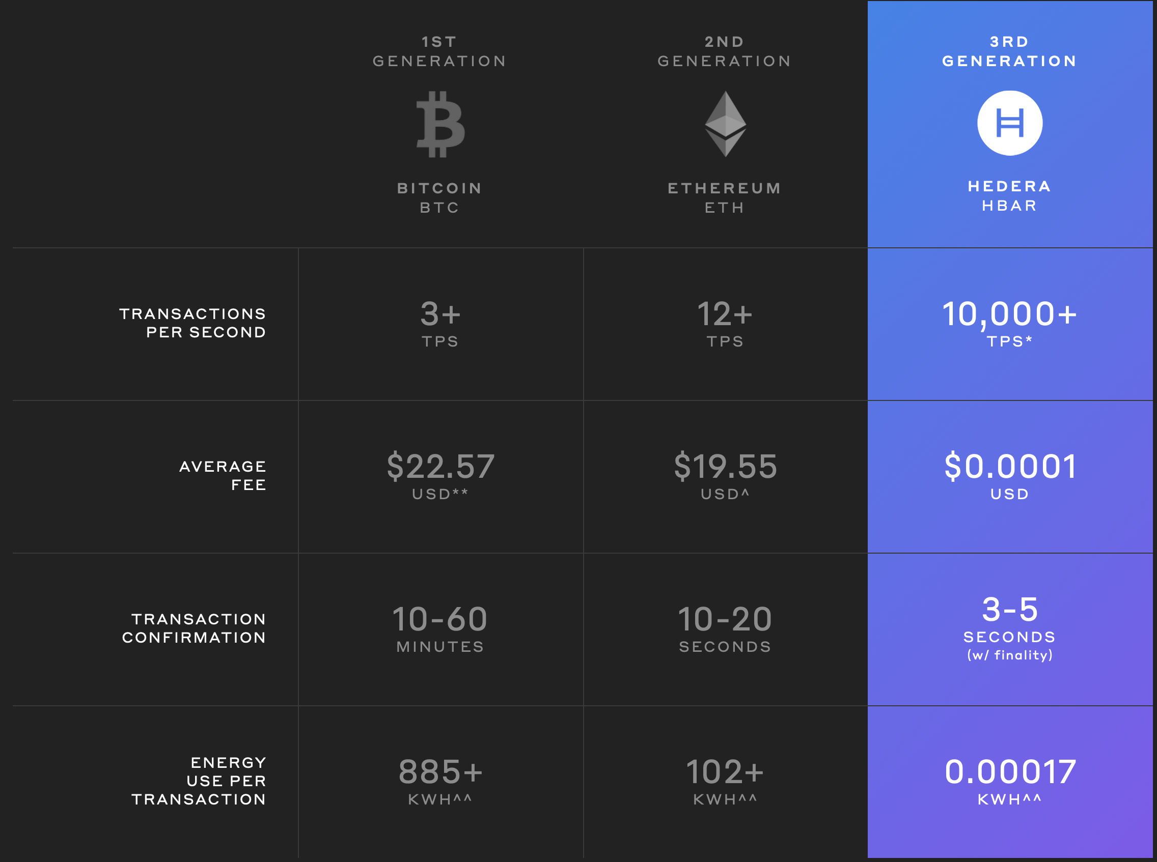

Why Hedera
Economic Viability (mostly in small fractions of $)
Stablecoin Pricing (fees based on $USD)
Real-time Performance (3-5 seconds to finality)
Rich Platform Services (native token services, fast smart contracts)
Highly Scalable (1000s of tps)
Most Sustainable (energy consumption even below VISA)
Next Generation Public DLT (optimal consensus, layer 1)
Accountable Governance (Governance Council of top organizations managing network and open-source code)

Slide 9
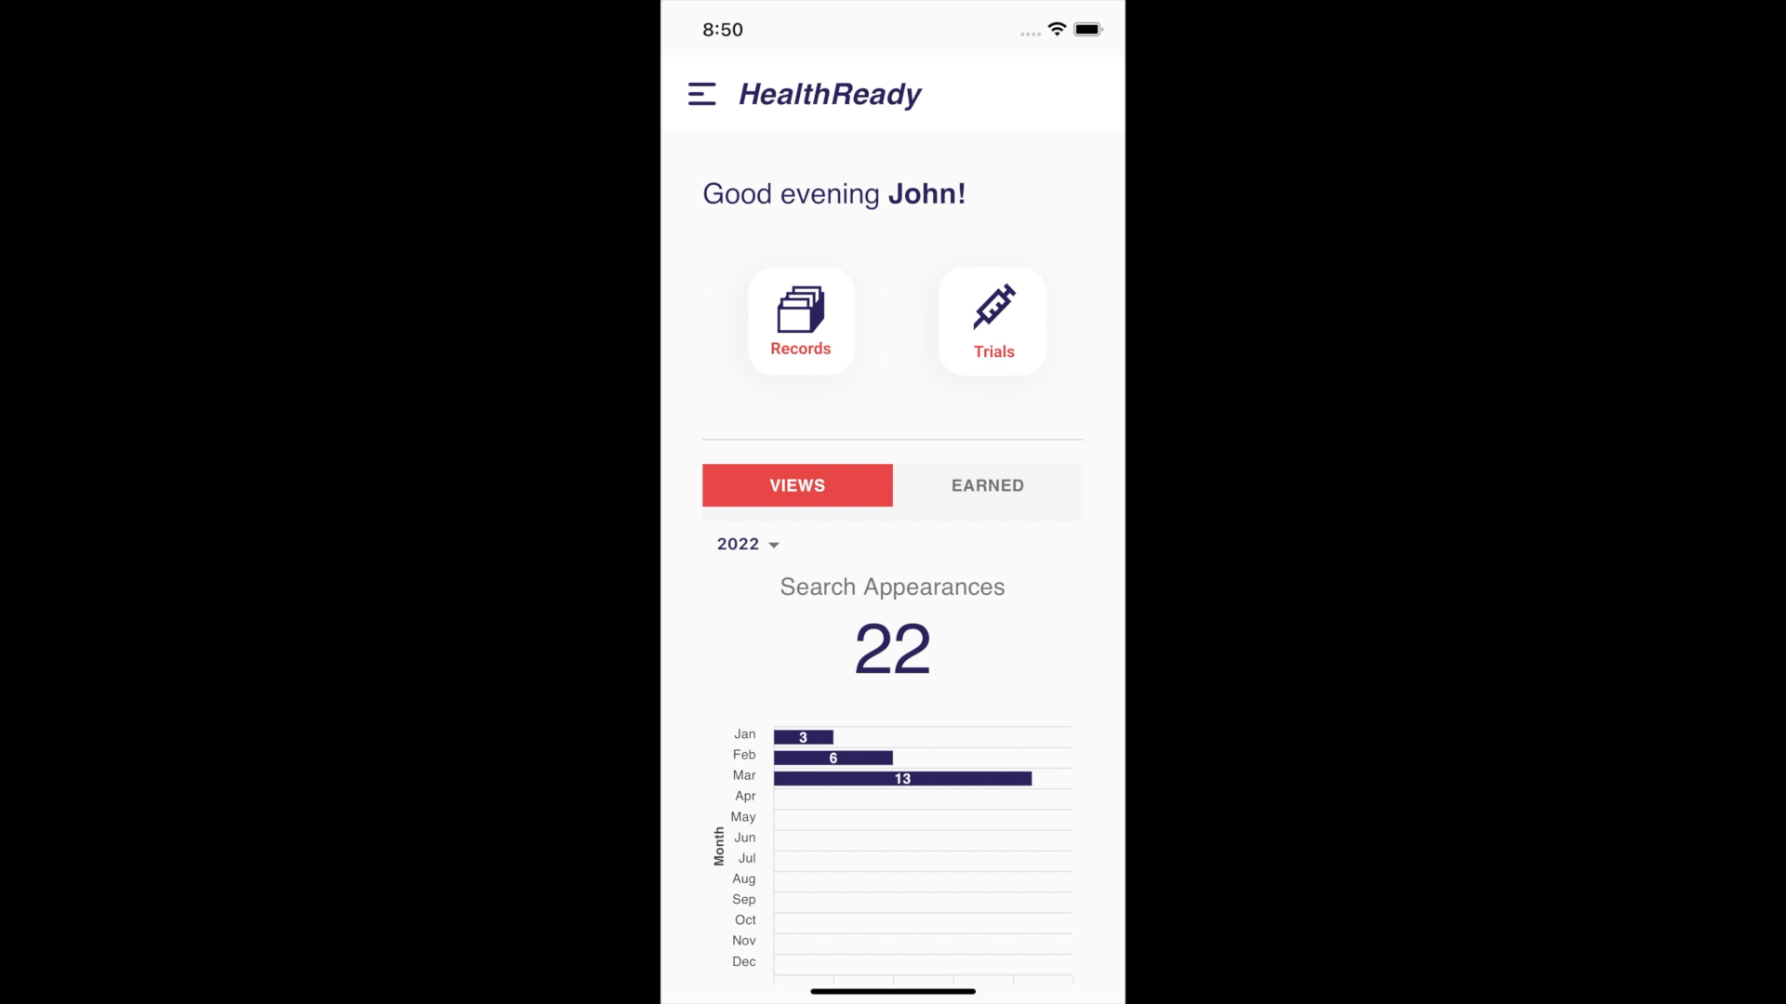
App Demo

Slide 10
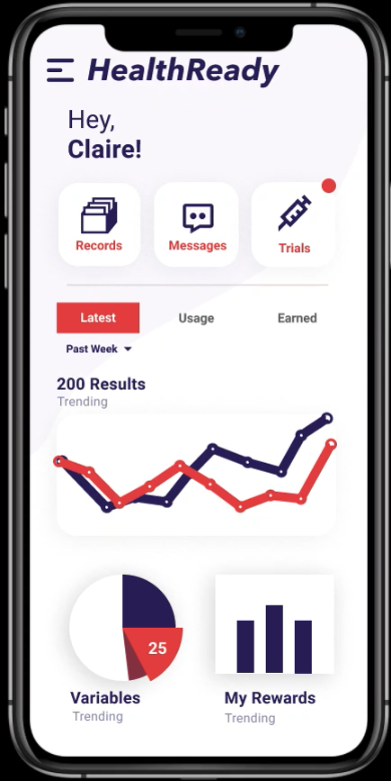
Token Reward System

Slide 11

Reference
Jim Nasr, CEO, Acoer
e: jnasr@acoer.com
t: @jnasr
www.acoer.com

Slide 12
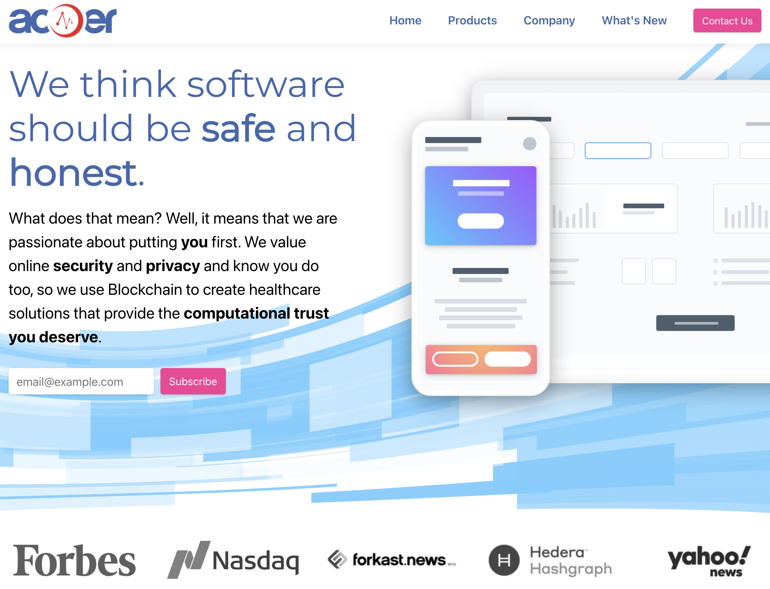

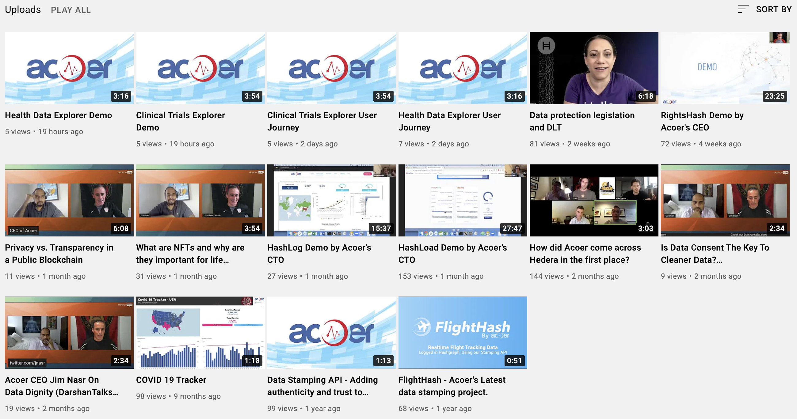

Who is Acoer?
Software development firm
  DNA: Usability first, Real-time data, Interoperable, Secure, Privacy-preserving
Building Blockchain-enabled technologies to protect consumer digital rights
  Industries: healthcare, life sciences, public health, publishing
From the creators of OpenCDC and numerous other large-scale healthcare applications and platforms
  Jim Nasr, CEO. Formerly CDC Chief Software Architect
  Ben Chevallereau, CTO. Formerly lead developer on numerous open-source initiatives
acoer.com
Demos on Acoer YouTube Channel:

Slide 13

Featured on…

Slide 14
Questions?
Jim Nasr, CEO, Acoer
e: jnasr@acoer.com
t: @jnasr
www.acoer.com

