Slide 1

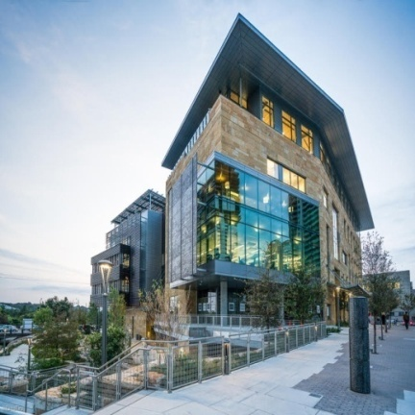
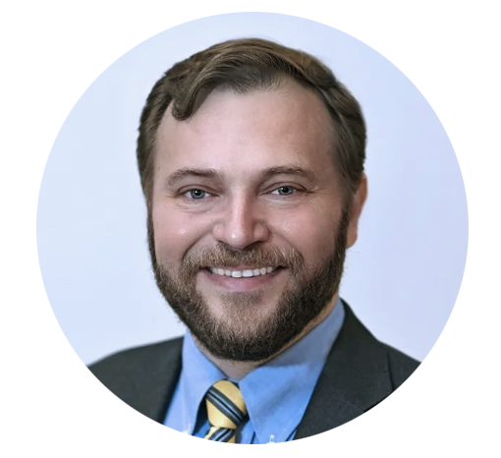



Blockchain in Healthcare
Today & Tomorrow
Symposium
September 15, 2022
Central Public Library
Austin, TX USA
DISTINGUISHED KEYNOTE SPEAKER
James Hury III
Deputy Director & Chief Innovation Officer
NASA HRP
2022

Slide 2

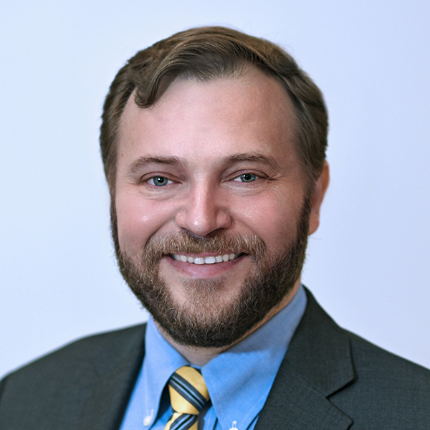
THE FUTURE OF HEALTH
DRIVEN BY
SPACE EXPLORATION
James Hury, MBA
Deputy Director & Chief Innovation Officer
Translational Research Institute for Space Health (TRISH)

Slide 3
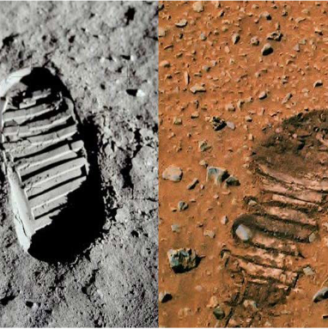
TRISH MISSION
Relentlessly seek and support high-impact scientific, technological, clinical, and psychological advances that will enable any human to explore space safely.
COMPLEMENTING NASA’S EFFORTS
NASA
Steady Progress
in reducing space
health risks
TRISH
Risk taking
for potential
GIANT LEAPS

Slide 4
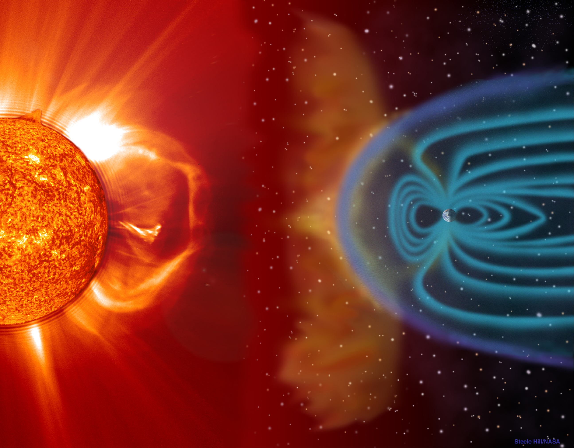
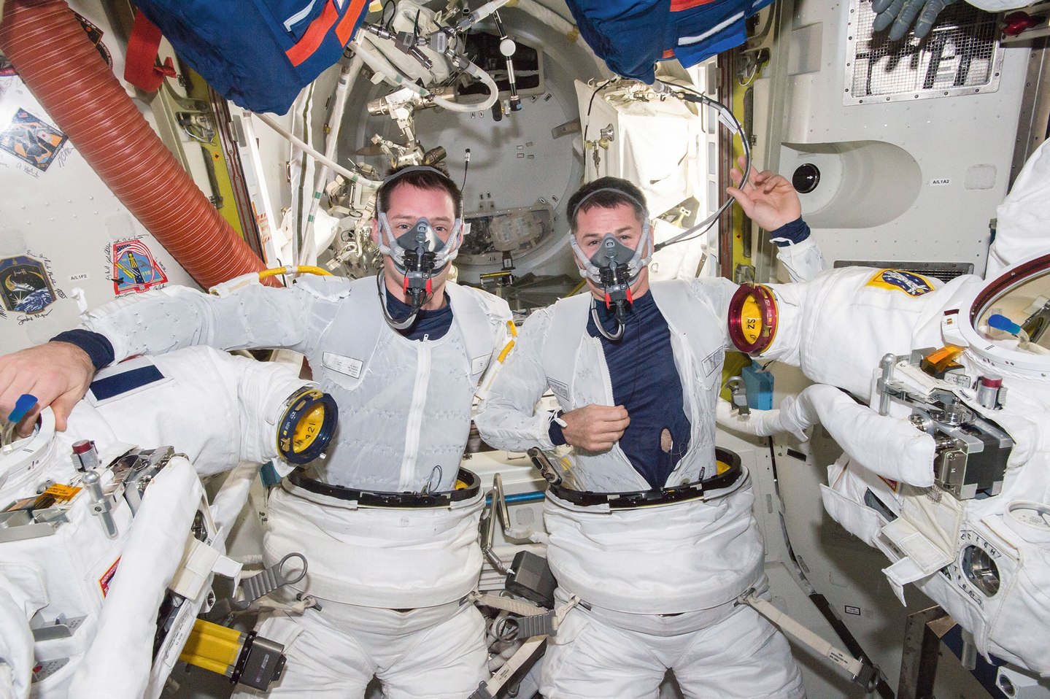
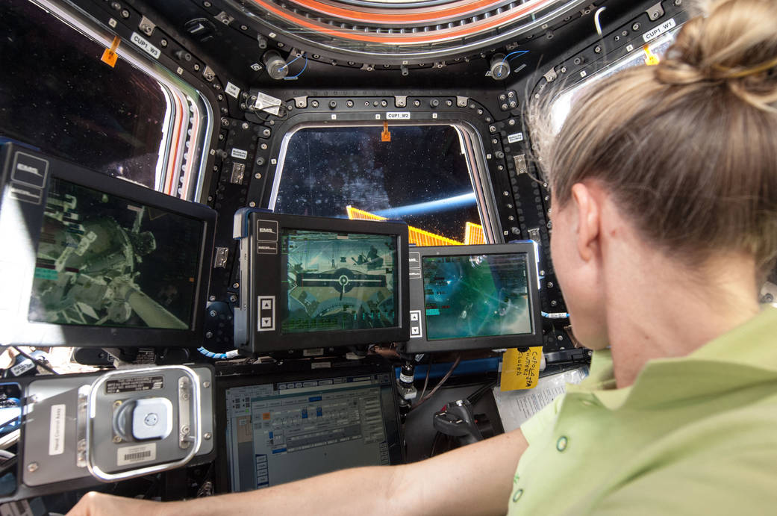
The Hazards of Human Spaceflight
(Operational)
SPACE ENVIRONMENT
Altered gravity fields
Radiation
Vacuum
Debris
SPACEFLIGHT MISSION
Distance from Earth (communications)
Circadian misalignment
Space Motion Sickness
Launch and re-entry
SPACECRAFT ENVIRONMENT
Isolation and confinement
Hostile closed environment
Noise and vibration
Waste production

Slide 5




Every Human System is Affected in Space
BONE
Bone mineral content
Bone mineral density
Urinary calcium
Renal stone risk
VISION ALTERATIONS
Globe Flattening
Optic Disc Edema
Vision Changes
CARDIOVASCULAR
Fluid volume
Orthostatic tolerance
Aerobic capacity
Arrhythmias
SKELETAL MUSCLE
Skeletal muscle mass
Skeletal muscle strength
Skeletal muscle endurance
GASTROINTESTINAL/PHARMACOKINETICS
GI motility and PK
PSYCHOSOCIAL
Confinement issues
Team issues
Fatigue
Stress
Cognitive Function
NEUROSENSORY
Space motion sickness
Vestibular disturbances
Sensorimotor function
Postural & locomotor stability
ENVIRONMENTAL
Radiation Exposure
Risk of cataracts/cancers
Hearing loss
Skin irritations due to microbial growths

Slide 7
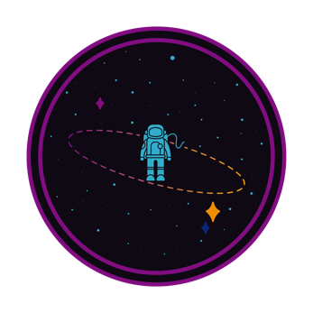
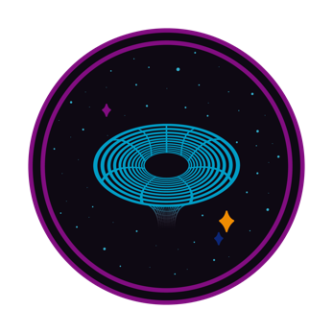
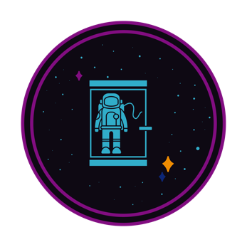



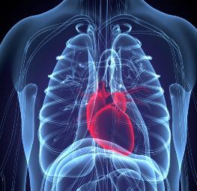



Needs for Space Health Drive Innovations
HOSTILE & CLOSED
ENVIRONMENTS
DISTANCE
FROM EARTH
ISOLATION
GRAVITY FIELDS
RADIATION
TRANSLATE THESE TO APPLICATIONS FOR HEALTH ON EARTH
MENTAL HEALTH
BONE & HEART HEALTH
NUTRUITION & NEW MEDICAL MODELS
AUTONOMOUS HEALTHCARE
CELLULAR & GENETIC REPAIR

Slide 8
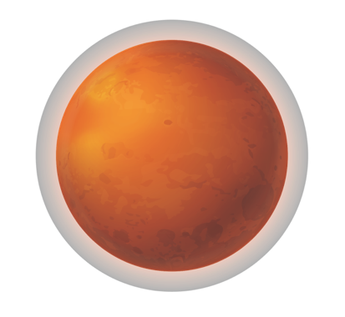

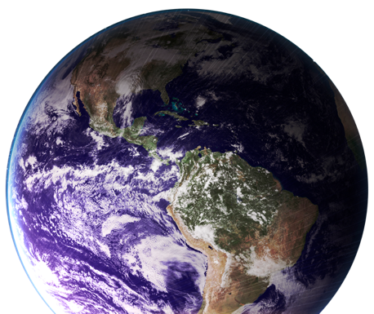
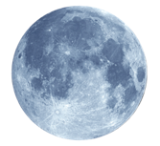
WHAT DOES TRISH FUND?
TRISH provides non-dilutive federal grant funding
TRISH supports the development of health technologies and knowledge for:
NASA’s Missions to the Mars system
NASA’s Artemis Program
Commercial Spaceflight Support
2030s
Reaching Mars Orbit
2.5-year mission
Very limited mass, power and volume
2020s
Lunar Vicinity
10-20 day missions
NOW
Advancing technologies, discovery and creating economic opportunities
Orbital and ISS
3–10 day
missions

Slide 9










EXPAND: Commercial Spaceflight Research Program
  Only non-government commercial space human research program & database
MULTIPLE FLIGHTS & PROVIDERS
USABLE DATA & NEW TECH
RESEARCHERS
SPACE AGENCIES
NASA
PRACTICIONERS

Slide 10
The Space Population Will Change
2021
≈2041
Source: Harvard Business Review. The Commercial Space Age is Here. 2021
Notes:
Unhealthy people in unhealthy environment.
Timeline, currently, in the future (year).

Slide 11

Inspiration4 Research
  BCM Biobank for participant specimen storage of pre/post samples
  TRISH supported four projects:
    Cognitive assessment via Cognition, Health vitals - pre/in/post flight
    Ultrasound scanning via Butterfly IQ+ pre/in/post flight
    Real-time blood analysis via point-of-care device - pre/in/post flight
    Pre- and post-flight sensorimotor testing
+
CURRENT FLIGHTS
PLANNING DISCUSSIONS

Slide 13

Resources to support future Space Research: NFTs!
Inspiration 4 flight data was given to a leading digital artist named Refik Anadol. A Studio minted NFTs from the art produced by Refik.
5,200 NFTs sold for $5.2M
$1.5M to St. Jude’s as the stated philanthropy focus
BCM/TRISH received $700k of proceeds of sales past expenses
No federal funds were used
All data is deidentified and destroyed after the drop
Make Space accessible to all

Slide 14


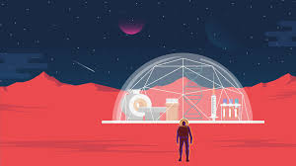
Blockchain Application in Space Research
Personalized Medical Records
  Astronaut results for posterity
Transparent Clinical Trials
  Coordinating research across participants, vehicles, and experiments
  Trial X
Secure interoperability
  Future focus: Medical hub with data coordination
  Future focus: Data transfer with data delay from Mars

Slide 15

Do you see some way that Blockchain can help our astronauts?

Slide 16

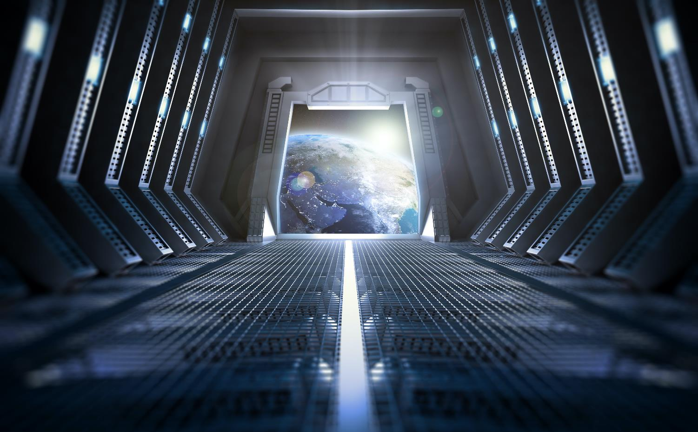
Thank You!!!
Spacehealth-info@bcm.edu
James Hury
Deputy Director, Chief Innovation Officer

Slide 17
Funding Opportunities with TRISH
Normal Grant process
BRASH: for Disruptive-Long Range
INDustry: for NASA Artemis missions
DIVersity: Underrepresented researchers
SHERPA: partnership grants
Catalyst: Catchall for space health
PostDoc Program
Clinical Research program
Commercial Spaceflight
Expand Funded PI – research in flight
Technology - facilitate research in flight
Partnerships

