Slide 1
Privacy-Enhancement with Blockchain
5th Annual #ConV2X Symposium - 2021
Halid Kayhan | Co-lead for Regulatory, Legal and Data Privacy Framework

Slide 2






























PHARMALEDGER IN A NUTSHELL
Who? Pharmaceutical companies, hospitals, universities, patient organizations, tech companies... building an ecosystem!
Why? To empower patients, increase digital trust, enable medicine drug traceability and data privacy, and foster a new culture of collaboration in healthcare.
What? A blockchain-based platform proven through reference use cases in supply chain, clinical trials and health data. A governance function for sustainability and legal, regulatory and data privacy compliance.
How? A public-private partnership of like-minded, collaborative partners working together and engaging patients, HCPS, regulators, other IMI projects and 3rd parties through several communication channels.
Duration 3 years Jan 20 – Dec 22 | Consortium 29 partners | EEAB External expert advisory board 10 members
Budget 22 million Euros | Focus Areas Supply Chain, Clinical Trial, and Health Data | Ethics Board 6 members
Notes:
Adiciionar as logos

Slide 3



















THE PHARMALEDGER CONSORTIUM
29 Members – 9 EU Member States, Switzerland, Israel, UK and USA
12 EFPIA members (ABBV, AZN, BAYER, BI, GSK, JANSEN, MSD, NOVO, PFE, ROCHE, UCB, NVS)
5 SMEs – Blockchain/ICT (RMS, PDM, AVO, TVS, EKN)
4 Research Centers & Tech. Universities v (UPM, CERTH, ICSI & DUT)
1 Social & Legal sciences research centre (KUL)
2 patients organizations (EPF, EFGCP)
1 government authority (INCM)
1 CRO (ONO)
3 hospitals (OPB, HES, UKW)

Slide 4

PHARMALEDGER OBJECTIVES
Propose an integrated health data marketplace and a collaborative platform.
Allow security of information and greater access across use cases.
Develop a scalable, sustainable, beyond-state-of-the-art blockchain reference architecture validating three prioritized business use cases from different healthcare domains involving key healthcare ecosystem stakeholders
Enable agile and secure delivery of innovative applications.
Provide a legal and ethical framework to ensure regulatory compliance.
Patient empowerment
Through self-sovereignty in a data marketplace
Define and formalize an effective governance for a sustainable PharmaLedger framework.
Ensure privacy and confidentiality of PharmaLedger data and transactions
Supply chain transparency
through traceability and interoperability
Clinical trial efficiency
through data provenance and digitization

Slide 5

PROJECT ORGANIZATION & GOVERNANCE
EU & EFPIA
(Innovative Medicine Initiative)
External Expert Advisory Board
Project Management Board
Project Leader: NVS | Coordinator: UPM
Ethics Board
Steering Committee
Project Management Board + Work Package Leaders + Scientific & Technical Managers
WP1
Business Use Cases
(MSD & UPM)
WP2
Implementations & Solutions
(ABBV & PDM)
WP3
Architecture & Reference Implementation
(NVS & RMS)
WP4
Governance
(PFZ & AVO)
WP5
Regulatory, Legal & Data Privacy
(NOVO & KUL)
WP6
Culture & Adoption
(NVS & TVS)
DRA1 | Supply Chain
J&J, Bayer & PDM
DRA2 | Health Data
UCB & UPM
DRA3 | Clinical Trial
UCB & ONO, OPGB, BI
Scientific Manager
CERTH
Sustainability & Innovation Manager PFZ
Ethical / Legal Manager
NOVO & KUL
Dissemination & Communication Manager TVS & NVS
Technical Manager
NVS & RMS
General Assembly
One representative from each consortium member entity

Slide 6
PHARMALEDGER PLATFORM OVERVIEW
Applications
Use Cases
Use Cases
ePI
Clinical Trial
Finished Goods
Others…
Legacy Systems, Systems of Records etc.
Edge Devices (Mobile Apps, IoT, WebApps)
Applications
Integration
APIs, Adapters etc.
Identities
EPCIS
Consent
Others…
Bridges between Application and Blockchain platform
Abstraction layer for Applications
PharmaLedger Platform
Web APIs / SDKs
APIs / Adapters / Integrations
DSU
Data Sharing Units
Encapsulates Data and Business Logic (code)
Build-in Data Privacy and Confidentiality
Enables secure sharing
Product
Batch
Profile
Health Data
Others…
OpenDSU APIs & Adapters
Off-chain Storage (Data Sharing Units)
Anchor
Hashlinks, Versions
UC1: ETH
Link the DSU in Blockchain
Guarantees integrity, traceability, provenance, immutability
Finished Goods
Company Ledger
UC2: HLF
Blockchain
Hierarchical Blockchains
Other Ledger
Anchoring in Blockchain
Use case specific Blockchain technologies
All Blockchains are anchored in the Root Blockchain
Hierarchical Blockchains

Slide 7

SELECTED
USE CASES
HEALTH DATA
Personalized Medicine | Clinical Trial Recruitment
CLINICAL TRIALS
Medical Device IOT | eConsent
HCP’s
Health Authorities
Patient Groups
Citizens
Environmental
Manufacturers
SUPPLY CHAIN
Clinical Supply Traceability | Finished Goods Traceability | eLeaflet ePI | Anti- Counterfeiting

Slide 8
VALUE CHAIN - USE CASES VIEW
Clinical Trial
eRecruitment
Clinical Trial
eConsent
Clinical Trial IOT devices
Clinical Supply
Finished Goods
Traceability
Epi -
Electronic Product Information
Anti-Counterfeiting
Personalized Medicines
Anonymized matching of qualified patient to trial requirements Enable voluntarily enrollment Less dependency of intermediaries Lower time and cost | Auditable and immutable ICF Dynamic and real time ICF management Less protocol deviations Specific versions can be managed Administratively​ agile Pilot real study with Pediatric heart failure patients | Dynamic acquisition and processing of data Remote patient monitoring Real-time notifications Pilot real study with Pediatric heart failure patients and 2 devices | Immutable record keeping Creates trust among partners Interoperable data points for decision making Improved ability to track drug accountability and reconciliation Value added for clinical sites/investigators (reduce admin burden) | Leverages industry standards Introduces digital identity Reliable demand signals Near real-time access to seamless and accurate supply information | Achieves EMA key principles for EPI Environmental footprint – CSR Multi-use of barcodes as digital key for delivering bundled digital services and value | Multifactor product Authentication Authentication feature agnostic ACDC (anti-counterfeiting data collaboration) regulatory and law enforcement value Leveraging ePI one app for additional anti-counterfeiting check | Establishes a trusted environment for patient-centric decentralized applications Uses blockchain’s trusted network to leverage RWE for research Uses Machine Learning and AI Value-Based health delivery in clinical practice

Slide 9

ROADMAP
Year 1 Design & Foundations |  |  |  | Year 2 Development & Deployment |  |  |  | Year 3 Validation & Sustainability
2020 |  |  |  | 2021 |  |  |  | 2022
Q1 | Q2 | Q3 | Q4 | Q1 | Q2 | Q3 | Q4 | Q1 | Q2 | Q3 | Q4
PharmaLedger Kick-Off Use-case short-list Use-case specification Marketing & Engagement Est. Ethical & Legal requirements' framework |  | Use-case definition Platform Architecture Planning and Development Specification for application & tools Blockchain protocol selection Design Platform Governance & Operating Model |  | Reference Domain applications development Architecture – blockchain platform & API implementation Governance Application, Legal & Ethical framework implementation |  | Platform Sustainability Planning Continuous Platform Enhancement Continuous Platform Promotion and 3rd Party engagement Use-case pilot implementation |  | Reference Domain Application Evaluation and validation Guidelines and lessons learnt Implement Governance and Operating Model Continuous Platform Promotion and 3rd Party engagement Strategic Positioning |  | Continuous Platform Sustainability Wide communication of project results Blockchain-Enabled-Healthcare!
1
2
3
Notes:
BANDEIRA PRO TIMELINE POINT

Slide 10





Legal, Ethical & Regulatory Framework for PharmaLedger
OBJECTIVES
FOCUS ON
Provide legal, ethical, regulatory framework by analyzing the EU legislation, case law, doctrine
Special attention to EU Data Protection and Privacy Legislation
Legal and regulatory framework for Clinical Trials
Legal and regulatory framework on Pharmaceutical Supply Chain
Assess the ethical and legal implications of the PharmaLedger blockchain-based solutions
Provide recommendations to law and policy makers for improving the regulatory framework

Slide 11
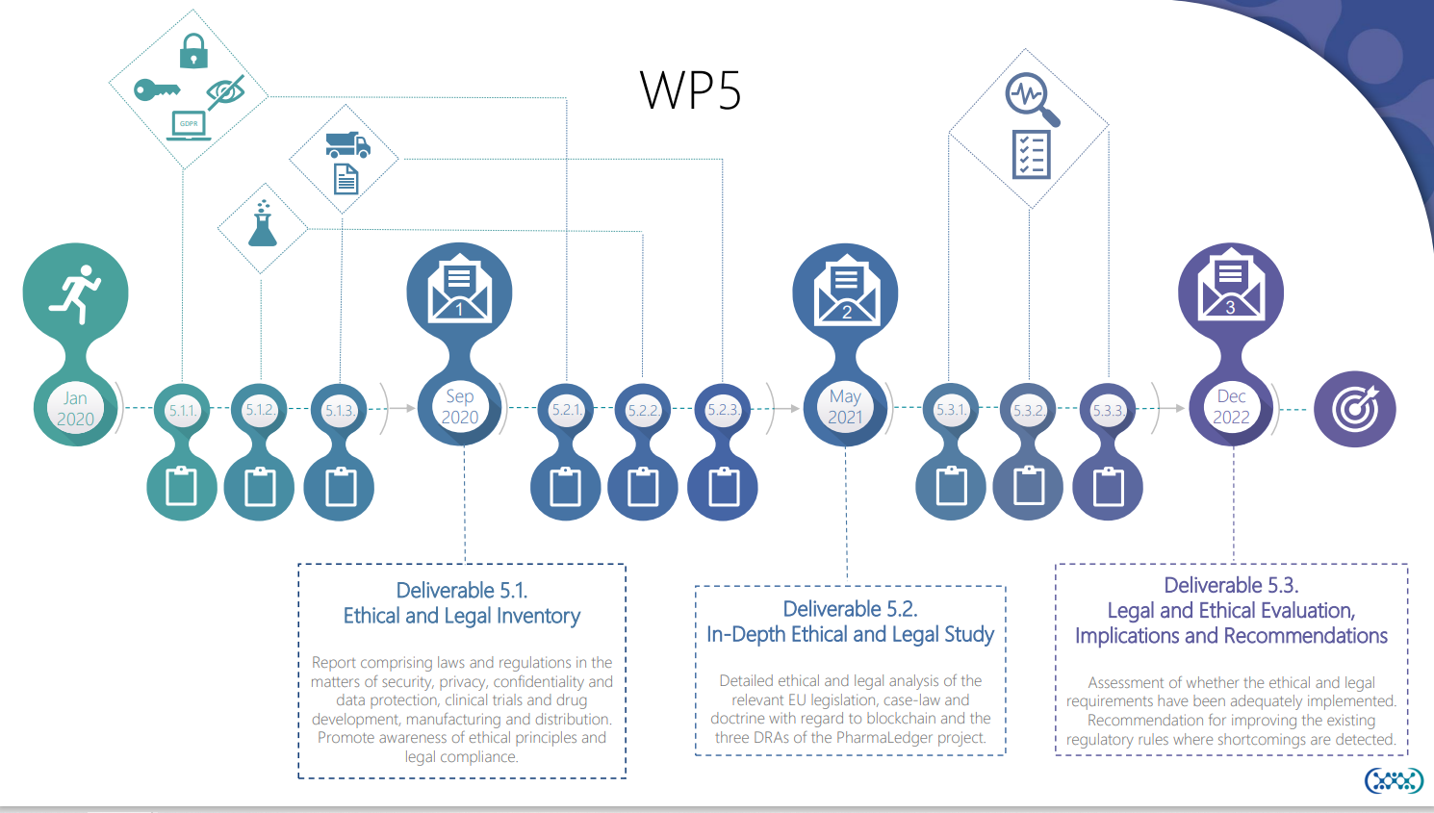

Slide 12
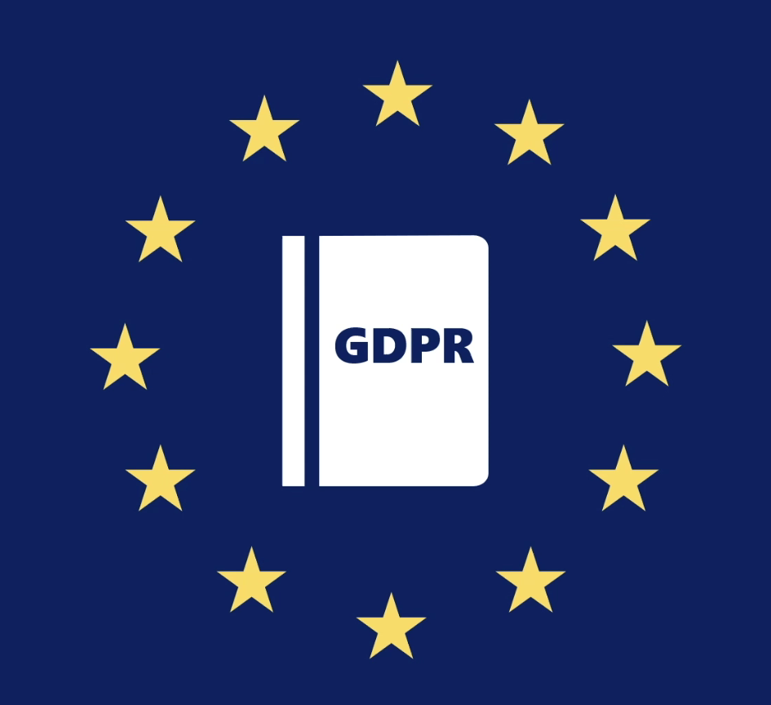
Privacy & Blockchain – Oxymorons?
Blockchain – shared & synchronized database, maintained by a consensus algorithm
Two terms generally seen in conflict with each other – particularly in the EU
  Decentralized nature
  Immutability
  Lack of regulatory guidance
PharmaLedger as a blueprint to use blockchain to achieve the purposes of GDPR
Accountability
Control over data
Data Integrity & Security
Trust

Slide 13
Privacy-Enhancement with Blockchain
Hash values for blockchain anchoring
OpenDSUs – storing data off-chain
Encryption in transit & at rest
Governance model
Special focus on certain rights of data subject:
  E.g., right to erasure
Self Sovereign Identities (SSI)
  PharmaLedger Identity Management Task Force (IMTF)
Enhanced Privacy with SSI
Anonymity
Zero-knowledge proof for verifying attributes & opportunity to issue abstract verifiable claims
Possible to limit attributes in verifiable claims to the minimum necessary
Exchange verifiable claims off-chain via encrypted channels
Data minimalization
Privacy by Design
Data security

Slide 14

FOLLOW US
for further information and the latest developments!

