Slide 1
Voice Biometrics and Blockchain: Achieving Interoperable Data Exchange in Healthcare
Ben Chevallereau, PhD
Gracie Carter, CSM
Jim Nasr, MBA
Sweta Sneha, PhD

Slide 2
Non-Interoperability
Patients do not control flow of information
Patients are unaware of the data lifecycle
Vendor lock in
Protectionist business models
Health data stagnates in data silos
Code depreciation
Insecure
Faxing, or patient couriers of records

Slide 3
Non-interoperability: Cost of complacency
Unstainable spending
CMS reports that heath care spending accounted for 17.9% of the GDP in 2016 and projected to rise to 19.7% by 2026
Deaths due to incomplete patient histories
Greater than 250,000 deaths per year are due to medical error, this makes it the third leading cause of death
Health information controlled by small number of vendors.
EPIC- 51% of population’s health information

Slide 4
Solution Overview
https://youtu.be/wC9API8lEXE

Slide 5
Why Blockchain
Immutable audit trail
Data security through transparency
Low barrier to entry
Efficiency, fewer human touch points

Slide 6
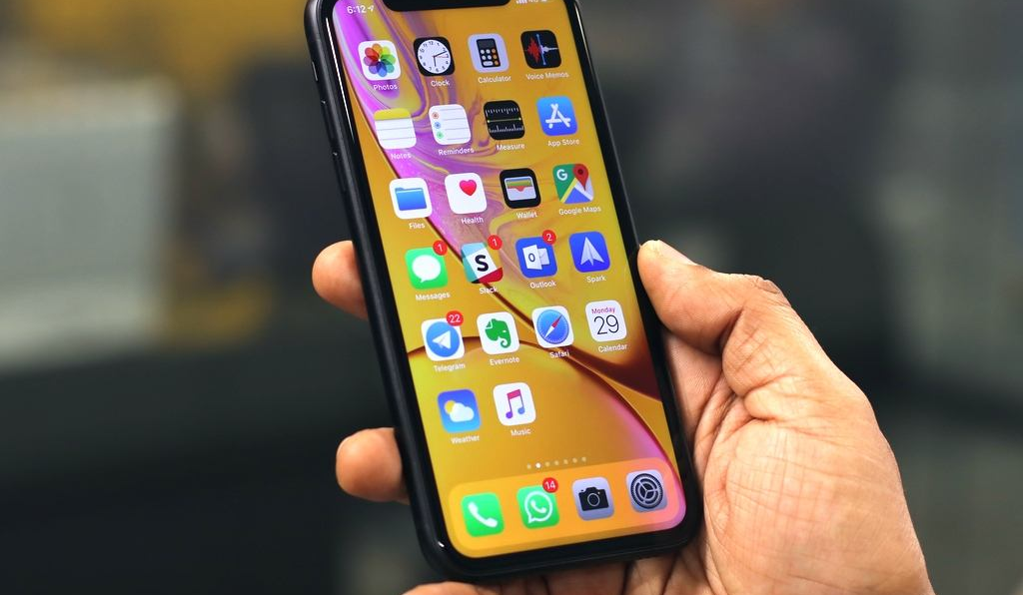
Why BioMetrics
Biometrics allow for patient specific signifier: their voice
Returns a unique identifier stored with a trusted third party
No sensitive information is stored on the Blockchain
Familiarity with AI (Alexa, Siri)
Ease of Use. No additional equipment required for Provider or Patient

Slide 7
Overview
FHIR Viewer
Open Technologies for Life Sciences
(1)
(8)
(5)
Hospital A
Specialist
Ethereum
(4)
(6)
Middleware Technology Stack
Middleware Technology Stack
(7)
(2)
Voice Authentication System
(3)
Encryption As A Service System
AWS KMS (Key Management System)

Slide 8
What is encrypted?
The smart contract stores the following information:
Patient IDs (i.e. Saavha User ID so not containing any PHI);
Partners Ping URLs (i.e. middleware public URL for each partner to check that their service is up, and to retrieve their public key);
Patient Resource URLs (i.e. middleware protected URLs to access Patient FHIR resources).
Each of this item don’t contain any private or sensible patient information, but to add an extra layer of security, we decided to encrypt all theses values before storing them in the smart contract, and after retrieving them to use it in the SMART on FHIR app.
How the data are encrypted?
Let’s explain first the initial goal. We wanted to encrypt data using an Encryption As a Service provider (such as AWS KMS, or Vault). We already have experience with AWS KMS, so we went this way. Here is how it works in a standard way:
You create a master key in KMS;
You send a request to KMS to encrypt a value (the size is limited to 4KB) using this master key;
KMS generates a dedicated encryption key for this value, and returns you the encrypted value;
The encrypted value contains a reference to the encryption key, and so you can ask KMS to decrypt the value easily.
The issue is that you get each time a different value when you encrypt the same string, because KMS generates this encryption key (or data key) each time. The solution is to generate a data key and to always use the same. The diagram explains how it’s done.
1. We initially created a master key in AWS KMS using our root AWS account. And gave access to all partners for encryption/decryption.
1. If you need to encrypt or decrypt values, you need access to the encrypted data key.
2. We generated a data key in AWS KMS using the protocol AES256.
3. Then, using AWS KMS, we encrypted the data key with the master key.
2. You need AWS access, and access to the master key, to be able to decrypt the data key.
4. We have now an encrypted data key that can be shared with our partners. Even if this encrypted key is stolen, our data is safe in the smart contract, because you need access to the master key to decrypt the data key to decrypt the data.
3. Then, you can use AWS to obtain the encryption key in clear mode.
4. You can encrypt/decrypt your data using the encryption key and the IV.
5. We generated as well a random IV (Initialization Vector) that can be shared too with all partners to be sure that our encryption process is deterministic.

Slide 9
Smart
Contract
(4) Hospital A middleware authenticates to Ethereum and registers a new resource URL: 044a04a65cac2a88dbcde...
For the following patient: D3c8aee319239f3751407...
(6) Specialist S middleware authenticates to Ethereum, and requests available resources for the following patient: D3c8aee319239f3751407...
And collects the following URL:
044a04a65cac2a88dbcde...
Hospital A
Specialist S
(5) John Doe is now going to a specialist where we follow the same process:
- The user authenticates and we get his Saavha Member ID:
18afc2cc-8de9-11e9-b683-526af7764f64
- Then, we encrypt it, and get:
D3c8aee319239f3751407...
John Doe goes to hospital A: authenticate with Saavha , get his Saavha Member ID:
18afc2cc-8de9-11e9-b683-526af7764f64
Middleware Technology Stack
Middleware Technology Stack
“FHIR Collaboration” smart contract verifies middleware is authorized to register, access patient resource URLs, and keep URLs registered for each patient
(2) We encrypt Saavha Member ID using our encryption system, and get:
D3c8aee319239f3751407...
(8) Specialist S middleware can send a signed request (using Ethereum wallet keys) to Hospital A middleware (that will verify the signature, and permission in the blockchain) to collect FHIR resource.
(3) To exchange information over internet, middleware mustbe exposed online. We compute the unique public URL for this patient:
http://hospital_a.com/fhir/ D3c8aee319239f3751407...
And then, we encrypt this URL, and get:
044a04a65cac2a88dbcde...
(7) The Specialist S middleware can decrypt the URL collected from Ethereum and get:
http://hospital_a.com/fhir/ D3c8aee319239f3751407...
Encryption As A Service System
This system is charged to verify if requester is allowed to use the encryption key and encrypt/decrypt data.

Slide 10
Potential issues
HIPAA
Adherence to Smart on FHIR is required
No way to narrow files to specialty
Scalability
File integration into EMR

